Slide 1

VECTO 0.11.0.3193 Development Version
29.09.2023
Release Notes

Slide 2
First VECTO beta release for the 3rd Amendment H2 Internal Combustion Engines
TUG

Slide 3
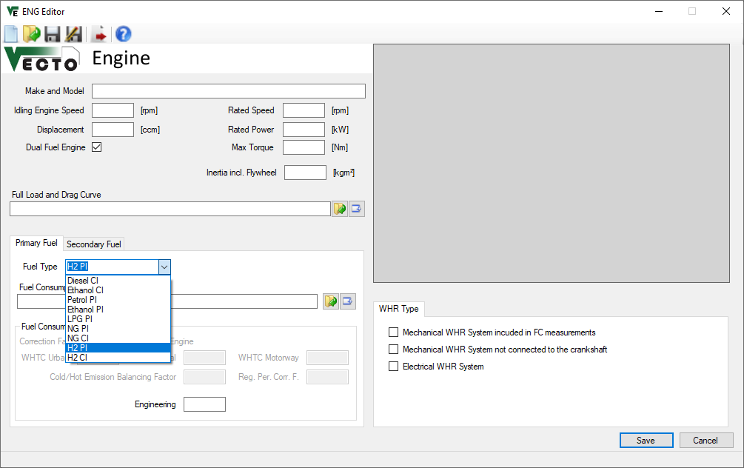
H2 ICE
New fuel types implemented „H2 PI“ and „H2 CI“ (i.e. H2-Diesel dual-fuel)
Well-known ICE input data structure unchanged, no new elements
Fuel characteristics used

Slide 4
First VECTO beta release for the 3rd Amendment Fuel Cell Hybrid Vehicles (FCHV)
TUG

Slide 5
Fuel cell hybrid vehicles (FCHV) – Op. strategy (1/5)
FCHV generic operation strategy (Charge Sustaining Mode) implemented as presented in TF FCS #15 with following basic principle:
Maximum phlegmatisation of FCS by operation strategy
FCS needs to provide average electric power demand over longer horizon
Longest possible averaging horizon depends on battery size and specific vehicle-cycle combination → The smaller the battery or the greater the electric energy demand of the vehicle, the smaller the averaging horizon will get leading to a more dynamic operation of the FCS.

Slide 6
Fuel cell hybrid vehicles (FCHV) – Op. strategy (2/5)
Basic approach for implementation of FCS operation in “CS” Mode in 4 steps
Pre-simulation run as PEV to determine electric power demand for propulsion and auxiliaries
Power limit of “special” battery defined as sum of respective maximum powers (BAT + FCS)
Resulting total electric power from step 1 will be averaged over a certain fixed window size which is distance based (details next slide)
Buffering of energy is limited by battery size, SOC limits min/max are not allowed to be exceeded
Using largest possible window size without violating SOC limits in any window
Adaption of start SOC to specific mission in order to maximize usage of battery as buffer
Actual simulation run as FCHV in-the-loop where FCS is operated following a fixed power trace to cover average electric power demand determined from pre-processing in step 2 (battery covers instantaneous deviations from average electric power demand)
ΔSOC correction in post-processing to account for small deviations from neutral SOC behaviour over cycle (e.g. variations in auxiliary power, small deviations in battery losses etc.)

Slide 7
Fuel cell hybrid vehicles (FCHV) – Op. strategy (3/5)
Averaging and window size explained (1/2)
The averaging window is placed distance-symmetrically over each actual time step from the pre-simulation
Window size is determined by total distance within window
distance
=
distance
=
window @ t+2
window @ t+1
window @ t
time
t-i
t+1-j
t+2+k
t
t+1
t+2
t+i
t+1+j
t+2+k

Slide 8
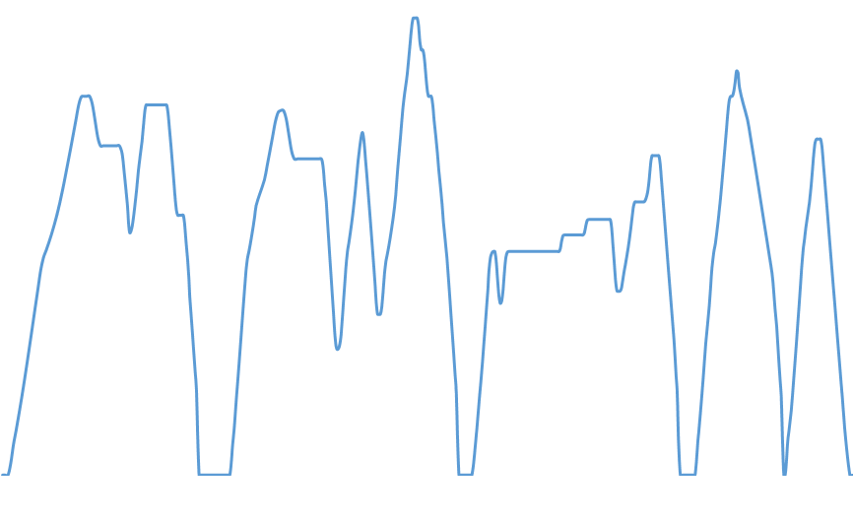
Fuel cell hybrid vehicles (FCHV) – Op. strategy (4/5)
Averaging and window size explained (2/2)
Maximum window size is given by complete cycle, thus cycle is concatenated 3 times in a row
For time steps near the beginning or end of the cycle, the windows expand over the actual cycle and continue at the adjacent parts at the end or beginning.
speed
window at beginning of cycle
window in the middle of cycle
window at end of cycle
time
previous copy of cycle
actual cycle
subsequent copy of cycle

Slide 9
Fuel cell hybrid vehicles (FCHV) – Op. strategy (5/5)
Actual simulation run as FCHV and applicable boundary conditions
In case average power demand over total cycle is higher than FCS maximum power: → defined error message and simulation is aborted (vehicle configuration not reasonable for this mission, should not occur in practice)
In case average power in a certain timestep is lower than FCS minimum power: → FCS is switched off → missing energy from FCS for those timesteps will be accounted for in post-processing via ΔSOC correction

Slide 10
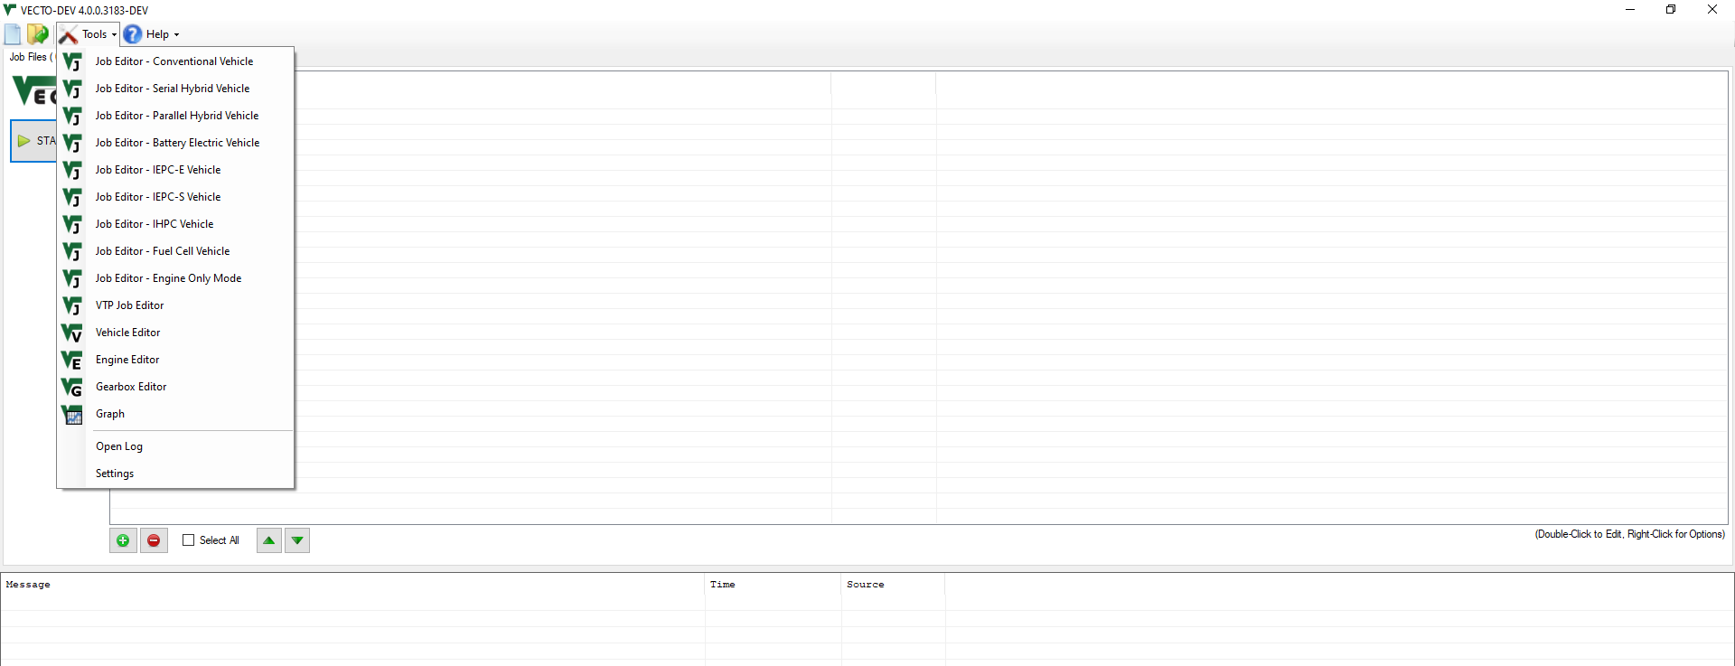
Fuel cell hybrid vehicles (FCHV) – VECTO features (1/5)
New powertrain type of FCHV added to Job Editor

Slide 11
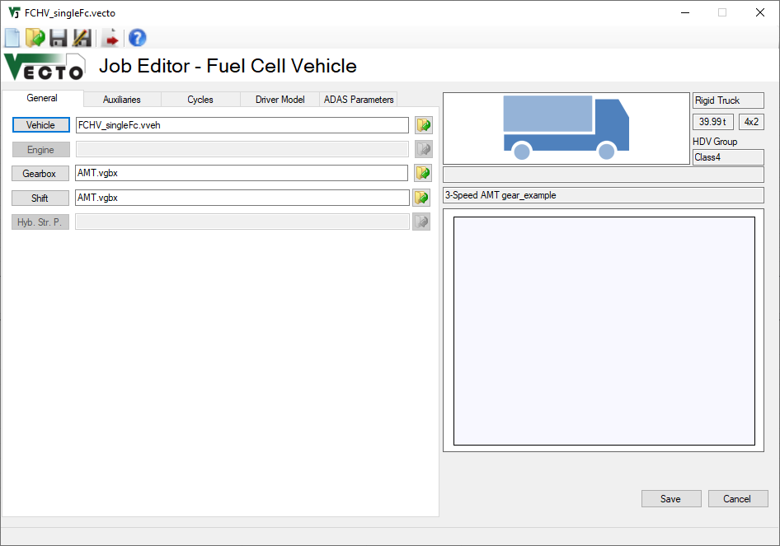
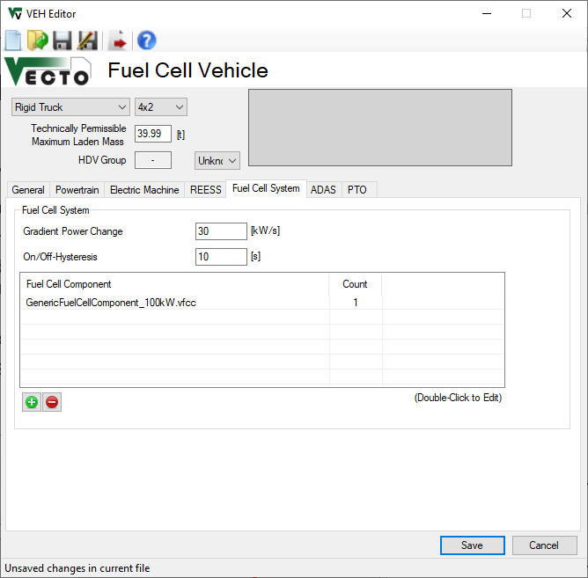
Fuel cell hybrid vehicles (FCHV) – VECTO features (2/5)
FCS to be parameterized via specific „Fuel Cell System“ tab in „Vehicle“ editor
Power gradient limits change in FCS power over time
On/off-Hysteresis is minimum time that FCS stays off or on after state change occurs → not required anymore after insights gained during work on implementation of multiple FCS

Slide 12
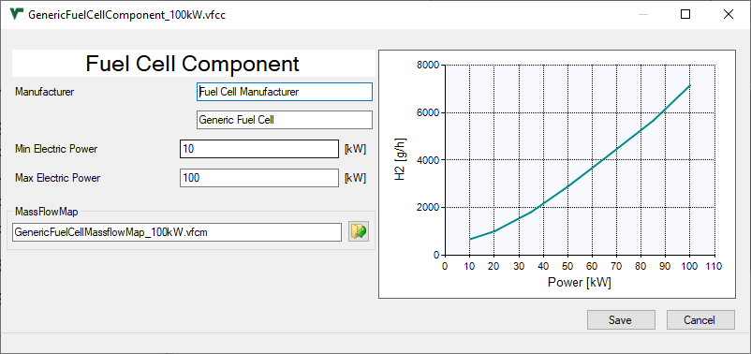
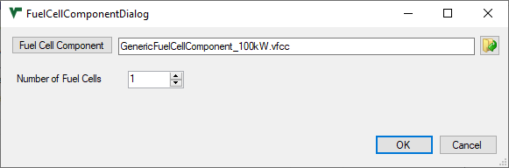
Fuel cell hybrid vehicles (FCHV) – VECTO features (3/5)
FCS to be parameterized via specific „Fuel Cell System“ tab in „Vehicle“ editor
Double-click or „+“
Max / min power limits operation range of FCS component
FCS mass flow map needs to cover the indicated range
Limited to 1
for this release

Slide 13
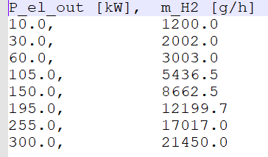
Fuel cell hybrid vehicles (FCHV) – VECTO features (4/5)
FCS to be parameterized via specific „Fuel Cell System“ tab in „Vehicle“ editor
Input data structure for FCS H2 mass flow map
CSV file format
1st column: Electric power output of FCS in [kW]
2nd column: H2 mass flow in [g/h]
FCS component efficiency should also include DC/DC converter (as this is part of component test procedure)!
Example data

Slide 14
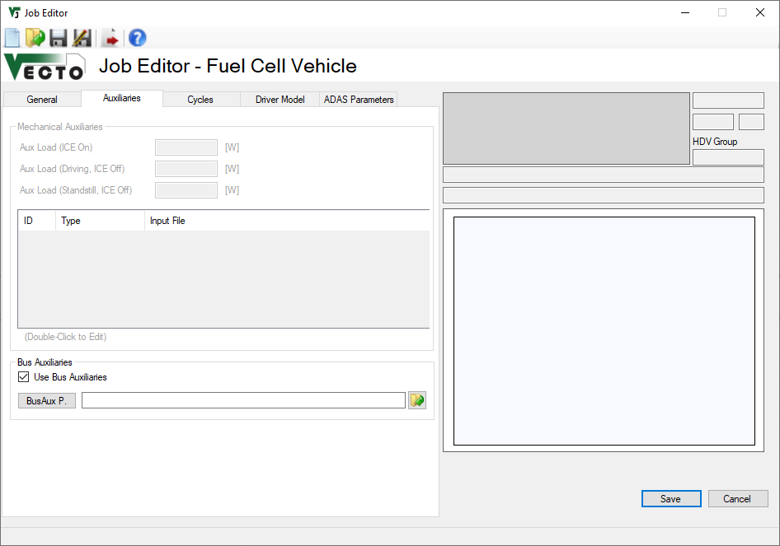
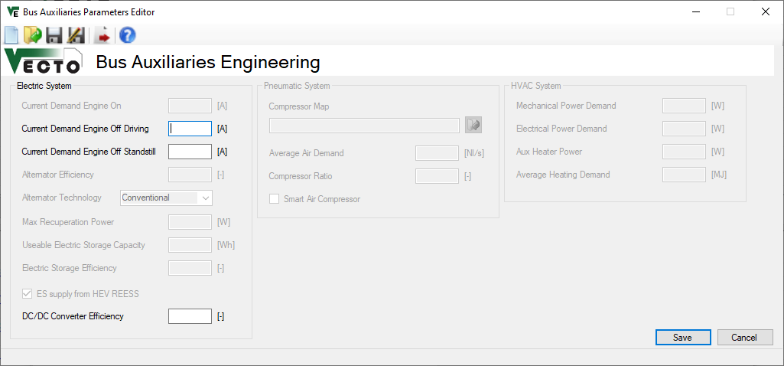
Fuel cell hybrid vehicles (FCHV) – VECTO features (5/5)
Parameterization of auxiliaries for FCHV
Electric power demand of auxiliaries for both, lorries and buses, need to be parameterized via the “Bus Auxiliaries” GUI window
INFO: Electric aux power demand is calculated by multiplying the specified current values by a voltage of 28.3V
Demand during vehicle driving
Demand during vehicle standstill

Slide 15
FCHV – Examples for generic operation strategy (1/5)
Exemplary results for VECTO Group 2 12-ton rigid lorry (9.5 ton actual mass) on following slides
Simulation in VECTO Urban Delivery Cycle
Average electric power demand around 22 kW
FCHV powertrain specifications:
100 kW FCS max power
following variants of battery:
5 kWh
10 kWh
20 kWh
Resulting speed profile was exactly the same for all different configurations

Slide 16
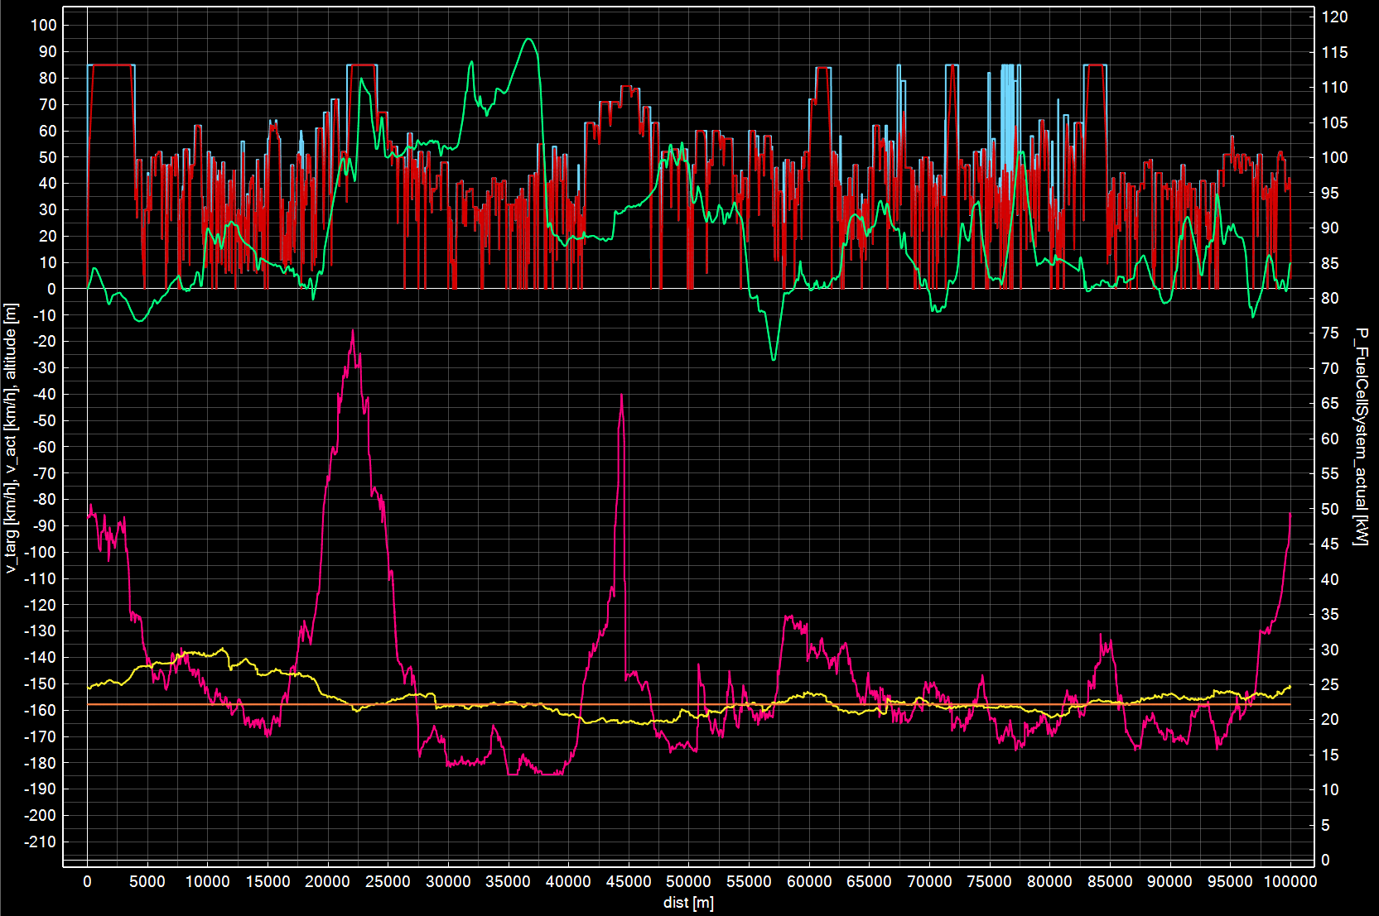
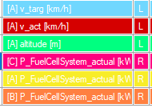
FCHV – Examples for generic operation strategy (2/5)
The lower the buffer size, the more dynamic the FCS operation gets
Exactly same speed profile for all variants
Averaging window sizes determined:
5 kWh: 6 km
10 kWh: 37.5 km
20 kWh: 100 km
Fuel cell power for different battery sizes
5 kWh
10 kWh
20 kWh

Slide 17
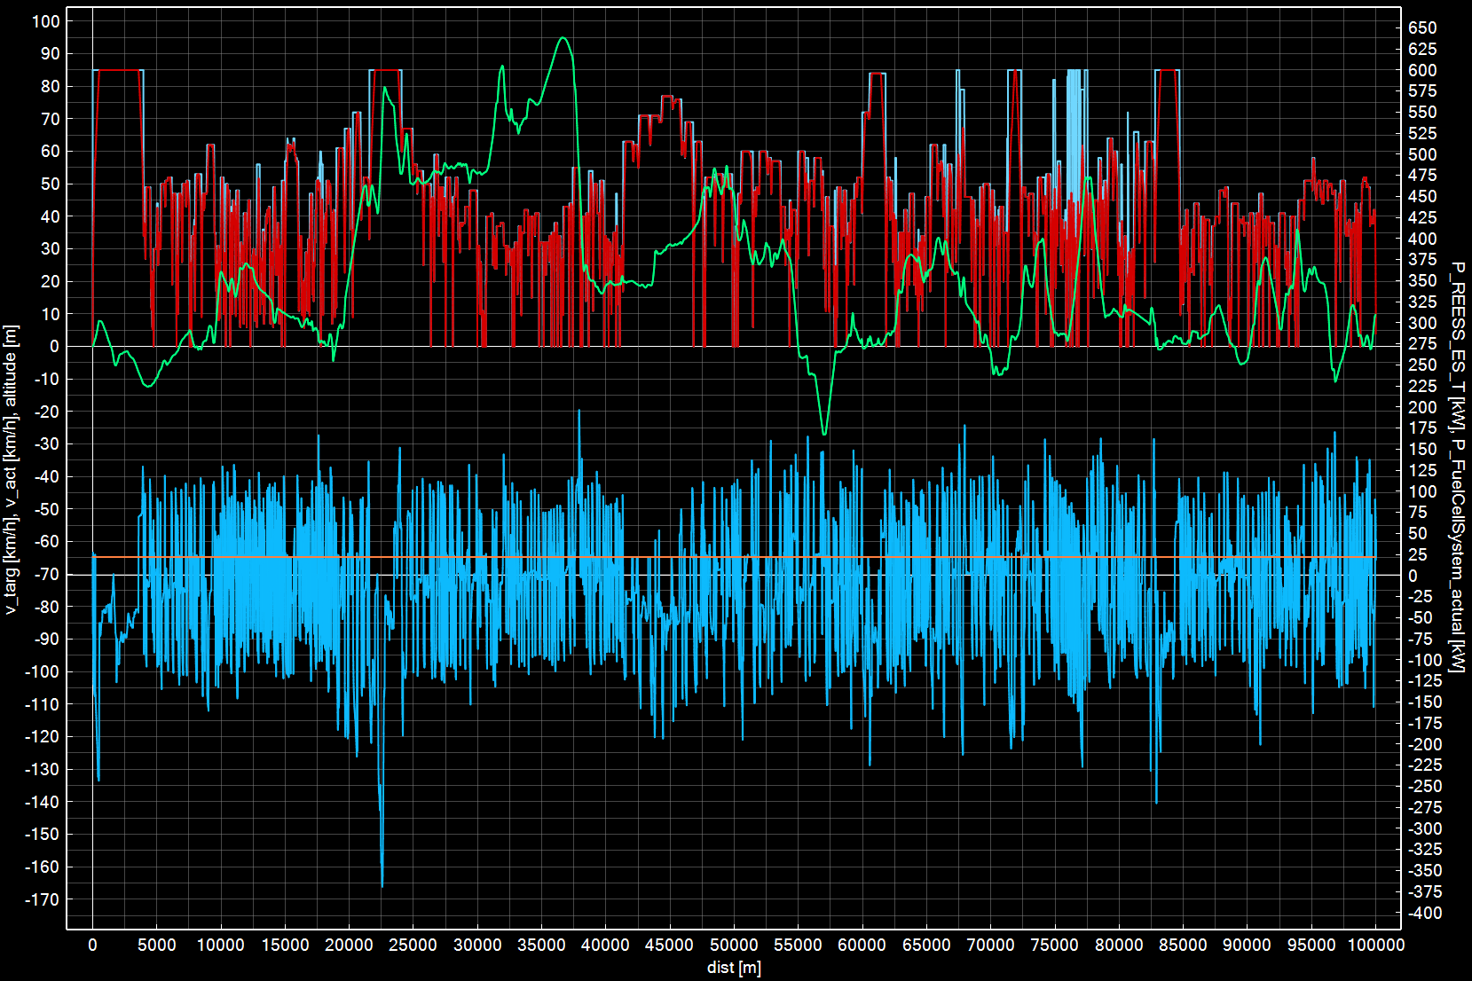
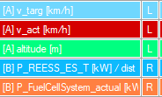
FCHV – Examples for generic operation strategy (3/5)
Battery covers instantaneous deviations from average electric power demand
Average electric power demand (i.e. FCS power) constant for the setting shown with 20 kWh REESS size
Battery power
Fuel cell power

Slide 18
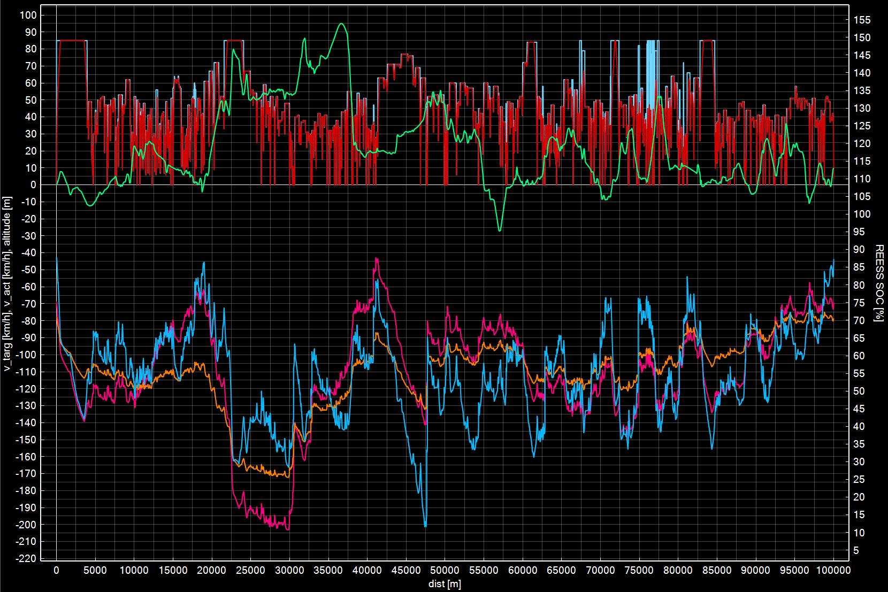
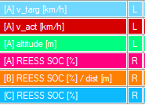
FCHV – Examples for generic operation strategy (4/5)
Using largest possible window size without violating SOC limits in any window → maximizing of battery buffer usage
Exactly same speed profile for all variants
SOC limits are Engineering settings, no connex to generic limits used in Declaration Mode
Upper SOC limit
Lower SOC limit
SOC for different battery sizes
5 kWh
10 kWh
20 kWh

Slide 19
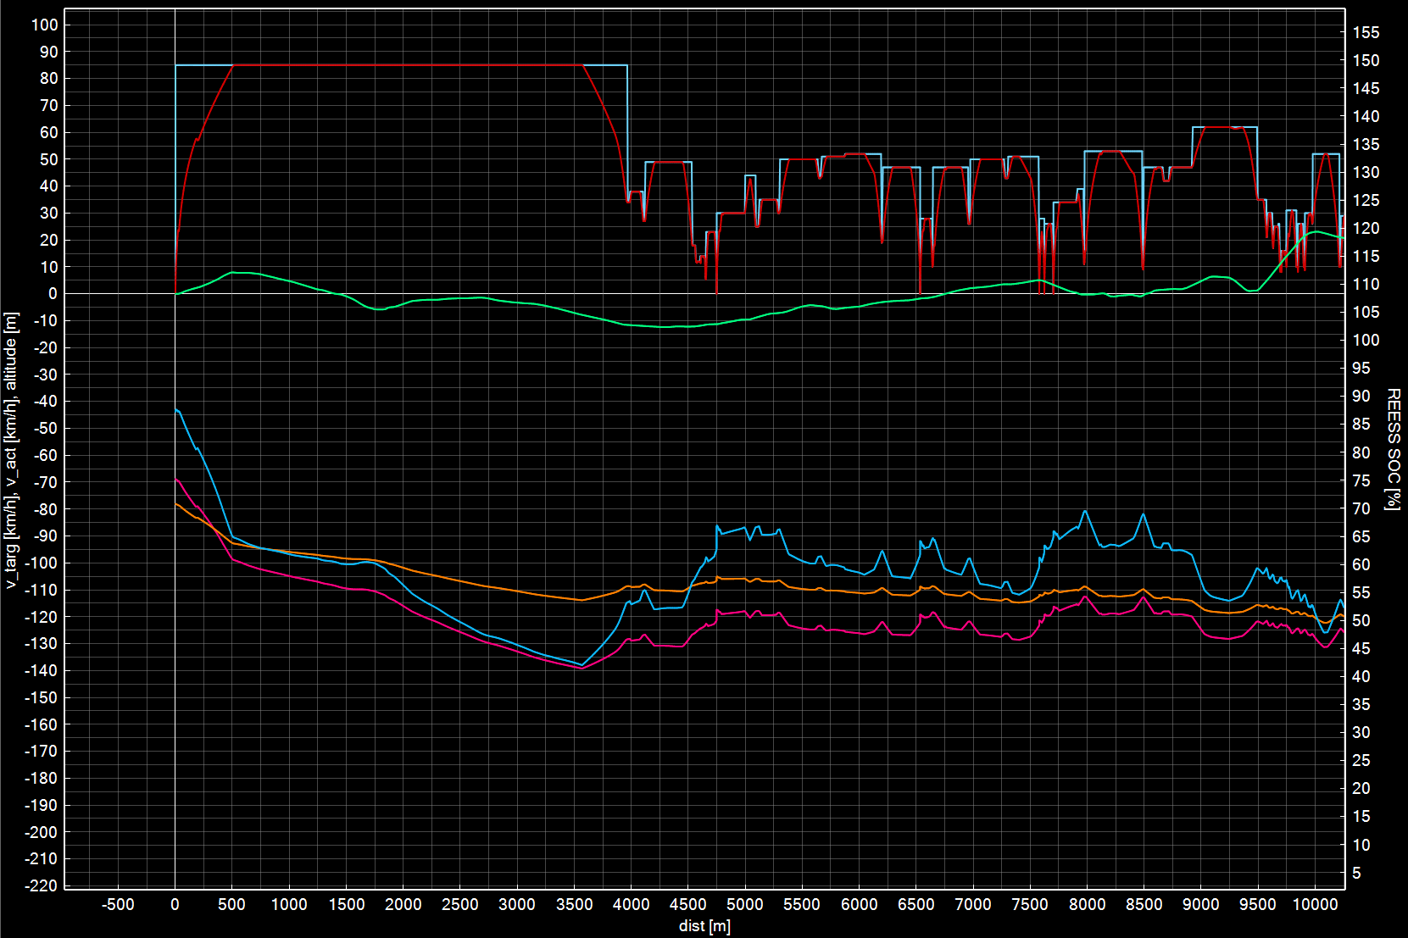
FCHV – Examples for generic operation strategy (5/5)
Adaption of start SOC to specific mission in order to maximize usage of battery as buffer (detail from previous graph)
Exactly same speed profile for all variants
Adapted start SOC
SOC for different battery sizes
5 kWh
10 kWh
20 kWh

Slide 20
Fuel cell hybrid vehicles (FCHV) - Comments
Release to be distributed via VECTO-DEV mailing list end of September
Basic description of FCHV features will also be added to VECTO release notes
Some example vehicles will be provided
Current release restricted to one single FCS component
Updated release end of October will be able to handle:
multiple FCS configurations as presented in TF FCS #17
Maximum 2x3 configuration i.e. 2 different FCS with a maximum number of 3 identical systems for each of the 2 different ones
Special provisions for handling power demands below minimum FCS power
IMC feature combined with FCHV

Slide 21
First VECTO beta release for the 3rd Amendment Vehicles with In-Motion Charging Features
TUG

Slide 22
Vehicles with In-Motion Charging (IMC) features (1/11)
One of the tasks of the pre-development project for the 3rd Amendment was to analyse different systems for in-use charging of electric vehicles
State of the art
Relevance and possible paths of implementation to Regulation (EU) 2017/2400
Functional prototype
The analyses and proposals for (1) and (2) were presented and discussed with stakeholders in five stakeholder meetings (Oct 2021, Dec 2021, Jan 2022, Jun 2022 and Sept 2022).
The following slides summarise the most important principles and present the functional prototype

Slide 23
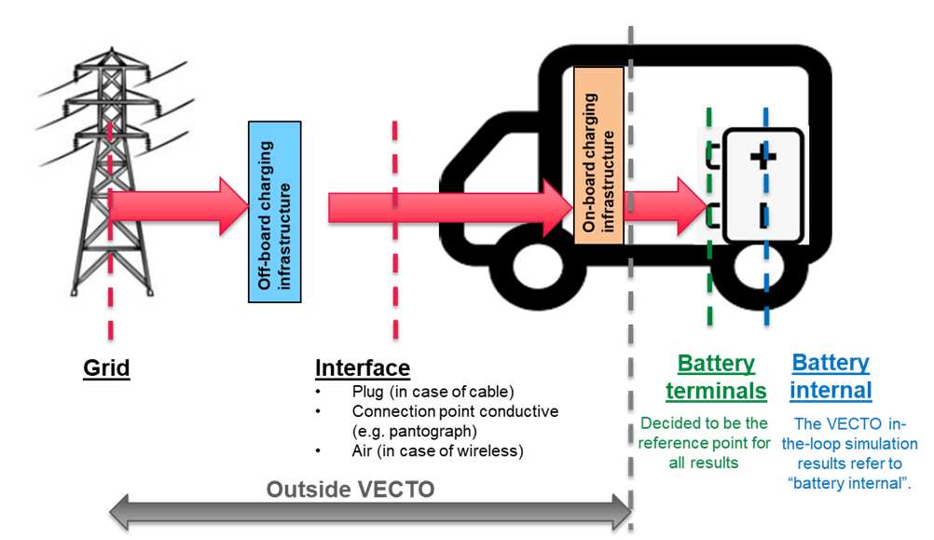
Vehicles with In-Motion Charging (IMC) features (2/11)
Reference point for results regarding electric energy consumption
Principle applied already for the 2nd amendment
Consequences for the 3rd amendment
Stationary charging: minor improvements to the Annex (max. charging power)
In-motion charging: Requires model extension and separate provisions in the Annex

Slide 24
Vehicles with In-Motion Charging (IMC) features (3/11)
Modelling in VECTO - Overview
Driving with “direct feed” incorporated to simulations of “charge depleting” mode by postprocessing (no additional sim time, no additional definitions etc.) (DECL) → higher utility factor / share of electric driving for OVC-HEV → (slightly) lower battery internal losses
Charging of batteries by IMC handled by postprocessing (DECL) → higher utility factor / share of electric driving for OVC-HEV
Impact on air drag incorporated to in-the loop simulation via a mission average share “active” (which applies either to motorway sections or to the total cycle) (ENG, DECL)
No direct influence on the “electric ranges", i.e. these are also only calculated on the basis of the usable battery capacity (DECL)
DECL / ENG: Effect visible in Declaration Mode / Engineering Mode
Report with detailed documentation to be published soon

Slide 25
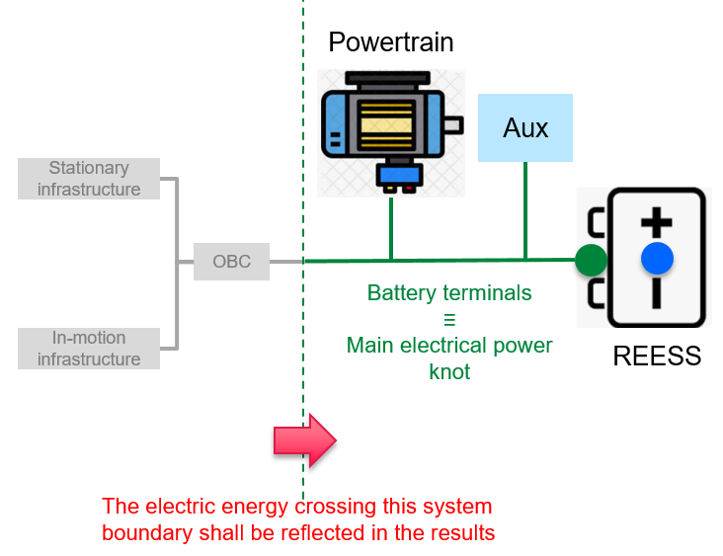
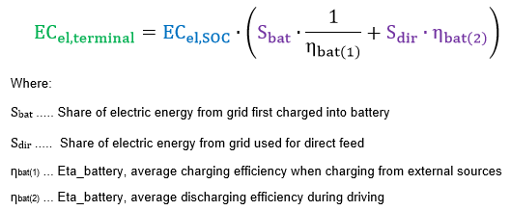
Vehicles with In-Motion Charging (IMC) features (4/11)
Modelling in VECTO – Calculations of electric energy consumption at battery terminals
Lila terms: new elements introduced for IMC modelling
Calculation examples see Task3_Masterexcel_OVC_IMC.xlsx as distributed with ppt Report with detailed documentation to be published soon

Slide 26
Vehicles with In-Motion Charging (IMC) features (5/11)
Modelling in VECTO – Current proposals for Declaration Mode
In-motion charging “technology” | Relevance |  |  | Proposal for definition in Regulation (EU) 2017/2400
 | Heavy lorries | Heavy buses | Medium lorries
Overhead pantograph | Yes | Yes | No | Vehicle equipped with overhead pantograph for connection with overhead catenary infrastructure as regulated by standard tbd and which is not overhead trolley.
Overhead trolley | No | Yes | No | Vehicle equipped with poles for connection with overhead catenary infrastructure as regulated in Annex 12 to UN Regulation 107 revision 8.
Ground-rail | Yes¹ | Yes¹ | Yes¹ | Charging technology that conductively transfers the electrical energy to the vehicle through rails embedded in or on top of the road surface.
Wireless | Yes¹ | Yes¹ | Yes¹ | Charging technology that inductively transfers the electrical energy to the vehicle through devices embedded in or on top of the road surface providing magnetic fields as they are specified IEC 61980.
¹ Only Potential niche applications are conceivable.
Lila: to be worked out for the 3rd amendment

Slide 27
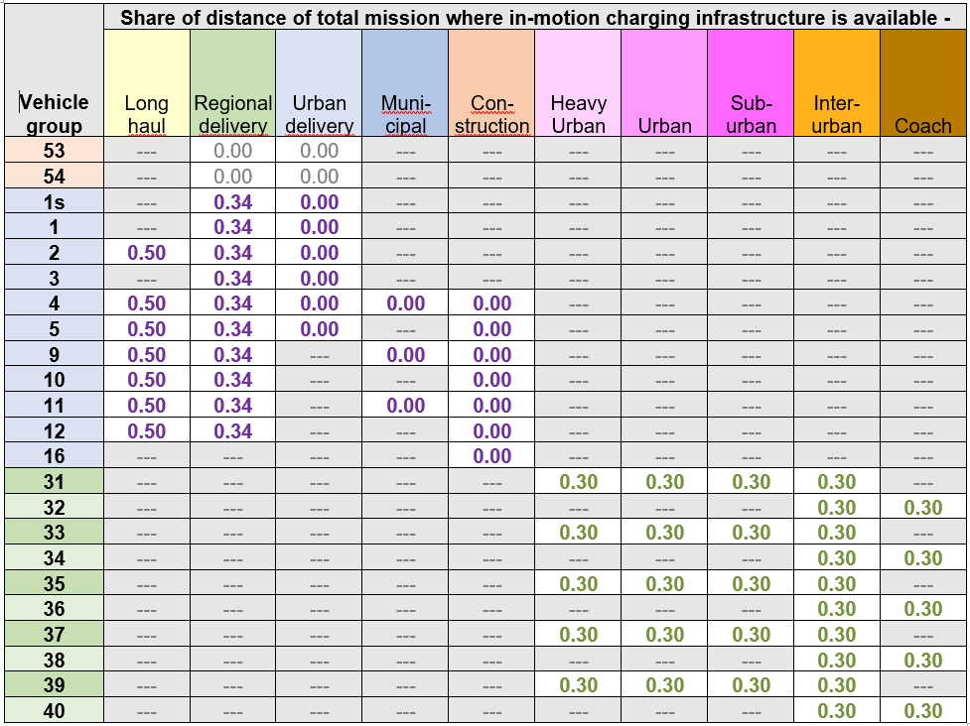
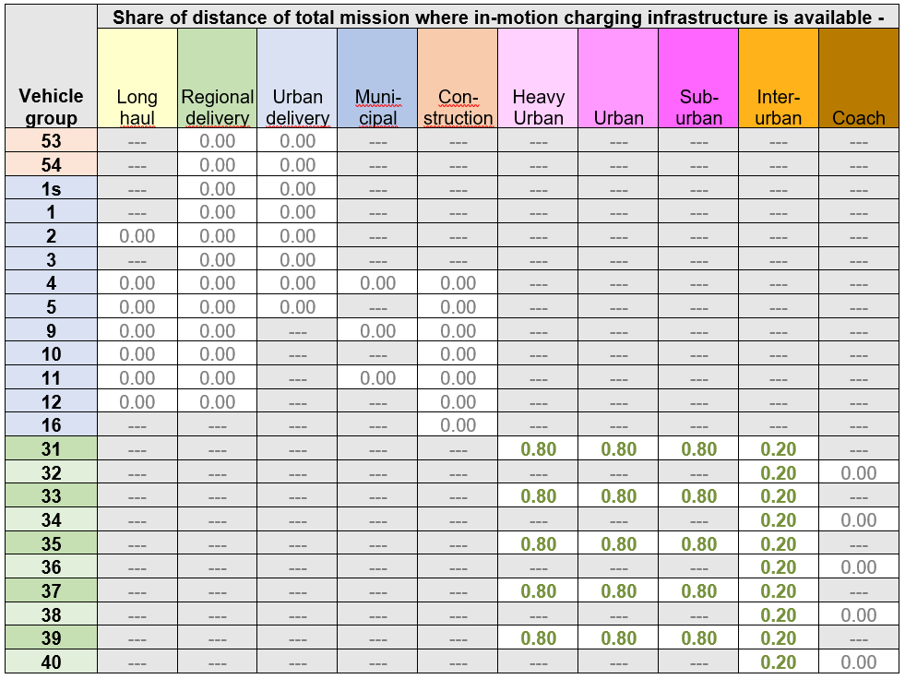
Vehicles with In-Motion Charging (IMC) features (6/11)
Modelling in VECTO – Proposal for IMC infrastructure availability
Overhead - Pantograph
Overhead - Trolley

Slide 28
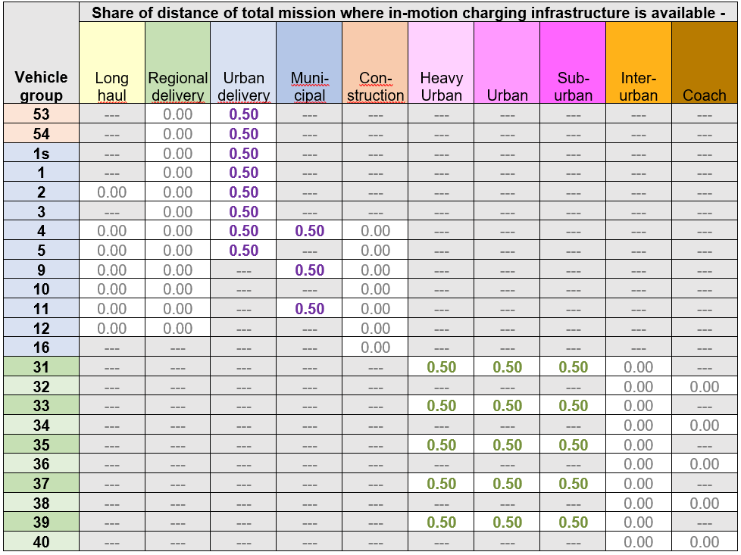
Vehicles with In-Motion Charging (IMC) features (7/11)
Modelling in VECTO – Proposal for IMC infrastructure availability
Ground rail + Wireless

Slide 29
Vehicles with In-Motion Charging (IMC) features (8/11)
Modelling in VECTO – Further proposed assumptions
Battery charging during mission
50% of usable battery capacity via “SOC lift” by IMC
No further stationary charging
Air drag
Considered only for “Overhead – pantograph”
ΔCdxA = 0.6 m² for the shares in the mission where IMC is available

Slide 30
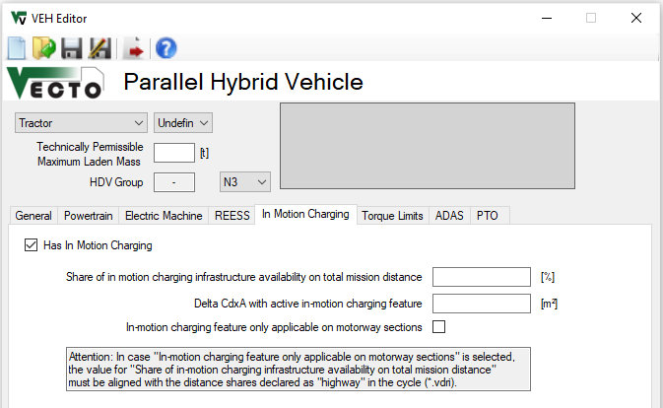
Vehicles with In-Motion Charging (IMC) features (9/11)
Inputs in Graphical User Interface (ENG)
New tab in “VEH Editor” for HEV and PEV vehicles
Attention!
Working with ENG mode simulations for IMC features requires detailed knowledge of the proposed approach (mainly for developers)
For checking of regulatory impact DECL mode testing recommended!

Slide 31
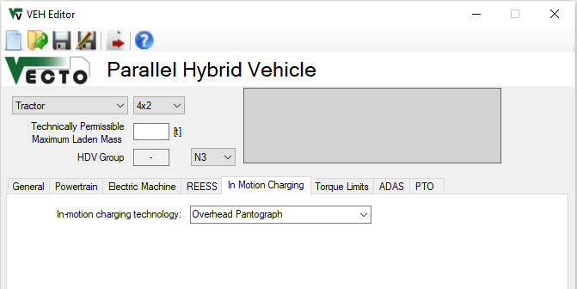
Vehicles with In-Motion Charging (IMC) features (10/11)
Inputs in Graphical User Interface (DECL)
Dropdown Menu with pre-defined technologies
None
Overhead Pantograph
Overhead Trolley
Ground Rail
Wireless

Slide 32
Vehicles with In-Motion Charging (IMC) features (11/11)
Example vehicle models will be distributed with the release (located in “\Generic vehicles”)
Base specs example models
Group 5 / HEV P2 / OVC: P_{cont_EM}: 200kW | E_{Reess}: 120kWh nominal
Group 5 / PEV: P_{cont_EM}: 325kW | E_{Reess}: 170kWh nominal
Example results: Long haul with rep payload Comparison results “w/o” and “w/” pantograph with similar other vehicle specs like mass
Group 5 / P2 / OVC w/o pantograph: UF = 0.149; CO2_{weighted} = 692.2 g/km
Group 5 / P2 / OVC w/ pantograph: UF = 0.660; CO2_{weighted} = 347.1 g/km → -50% CO2
Group 5 / PEV w/o pantograph: EC_{el} = 1.262 kWh/km
Group 5 / PEV w/ pantograph: EC_{el} = 1.297 kWh/km → +2.8% EC_{el}

Slide 33
Vecto 4.0.0.xx Development Version NOT FOR CERTIFICATION! June 2023
First fully functional tool version according to the provisions of the 2nd amendment of Regulation (EU) 2017/2400.
Changes
Dropped support for .Net Framework 4.5 (EOL 04/2022)
Supported .Net versions: .Net Framework 4.8, .Net 6.0
Implementation of Declaration-Mode for xEV-Buses (see next slides)
New generic vehicles (XML)
Bugfixes XML schema (see VECTO DEV WS #16, sl. 4)
Bugfixes Battery Capacity in MRF/CIF (see VECTO DEV WS #16, sl. 5)
Correction of internal resistance in case of standard values for batteries (see VECTO DEV WS #16, sl. 6)

Slide 34
First VECTO beta release for the 3rd Amendment H2 Internal Combustion Engines
TUG

Slide 35
H2 ICE
New fuel types implemented „H2 PI“ and „H2 CI“ (i.e. H2-Diesel dual-fuel)
Well-known ICE input data structure unchanged, no new elements
Fuel characteristics used

Slide 36
First VECTO beta release for the 3rd Amendment Fuel Cell Hybrid Vehicles (FCHV)
TUG

Slide 37
Fuel cell hybrid vehicles (FCHV) – Op. strategy (1/5)
FCHV generic operation strategy (Charge Sustaining Mode) implemented as presented in TF FCS #15 with following basic principle:
Maximum phlegmatisation of FCS by operation strategy
FCS needs to provide average electric power demand over longer horizon
Longest possible averaging horizon depends on battery size and specific vehicle-cycle combination → The smaller the battery or the greater the electric energy demand of the vehicle, the smaller the averaging horizon will get leading to a more dynamic operation of the FCS.

Slide 38
Fuel cell hybrid vehicles (FCHV) – Op. strategy (2/5)
Basic approach for implementation of FCS operation in “CS” Mode in 4 steps
Pre-simulation run as PEV to determine electric power demand for propulsion and auxiliaries
Power limit of “special” battery defined as sum of respective maximum powers (BAT + FCS)
Resulting total electric power from step 1 will be averaged over a certain fixed window size which is distance based (details next slide)
Buffering of energy is limited by battery size, SOC limits min/max are not allowed to be exceeded
Using largest possible window size without violating SOC limits in any window
Adaption of start SOC to specific mission in order to maximize usage of battery as buffer
Actual simulation run as FCHV in-the-loop where FCS is operated following a fixed power trace to cover average electric power demand determined from pre-processing in step 2 (battery covers instantaneous deviations from average electric power demand)
ΔSOC correction in post-processing to account for small deviations from neutral SOC behaviour over cycle (e.g. variations in auxiliary power, small deviations in battery losses etc.)

Slide 39
Fuel cell hybrid vehicles (FCHV) – Op. strategy (3/5)
Averaging and window size explained (1/2)
The averaging window is placed distance-symmetrically over each actual time step from the pre-simulation
Window size is determined by total distance within window
distance
=
distance
=
window @ t+2
window @ t+1
window @ t
time
t-i
t+1-j
t+2+k
t
t+1
t+2
t+i
t+1+j
t+2+k

Slide 40
Fuel cell hybrid vehicles (FCHV) – Op. strategy (4/5)
Averaging and window size explained (2/2)
Maximum window size is given by complete cycle, thus cycle is concatenated 3 times in a row
For time steps near the beginning or end of the cycle, the windows expand over the actual cycle and continue at the adjacent parts at the end or beginning.
speed
window at beginning of cycle
window in the middle of cycle
window at end of cycle
time
previous copy of cycle
actual cycle
subsequent copy of cycle

Slide 41
Fuel cell hybrid vehicles (FCHV) – Op. strategy (5/5)
Actual simulation run as FCHV and applicable boundary conditions
In case average power demand over total cycle is higher than FCS maximum power: → defined error message and simulation is aborted (vehicle configuration not reasonable for this mission, should not occur in practice)
In case average power in a certain timestep is lower than FCS minimum power: → FCS is switched off → missing energy from FCS for those timesteps will be accounted for in post-processing via ΔSOC correction

Slide 42
Fuel cell hybrid vehicles (FCHV) – VECTO features (1/5)
New powertrain type of FCHV added to Job Editor

Slide 43
Fuel cell hybrid vehicles (FCHV) – VECTO features (2/5)
FCS to be parameterized via specific „Fuel Cell System“ tab in „Vehicle“ editor
Power gradient limits change in FCS power over time
On/off-Hysteresis is minimum time that FCS stays off or on after state change occurs → not required anymore after insights gained during work on implementation of multiple FCS

Slide 44
Fuel cell hybrid vehicles (FCHV) – VECTO features (3/5)
FCS to be parameterized via specific „Fuel Cell System“ tab in „Vehicle“ editor
Double-click or „+“
Max / min power limits operation range of FCS component
FCS mass flow map needs to cover the indicated range
Limited to 1
for this release

Slide 45
Fuel cell hybrid vehicles (FCHV) – VECTO features (4/5)
FCS to be parameterized via specific „Fuel Cell System“ tab in „Vehicle“ editor
Input data structure for FCS H2 mass flow map
CSV file format
1st column: Electric power output of FCS in [kW]
2nd column: H2 mass flow in [g/h]
FCS component efficiency should also include DC/DC converter (as this is part of component test procedure)!
Example data

Slide 46
Fuel cell hybrid vehicles (FCHV) – VECTO features (5/5)
Parameterization of auxiliaries for FCHV
Electric power demand of auxiliaries for both, lorries and buses, need to be parameterized via the “Bus Auxiliaries” GUI window
INFO: Electric aux power demand is calculated by multiplying the specified current values by a voltage of 28.3V
Demand during vehicle driving
Demand during vehicle standstill

Slide 47
FCHV – Examples for generic operation strategy (1/5)
Exemplary results for VECTO Group 2 12-ton rigid lorry (9.5 ton actual mass) on following slides
Simulation in VECTO Urban Delivery Cycle
Average electric power demand around 22 kW
FCHV powertrain specifications:
100 kW FCS max power
following variants of battery:
5 kWh
10 kWh
20 kWh
Resulting speed profile was exactly the same for all different configurations

Slide 48
FCHV – Examples for generic operation strategy (2/5)
The lower the buffer size, the more dynamic the FCS operation gets
Exactly same speed profile for all variants
Averaging window sizes determined:
5 kWh: 6 km
10 kWh: 37.5 km
20 kWh: 100 km
Fuel cell power for different battery sizes
5 kWh
10 kWh
20 kWh

Slide 49
FCHV – Examples for generic operation strategy (3/5)
Battery covers instantaneous deviations from average electric power demand
Average electric power demand (i.e. FCS power) constant for the setting shown with 20 kWh REESS size
Battery power
Fuel cell power

Slide 50
FCHV – Examples for generic operation strategy (4/5)
Using largest possible window size without violating SOC limits in any window → maximizing of battery buffer usage
Exactly same speed profile for all variants
SOC limits are Engineering settings, no connex to generic limits used in Declaration Mode
Upper SOC limit
Lower SOC limit
SOC for different battery sizes
5 kWh
10 kWh
20 kWh

Slide 51
FCHV – Examples for generic operation strategy (5/5)
Adaption of start SOC to specific mission in order to maximize usage of battery as buffer (detail from previous graph)
Exactly same speed profile for all variants
Adapted start SOC
SOC for different battery sizes
5 kWh
10 kWh
20 kWh

Slide 52
Fuel cell hybrid vehicles (FCHV) - Comments
Release to be distributed via VECTO-DEV mailing list end of September
Basic description of FCHV features will also be added to VECTO release notes
Some example vehicles will be provided
Current release restricted to one single FCS component
Updated release end of October will be able to handle:
multiple FCS configurations as presented in TF FCS #17
Maximum 2x3 configuration i.e. 2 different FCS with a maximum number of 3 identical systems for each of the 2 different ones
Special provisions for handling power demands below minimum FCS power
IMC feature combined with FCHV

Slide 53
First VECTO beta release for the 3rd Amendment Vehicles with In-Motion Charging Features
TUG

Slide 54
Vehicles with In-Motion Charging (IMC) features (1/11)
One of the tasks of the pre-development project for the 3rd Amendment was to analyse different systems for in-use charging of electric vehicles
State of the art
Relevance and possible paths of implementation to Regulation (EU) 2017/2400
Functional prototype
The analyses and proposals for (1) and (2) were presented and discussed with stakeholders in five stakeholder meetings (Oct 2021, Dec 2021, Jan 2022, Jun 2022 and Sept 2022).
The following slides summarise the most important principles and present the functional prototype

Slide 55
Vehicles with In-Motion Charging (IMC) features (2/11)
Reference point for results regarding electric energy consumption
Principle applied already for the 2nd amendment
Consequences for the 3rd amendment
Stationary charging: minor improvements to the Annex (max. charging power)
In-motion charging: Requires model extension and separate provisions in the Annex

Slide 56
Vehicles with In-Motion Charging (IMC) features (3/11)
Modelling in VECTO - Overview
Driving with “direct feed” incorporated to simulations of “charge depleting” mode by postprocessing (no additional sim time, no additional definitions etc.) (DECL) → higher utility factor / share of electric driving for OVC-HEV → (slightly) lower battery internal losses
Charging of batteries by IMC handled by postprocessing (DECL) → higher utility factor / share of electric driving for OVC-HEV
Impact on air drag incorporated to in-the loop simulation via a mission average share “active” (which applies either to motorway sections or to the total cycle) (ENG, DECL)
No direct influence on the “electric ranges", i.e. these are also only calculated on the basis of the usable battery capacity (DECL)
DECL / ENG: Effect visible in Declaration Mode / Engineering Mode
Report with detailed documentation to be published soon

Slide 57
Vehicles with In-Motion Charging (IMC) features (4/11)
Modelling in VECTO – Calculations of electric energy consumption at battery terminals
Lila terms: new elements introduced for IMC modelling
Calculation examples see Task3_Masterexcel_OVC_IMC.xlsx as distributed with ppt Report with detailed documentation to be published soon

Slide 58
Vehicles with In-Motion Charging (IMC) features (5/11)
Modelling in VECTO – Current proposals for Declaration Mode
In-motion charging “technology” | Relevance |  |  | Proposal for definition in Regulation (EU) 2017/2400
 | Heavy lorries | Heavy buses | Medium lorries
Overhead pantograph | Yes | Yes | No | Vehicle equipped with overhead pantograph for connection with overhead catenary infrastructure as regulated by standard tbd and which is not overhead trolley.
Overhead trolley | No | Yes | No | Vehicle equipped with poles for connection with overhead catenary infrastructure as regulated in Annex 12 to UN Regulation 107 revision 8.
Ground-rail | Yes¹ | Yes¹ | Yes¹ | Charging technology that conductively transfers the electrical energy to the vehicle through rails embedded in or on top of the road surface.
Wireless | Yes¹ | Yes¹ | Yes¹ | Charging technology that inductively transfers the electrical energy to the vehicle through devices embedded in or on top of the road surface providing magnetic fields as they are specified IEC 61980.
¹ Only Potential niche applications are conceivable.
Lila: to be worked out for the 3rd amendment

Slide 59
Vehicles with In-Motion Charging (IMC) features (6/11)
Modelling in VECTO – Proposal for IMC infrastructure availability
Overhead - Pantograph
Overhead - Trolley

Slide 60
Vehicles with In-Motion Charging (IMC) features (7/11)
Modelling in VECTO – Proposal for IMC infrastructure availability
Ground rail + Wireless

Slide 61
Vehicles with In-Motion Charging (IMC) features (8/11)
Modelling in VECTO – Further proposed assumptions
Battery charging during mission
50% of usable battery capacity via “SOC lift” by IMC
No further stationary charging
Air drag
Considered only for “Overhead – pantograph”
ΔCdxA = 0.6 m² for the shares in the mission where IMC is available

Slide 62
Vehicles with In-Motion Charging (IMC) features (9/11)
Inputs in Graphical User Interface (ENG)
New tab in “VEH Editor” for HEV and PEV vehicles
Attention!
Working with ENG mode simulations for IMC features requires detailed knowledge of the proposed approach (mainly for developers)
For checking of regulatory impact DECL mode testing recommended!

Slide 63
Vehicles with In-Motion Charging (IMC) features (10/11)
Inputs in Graphical User Interface (DECL)
Dropdown Menu with pre-defined technologies
None
Overhead Pantograph
Overhead Trolley
Ground Rail
Wireless

Slide 64
Vehicles with In-Motion Charging (IMC) features (11/11)
Example vehicle models will be distributed with the release (located in “\Generic vehicles”)
Base specs example models
Group 5 / HEV P2 / OVC: P_{cont_EM}: 200kW | E_{Reess}: 120kWh nominal
Group 5 / PEV: P_{cont_EM}: 325kW | E_{Reess}: 170kWh nominal
Example results: Long haul with rep payload Comparison results “w/o” and “w/” pantograph with similar other vehicle specs like mass
Group 5 / P2 / OVC w/o pantograph: UF = 0.149; CO2_{weighted} = 692.2 g/km
Group 5 / P2 / OVC w/ pantograph: UF = 0.660; CO2_{weighted} = 347.1 g/km → -50% CO2
Group 5 / PEV w/o pantograph: EC_{el} = 1.262 kWh/km
Group 5 / PEV w/ pantograph: EC_{el} = 1.297 kWh/km → +2.8% EC_{el}

Slide 65
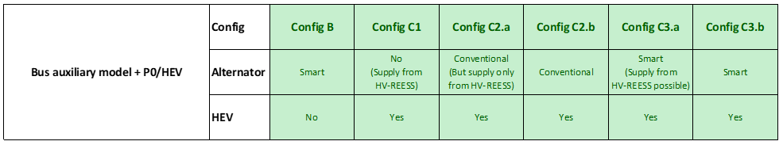
Updated bus auxiliary model (1/2)
Vecto 4.0.0.xx Development Version
From the existing basis for conventional ICE-only buses released in summer 2020, the following elements were implemented/adapted:
Multiple bug-fixes in existing code developed by other contractor → exact aux power demand does not match anymore with 2020 version
Basic methodology for determining aux power demand of each specific system was kept → post-processing of all different systems was correctly implemented from a methodical point of view and completely restructured to be compatible with other elements outside of bus aux model
Different calculation cases for HEV depending on source of electric aux power (alternator or HV-REESS) and also alternator type (smart or not) implemented
Details regarding methodology for post-processing can be found in DEV-WS#6 (12.07.2021)

Slide 66
First VECTO beta release for the 3rd Amendment H2 Internal Combustion Engines
TUG

Slide 67
H2 ICE
New fuel types implemented „H2 PI“ and „H2 CI“ (i.e. H2-Diesel dual-fuel)
Well-known ICE input data structure unchanged, no new elements
Fuel characteristics used

Slide 68
First VECTO beta release for the 3rd Amendment Fuel Cell Hybrid Vehicles (FCHV)
TUG

Slide 69
Fuel cell hybrid vehicles (FCHV) – Op. strategy (1/5)
FCHV generic operation strategy (Charge Sustaining Mode) implemented as presented in TF FCS #15 with following basic principle:
Maximum phlegmatisation of FCS by operation strategy
FCS needs to provide average electric power demand over longer horizon
Longest possible averaging horizon depends on battery size and specific vehicle-cycle combination → The smaller the battery or the greater the electric energy demand of the vehicle, the smaller the averaging horizon will get leading to a more dynamic operation of the FCS.

Slide 70
Fuel cell hybrid vehicles (FCHV) – Op. strategy (2/5)
Basic approach for implementation of FCS operation in “CS” Mode in 4 steps
Pre-simulation run as PEV to determine electric power demand for propulsion and auxiliaries
Power limit of “special” battery defined as sum of respective maximum powers (BAT + FCS)
Resulting total electric power from step 1 will be averaged over a certain fixed window size which is distance based (details next slide)
Buffering of energy is limited by battery size, SOC limits min/max are not allowed to be exceeded
Using largest possible window size without violating SOC limits in any window
Adaption of start SOC to specific mission in order to maximize usage of battery as buffer
Actual simulation run as FCHV in-the-loop where FCS is operated following a fixed power trace to cover average electric power demand determined from pre-processing in step 2 (battery covers instantaneous deviations from average electric power demand)
ΔSOC correction in post-processing to account for small deviations from neutral SOC behaviour over cycle (e.g. variations in auxiliary power, small deviations in battery losses etc.)

Slide 71
Fuel cell hybrid vehicles (FCHV) – Op. strategy (3/5)
Averaging and window size explained (1/2)
The averaging window is placed distance-symmetrically over each actual time step from the pre-simulation
Window size is determined by total distance within window
distance
=
distance
=
window @ t+2
window @ t+1
window @ t
time
t-i
t+1-j
t+2+k
t
t+1
t+2
t+i
t+1+j
t+2+k

Slide 72
Fuel cell hybrid vehicles (FCHV) – Op. strategy (4/5)
Averaging and window size explained (2/2)
Maximum window size is given by complete cycle, thus cycle is concatenated 3 times in a row
For time steps near the beginning or end of the cycle, the windows expand over the actual cycle and continue at the adjacent parts at the end or beginning.
speed
window at beginning of cycle
window in the middle of cycle
window at end of cycle
time
previous copy of cycle
actual cycle
subsequent copy of cycle

Slide 73
Fuel cell hybrid vehicles (FCHV) – Op. strategy (5/5)
Actual simulation run as FCHV and applicable boundary conditions
In case average power demand over total cycle is higher than FCS maximum power: → defined error message and simulation is aborted (vehicle configuration not reasonable for this mission, should not occur in practice)
In case average power in a certain timestep is lower than FCS minimum power: → FCS is switched off → missing energy from FCS for those timesteps will be accounted for in post-processing via ΔSOC correction

Slide 74
Fuel cell hybrid vehicles (FCHV) – VECTO features (1/5)
New powertrain type of FCHV added to Job Editor

Slide 75
Fuel cell hybrid vehicles (FCHV) – VECTO features (2/5)
FCS to be parameterized via specific „Fuel Cell System“ tab in „Vehicle“ editor
Power gradient limits change in FCS power over time
On/off-Hysteresis is minimum time that FCS stays off or on after state change occurs → not required anymore after insights gained during work on implementation of multiple FCS

Slide 76
Fuel cell hybrid vehicles (FCHV) – VECTO features (3/5)
FCS to be parameterized via specific „Fuel Cell System“ tab in „Vehicle“ editor
Double-click or „+“
Max / min power limits operation range of FCS component
FCS mass flow map needs to cover the indicated range
Limited to 1
for this release

Slide 77
Fuel cell hybrid vehicles (FCHV) – VECTO features (4/5)
FCS to be parameterized via specific „Fuel Cell System“ tab in „Vehicle“ editor
Input data structure for FCS H2 mass flow map
CSV file format
1st column: Electric power output of FCS in [kW]
2nd column: H2 mass flow in [g/h]
FCS component efficiency should also include DC/DC converter (as this is part of component test procedure)!
Example data

Slide 78
Fuel cell hybrid vehicles (FCHV) – VECTO features (5/5)
Parameterization of auxiliaries for FCHV
Electric power demand of auxiliaries for both, lorries and buses, need to be parameterized via the “Bus Auxiliaries” GUI window
INFO: Electric aux power demand is calculated by multiplying the specified current values by a voltage of 28.3V
Demand during vehicle driving
Demand during vehicle standstill

Slide 79
FCHV – Examples for generic operation strategy (1/5)
Exemplary results for VECTO Group 2 12-ton rigid lorry (9.5 ton actual mass) on following slides
Simulation in VECTO Urban Delivery Cycle
Average electric power demand around 22 kW
FCHV powertrain specifications:
100 kW FCS max power
following variants of battery:
5 kWh
10 kWh
20 kWh
Resulting speed profile was exactly the same for all different configurations

Slide 80
FCHV – Examples for generic operation strategy (2/5)
The lower the buffer size, the more dynamic the FCS operation gets
Exactly same speed profile for all variants
Averaging window sizes determined:
5 kWh: 6 km
10 kWh: 37.5 km
20 kWh: 100 km
Fuel cell power for different battery sizes
5 kWh
10 kWh
20 kWh

Slide 81
FCHV – Examples for generic operation strategy (3/5)
Battery covers instantaneous deviations from average electric power demand
Average electric power demand (i.e. FCS power) constant for the setting shown with 20 kWh REESS size
Battery power
Fuel cell power

Slide 82
FCHV – Examples for generic operation strategy (4/5)
Using largest possible window size without violating SOC limits in any window → maximizing of battery buffer usage
Exactly same speed profile for all variants
SOC limits are Engineering settings, no connex to generic limits used in Declaration Mode
Upper SOC limit
Lower SOC limit
SOC for different battery sizes
5 kWh
10 kWh
20 kWh

Slide 83
FCHV – Examples for generic operation strategy (5/5)
Adaption of start SOC to specific mission in order to maximize usage of battery as buffer (detail from previous graph)
Exactly same speed profile for all variants
Adapted start SOC
SOC for different battery sizes
5 kWh
10 kWh
20 kWh

Slide 84
Fuel cell hybrid vehicles (FCHV) - Comments
Release to be distributed via VECTO-DEV mailing list end of September
Basic description of FCHV features will also be added to VECTO release notes
Some example vehicles will be provided
Current release restricted to one single FCS component
Updated release end of October will be able to handle:
multiple FCS configurations as presented in TF FCS #17
Maximum 2x3 configuration i.e. 2 different FCS with a maximum number of 3 identical systems for each of the 2 different ones
Special provisions for handling power demands below minimum FCS power
IMC feature combined with FCHV

Slide 85
First VECTO beta release for the 3rd Amendment Vehicles with In-Motion Charging Features
TUG

Slide 86
Vehicles with In-Motion Charging (IMC) features (1/11)
One of the tasks of the pre-development project for the 3rd Amendment was to analyse different systems for in-use charging of electric vehicles
State of the art
Relevance and possible paths of implementation to Regulation (EU) 2017/2400
Functional prototype
The analyses and proposals for (1) and (2) were presented and discussed with stakeholders in five stakeholder meetings (Oct 2021, Dec 2021, Jan 2022, Jun 2022 and Sept 2022).
The following slides summarise the most important principles and present the functional prototype

Slide 87
Vehicles with In-Motion Charging (IMC) features (2/11)
Reference point for results regarding electric energy consumption
Principle applied already for the 2nd amendment
Consequences for the 3rd amendment
Stationary charging: minor improvements to the Annex (max. charging power)
In-motion charging: Requires model extension and separate provisions in the Annex

Slide 88
Vehicles with In-Motion Charging (IMC) features (3/11)
Modelling in VECTO - Overview
Driving with “direct feed” incorporated to simulations of “charge depleting” mode by postprocessing (no additional sim time, no additional definitions etc.) (DECL) → higher utility factor / share of electric driving for OVC-HEV → (slightly) lower battery internal losses
Charging of batteries by IMC handled by postprocessing (DECL) → higher utility factor / share of electric driving for OVC-HEV
Impact on air drag incorporated to in-the loop simulation via a mission average share “active” (which applies either to motorway sections or to the total cycle) (ENG, DECL)
No direct influence on the “electric ranges", i.e. these are also only calculated on the basis of the usable battery capacity (DECL)
DECL / ENG: Effect visible in Declaration Mode / Engineering Mode
Report with detailed documentation to be published soon

Slide 89
Vehicles with In-Motion Charging (IMC) features (4/11)
Modelling in VECTO – Calculations of electric energy consumption at battery terminals
Lila terms: new elements introduced for IMC modelling
Calculation examples see Task3_Masterexcel_OVC_IMC.xlsx as distributed with ppt Report with detailed documentation to be published soon

Slide 90
Vehicles with In-Motion Charging (IMC) features (5/11)
Modelling in VECTO – Current proposals for Declaration Mode
In-motion charging “technology” | Relevance |  |  | Proposal for definition in Regulation (EU) 2017/2400
 | Heavy lorries | Heavy buses | Medium lorries
Overhead pantograph | Yes | Yes | No | Vehicle equipped with overhead pantograph for connection with overhead catenary infrastructure as regulated by standard tbd and which is not overhead trolley.
Overhead trolley | No | Yes | No | Vehicle equipped with poles for connection with overhead catenary infrastructure as regulated in Annex 12 to UN Regulation 107 revision 8.
Ground-rail | Yes¹ | Yes¹ | Yes¹ | Charging technology that conductively transfers the electrical energy to the vehicle through rails embedded in or on top of the road surface.
Wireless | Yes¹ | Yes¹ | Yes¹ | Charging technology that inductively transfers the electrical energy to the vehicle through devices embedded in or on top of the road surface providing magnetic fields as they are specified IEC 61980.
¹ Only Potential niche applications are conceivable.
Lila: to be worked out for the 3rd amendment

Slide 91
Vehicles with In-Motion Charging (IMC) features (6/11)
Modelling in VECTO – Proposal for IMC infrastructure availability
Overhead - Pantograph
Overhead - Trolley

Slide 92
Vehicles with In-Motion Charging (IMC) features (7/11)
Modelling in VECTO – Proposal for IMC infrastructure availability
Ground rail + Wireless

Slide 93
Vehicles with In-Motion Charging (IMC) features (8/11)
Modelling in VECTO – Further proposed assumptions
Battery charging during mission
50% of usable battery capacity via “SOC lift” by IMC
No further stationary charging
Air drag
Considered only for “Overhead – pantograph”
ΔCdxA = 0.6 m² for the shares in the mission where IMC is available

Slide 94
Vehicles with In-Motion Charging (IMC) features (9/11)
Inputs in Graphical User Interface (ENG)
New tab in “VEH Editor” for HEV and PEV vehicles
Attention!
Working with ENG mode simulations for IMC features requires detailed knowledge of the proposed approach (mainly for developers)
For checking of regulatory impact DECL mode testing recommended!

Slide 95
Vehicles with In-Motion Charging (IMC) features (10/11)
Inputs in Graphical User Interface (DECL)
Dropdown Menu with pre-defined technologies
None
Overhead Pantograph
Overhead Trolley
Ground Rail
Wireless

Slide 96
Vehicles with In-Motion Charging (IMC) features (11/11)
Example vehicle models will be distributed with the release (located in “\Generic vehicles”)
Base specs example models
Group 5 / HEV P2 / OVC: P_{cont_EM}: 200kW | E_{Reess}: 120kWh nominal
Group 5 / PEV: P_{cont_EM}: 325kW | E_{Reess}: 170kWh nominal
Example results: Long haul with rep payload Comparison results “w/o” and “w/” pantograph with similar other vehicle specs like mass
Group 5 / P2 / OVC w/o pantograph: UF = 0.149; CO2_{weighted} = 692.2 g/km
Group 5 / P2 / OVC w/ pantograph: UF = 0.660; CO2_{weighted} = 347.1 g/km → -50% CO2
Group 5 / PEV w/o pantograph: EC_{el} = 1.262 kWh/km
Group 5 / PEV w/ pantograph: EC_{el} = 1.297 kWh/km → +2.8% EC_{el}

Slide 97
First VECTO beta release for the 3rd Amendment H2 Internal Combustion Engines
TUG

Slide 98
H2 ICE
New fuel types implemented „H2 PI“ and „H2 CI“ (i.e. H2-Diesel dual-fuel)
Well-known ICE input data structure unchanged, no new elements
Fuel characteristics used

Slide 99
First VECTO beta release for the 3rd Amendment Fuel Cell Hybrid Vehicles (FCHV)
TUG

Slide 100
Fuel cell hybrid vehicles (FCHV) – Op. strategy (1/5)
FCHV generic operation strategy (Charge Sustaining Mode) implemented as presented in TF FCS #15 with following basic principle:
Maximum phlegmatisation of FCS by operation strategy
FCS needs to provide average electric power demand over longer horizon
Longest possible averaging horizon depends on battery size and specific vehicle-cycle combination → The smaller the battery or the greater the electric energy demand of the vehicle, the smaller the averaging horizon will get leading to a more dynamic operation of the FCS.

Slide 101
Fuel cell hybrid vehicles (FCHV) – Op. strategy (2/5)
Basic approach for implementation of FCS operation in “CS” Mode in 4 steps
Pre-simulation run as PEV to determine electric power demand for propulsion and auxiliaries
Power limit of “special” battery defined as sum of respective maximum powers (BAT + FCS)
Resulting total electric power from step 1 will be averaged over a certain fixed window size which is distance based (details next slide)
Buffering of energy is limited by battery size, SOC limits min/max are not allowed to be exceeded
Using largest possible window size without violating SOC limits in any window
Adaption of start SOC to specific mission in order to maximize usage of battery as buffer
Actual simulation run as FCHV in-the-loop where FCS is operated following a fixed power trace to cover average electric power demand determined from pre-processing in step 2 (battery covers instantaneous deviations from average electric power demand)
ΔSOC correction in post-processing to account for small deviations from neutral SOC behaviour over cycle (e.g. variations in auxiliary power, small deviations in battery losses etc.)

Slide 102
Fuel cell hybrid vehicles (FCHV) – Op. strategy (3/5)
Averaging and window size explained (1/2)
The averaging window is placed distance-symmetrically over each actual time step from the pre-simulation
Window size is determined by total distance within window
distance
=
distance
=
window @ t+2
window @ t+1
window @ t
time
t-i
t+1-j
t+2+k
t
t+1
t+2
t+i
t+1+j
t+2+k

Slide 103
Fuel cell hybrid vehicles (FCHV) – Op. strategy (4/5)
Averaging and window size explained (2/2)
Maximum window size is given by complete cycle, thus cycle is concatenated 3 times in a row
For time steps near the beginning or end of the cycle, the windows expand over the actual cycle and continue at the adjacent parts at the end or beginning.
speed
window at beginning of cycle
window in the middle of cycle
window at end of cycle
time
previous copy of cycle
actual cycle
subsequent copy of cycle

Slide 104
Fuel cell hybrid vehicles (FCHV) – Op. strategy (5/5)
Actual simulation run as FCHV and applicable boundary conditions
In case average power demand over total cycle is higher than FCS maximum power: → defined error message and simulation is aborted (vehicle configuration not reasonable for this mission, should not occur in practice)
In case average power in a certain timestep is lower than FCS minimum power: → FCS is switched off → missing energy from FCS for those timesteps will be accounted for in post-processing via ΔSOC correction

Slide 105
Fuel cell hybrid vehicles (FCHV) – VECTO features (1/5)
New powertrain type of FCHV added to Job Editor

Slide 106
Fuel cell hybrid vehicles (FCHV) – VECTO features (2/5)
FCS to be parameterized via specific „Fuel Cell System“ tab in „Vehicle“ editor
Power gradient limits change in FCS power over time
On/off-Hysteresis is minimum time that FCS stays off or on after state change occurs → not required anymore after insights gained during work on implementation of multiple FCS

Slide 107
Fuel cell hybrid vehicles (FCHV) – VECTO features (3/5)
FCS to be parameterized via specific „Fuel Cell System“ tab in „Vehicle“ editor
Double-click or „+“
Max / min power limits operation range of FCS component
FCS mass flow map needs to cover the indicated range
Limited to 1
for this release

Slide 108
Fuel cell hybrid vehicles (FCHV) – VECTO features (4/5)
FCS to be parameterized via specific „Fuel Cell System“ tab in „Vehicle“ editor
Input data structure for FCS H2 mass flow map
CSV file format
1st column: Electric power output of FCS in [kW]
2nd column: H2 mass flow in [g/h]
FCS component efficiency should also include DC/DC converter (as this is part of component test procedure)!
Example data

Slide 109
Fuel cell hybrid vehicles (FCHV) – VECTO features (5/5)
Parameterization of auxiliaries for FCHV
Electric power demand of auxiliaries for both, lorries and buses, need to be parameterized via the “Bus Auxiliaries” GUI window
INFO: Electric aux power demand is calculated by multiplying the specified current values by a voltage of 28.3V
Demand during vehicle driving
Demand during vehicle standstill

Slide 110
FCHV – Examples for generic operation strategy (1/5)
Exemplary results for VECTO Group 2 12-ton rigid lorry (9.5 ton actual mass) on following slides
Simulation in VECTO Urban Delivery Cycle
Average electric power demand around 22 kW
FCHV powertrain specifications:
100 kW FCS max power
following variants of battery:
5 kWh
10 kWh
20 kWh
Resulting speed profile was exactly the same for all different configurations

Slide 111
FCHV – Examples for generic operation strategy (2/5)
The lower the buffer size, the more dynamic the FCS operation gets
Exactly same speed profile for all variants
Averaging window sizes determined:
5 kWh: 6 km
10 kWh: 37.5 km
20 kWh: 100 km
Fuel cell power for different battery sizes
5 kWh
10 kWh
20 kWh

Slide 112
FCHV – Examples for generic operation strategy (3/5)
Battery covers instantaneous deviations from average electric power demand
Average electric power demand (i.e. FCS power) constant for the setting shown with 20 kWh REESS size
Battery power
Fuel cell power

Slide 113
FCHV – Examples for generic operation strategy (4/5)
Using largest possible window size without violating SOC limits in any window → maximizing of battery buffer usage
Exactly same speed profile for all variants
SOC limits are Engineering settings, no connex to generic limits used in Declaration Mode
Upper SOC limit
Lower SOC limit
SOC for different battery sizes
5 kWh
10 kWh
20 kWh

Slide 114
FCHV – Examples for generic operation strategy (5/5)
Adaption of start SOC to specific mission in order to maximize usage of battery as buffer (detail from previous graph)
Exactly same speed profile for all variants
Adapted start SOC
SOC for different battery sizes
5 kWh
10 kWh
20 kWh

Slide 115
Fuel cell hybrid vehicles (FCHV) - Comments
Release to be distributed via VECTO-DEV mailing list end of September
Basic description of FCHV features will also be added to VECTO release notes
Some example vehicles will be provided
Current release restricted to one single FCS component
Updated release end of October will be able to handle:
multiple FCS configurations as presented in TF FCS #17
Maximum 2x3 configuration i.e. 2 different FCS with a maximum number of 3 identical systems for each of the 2 different ones
Special provisions for handling power demands below minimum FCS power
IMC feature combined with FCHV

Slide 116
First VECTO beta release for the 3rd Amendment Vehicles with In-Motion Charging Features
TUG

Slide 117
Vehicles with In-Motion Charging (IMC) features (1/11)
One of the tasks of the pre-development project for the 3rd Amendment was to analyse different systems for in-use charging of electric vehicles
State of the art
Relevance and possible paths of implementation to Regulation (EU) 2017/2400
Functional prototype
The analyses and proposals for (1) and (2) were presented and discussed with stakeholders in five stakeholder meetings (Oct 2021, Dec 2021, Jan 2022, Jun 2022 and Sept 2022).
The following slides summarise the most important principles and present the functional prototype

Slide 118
Vehicles with In-Motion Charging (IMC) features (2/11)
Reference point for results regarding electric energy consumption
Principle applied already for the 2nd amendment
Consequences for the 3rd amendment
Stationary charging: minor improvements to the Annex (max. charging power)
In-motion charging: Requires model extension and separate provisions in the Annex

Slide 119
Vehicles with In-Motion Charging (IMC) features (3/11)
Modelling in VECTO - Overview
Driving with “direct feed” incorporated to simulations of “charge depleting” mode by postprocessing (no additional sim time, no additional definitions etc.) (DECL) → higher utility factor / share of electric driving for OVC-HEV → (slightly) lower battery internal losses
Charging of batteries by IMC handled by postprocessing (DECL) → higher utility factor / share of electric driving for OVC-HEV
Impact on air drag incorporated to in-the loop simulation via a mission average share “active” (which applies either to motorway sections or to the total cycle) (ENG, DECL)
No direct influence on the “electric ranges", i.e. these are also only calculated on the basis of the usable battery capacity (DECL)
DECL / ENG: Effect visible in Declaration Mode / Engineering Mode
Report with detailed documentation to be published soon

Slide 120
Vehicles with In-Motion Charging (IMC) features (4/11)
Modelling in VECTO – Calculations of electric energy consumption at battery terminals
Lila terms: new elements introduced for IMC modelling
Calculation examples see Task3_Masterexcel_OVC_IMC.xlsx as distributed with ppt Report with detailed documentation to be published soon

Slide 121
Vehicles with In-Motion Charging (IMC) features (5/11)
Modelling in VECTO – Current proposals for Declaration Mode
In-motion charging “technology” | Relevance |  |  | Proposal for definition in Regulation (EU) 2017/2400
 | Heavy lorries | Heavy buses | Medium lorries
Overhead pantograph | Yes | Yes | No | Vehicle equipped with overhead pantograph for connection with overhead catenary infrastructure as regulated by standard tbd and which is not overhead trolley.
Overhead trolley | No | Yes | No | Vehicle equipped with poles for connection with overhead catenary infrastructure as regulated in Annex 12 to UN Regulation 107 revision 8.
Ground-rail | Yes¹ | Yes¹ | Yes¹ | Charging technology that conductively transfers the electrical energy to the vehicle through rails embedded in or on top of the road surface.
Wireless | Yes¹ | Yes¹ | Yes¹ | Charging technology that inductively transfers the electrical energy to the vehicle through devices embedded in or on top of the road surface providing magnetic fields as they are specified IEC 61980.
¹ Only Potential niche applications are conceivable.
Lila: to be worked out for the 3rd amendment

Slide 122
Vehicles with In-Motion Charging (IMC) features (6/11)
Modelling in VECTO – Proposal for IMC infrastructure availability
Overhead - Pantograph
Overhead - Trolley

Slide 123
Vehicles with In-Motion Charging (IMC) features (7/11)
Modelling in VECTO – Proposal for IMC infrastructure availability
Ground rail + Wireless

Slide 124
Vehicles with In-Motion Charging (IMC) features (8/11)
Modelling in VECTO – Further proposed assumptions
Battery charging during mission
50% of usable battery capacity via “SOC lift” by IMC
No further stationary charging
Air drag
Considered only for “Overhead – pantograph”
ΔCdxA = 0.6 m² for the shares in the mission where IMC is available

Slide 125
Vehicles with In-Motion Charging (IMC) features (9/11)
Inputs in Graphical User Interface (ENG)
New tab in “VEH Editor” for HEV and PEV vehicles
Attention!
Working with ENG mode simulations for IMC features requires detailed knowledge of the proposed approach (mainly for developers)
For checking of regulatory impact DECL mode testing recommended!

Slide 126
Vehicles with In-Motion Charging (IMC) features (10/11)
Inputs in Graphical User Interface (DECL)
Dropdown Menu with pre-defined technologies
None
Overhead Pantograph
Overhead Trolley
Ground Rail
Wireless

Slide 127
Vehicles with In-Motion Charging (IMC) features (11/11)
Example vehicle models will be distributed with the release (located in “\Generic vehicles”)
Base specs example models
Group 5 / HEV P2 / OVC: P_{cont_EM}: 200kW | E_{Reess}: 120kWh nominal
Group 5 / PEV: P_{cont_EM}: 325kW | E_{Reess}: 170kWh nominal
Example results: Long haul with rep payload Comparison results “w/o” and “w/” pantograph with similar other vehicle specs like mass
Group 5 / P2 / OVC w/o pantograph: UF = 0.149; CO2_{weighted} = 692.2 g/km
Group 5 / P2 / OVC w/ pantograph: UF = 0.660; CO2_{weighted} = 347.1 g/km → -50% CO2
Group 5 / PEV w/o pantograph: EC_{el} = 1.262 kWh/km
Group 5 / PEV w/ pantograph: EC_{el} = 1.297 kWh/km → +2.8% EC_{el}

Slide 128
Updated bus auxiliary model (2/2)
Vecto 4.0.0.xx Development Version
List continued…
Electric technologies for all different aux systems
HVAC specific:
Input data structure for HVAC systems + differentiation of systems for cooling and heating
Generation of cooling/heating power depending on HVAC system layout and technologies (handling of mixed configurations)
Methods for smart alternators (i.e. P0-HEV)
Methods for engine stop-start and corresponding post-processing
Methods for post-processing for all electrical auxiliary technologies
Methods for auxiliary fuel heater for different powertrain architectures
Differentiation in output regarding electrical or mechanical energy demand

Slide 129
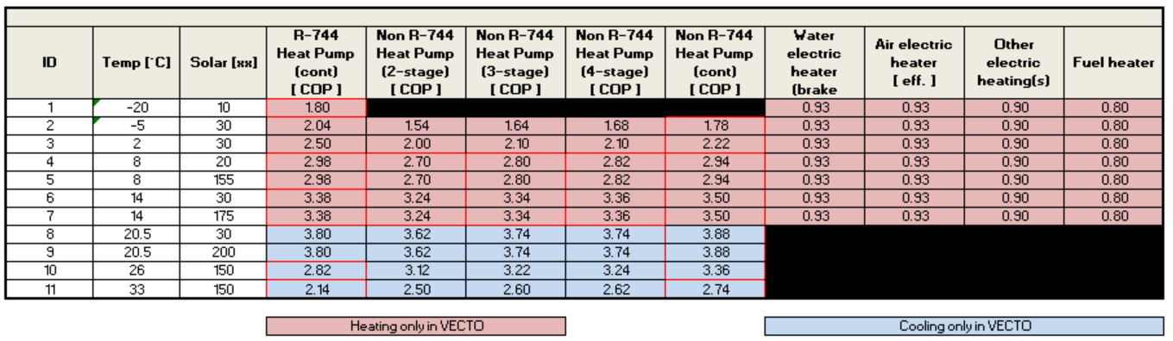
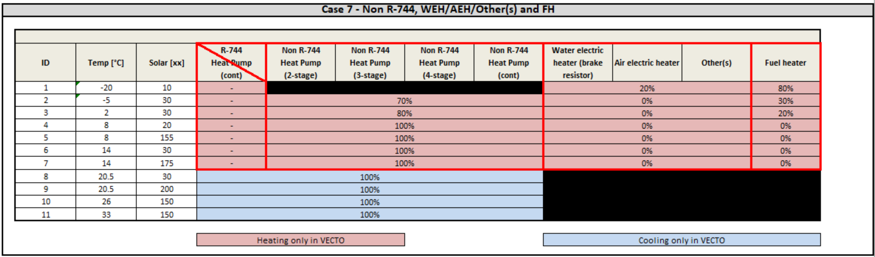
Updated bus auxiliary model – HVAC implementation (1/5)
Vecto 4.0.0.xx Development Version
Details for HVAC system implementation
Generic values for efficiency/COP for all different cooling/heating systems
Generic load share per technology for all possible cases of combination of different heating systems
as presented and distributed in DEV-WS#12 (18.05.2022)
Example for one specific load distribution case

Slide 130
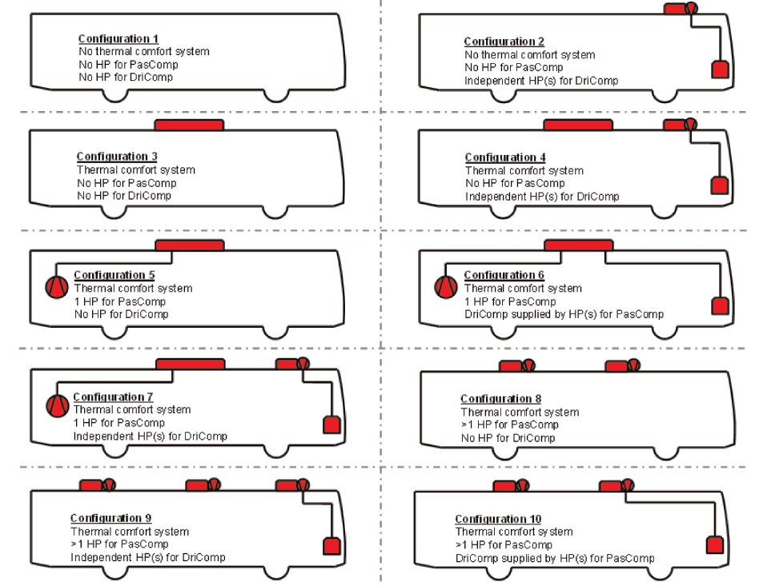
Vecto 4.0.0.xx Development Version
Updated bus auxiliary model – HVAC implementation (2/5)
Matching of configurations defined in Annex to specific calculation settings
Separate consideration of all cases for cooling and heating
Configuration defines:
If thermal comfort system is available (effect on ventilation power demand via different air exchange rate)
If heat-pump is available for driver and/or passenger compartment
If heat-pump of passenger compartment supplies also driver compartment
Number of heat-pumps available (effect on limitation of heating/cooling power; more heat-pumps, more power)
NB: Input independent of cooling/heating functionality!

Slide 131
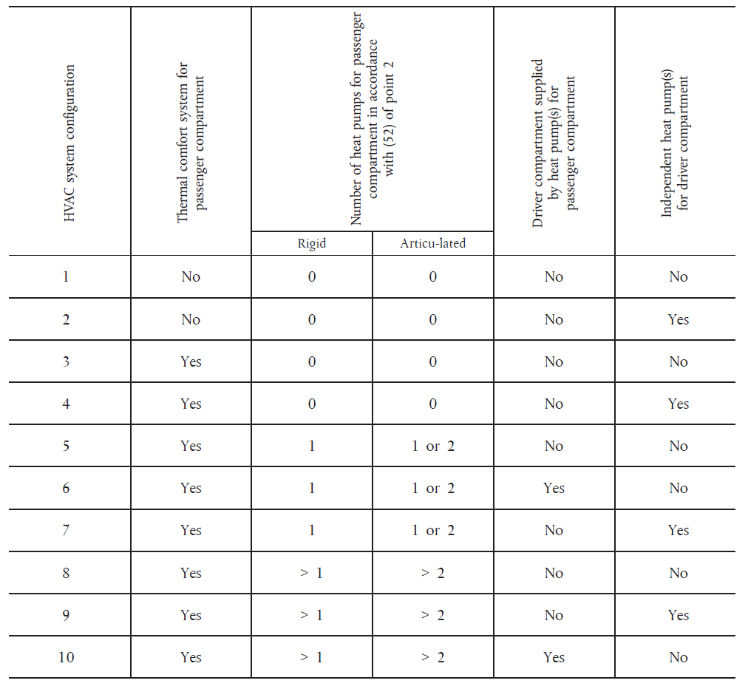
Updated bus auxiliary model – HVAC implementation (3/5)
Vecto 4.0.0.xx Development Version
Matching of HVAC input to specific calculation settings – Valid inputs
Calculation configuration determined separately and independently for cooling + heating
Table 13 in Annex IX
!!! At least for either cooling or heating number of declared HP types needs to match with declared config!
Configs 8-10 are matching configs 5-7 just with higher cooling/heating power limitation
→ Calculation settings are exactly the same
No passenger HP
Single pass. HP
NB: Input independent of cooling/heating functionality!
VECTO determines calculation config
Multiple pass. HP

Slide 132
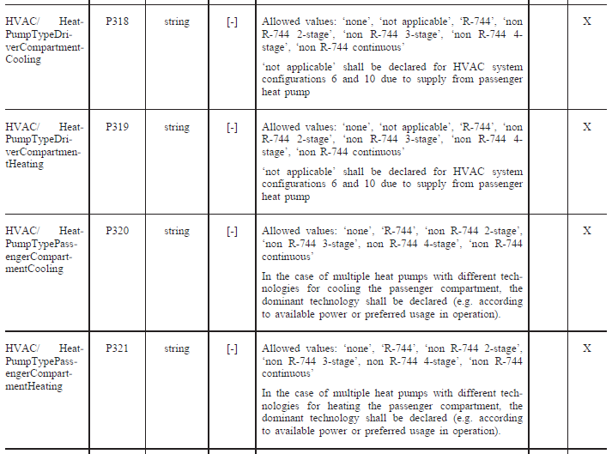
Updated bus auxiliary model – HVAC implementation (4/5)
Vecto 4.0.0.xx Development Version
Matching of HVAC input to specific calculation settings – Valid inputs
“None” vs. “Not applicable” ?
“None” is declared either for heating or cooling HP type if a HP is present in vehicle according to declared Config, but this HP is not used for one case (i.e. HP used only for heating or only for cooling and not for both cases)
“Not applicable” is declared only for configurations 6 and 10, since there the driver compartment is supplied by HP of the passenger compartment
Table 3a in Annex III

Slide 133
Updated bus auxiliary model – HVAC implementation (5/5)
Vecto 4.0.0.xx Development Version
HVAC input – valid combinations of different heating systems
All other combinations are considered invalid
Excel table with specific heating distribution cases will be distributed together with meeting material
Valid combinations of heating distribution case
Example for one specific heating distribution case

Slide 134
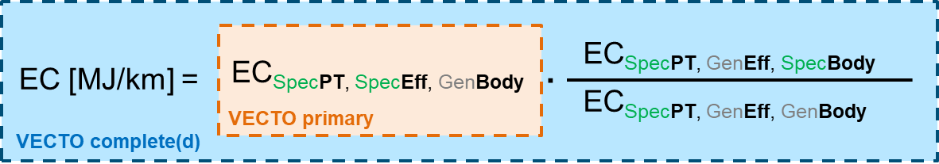
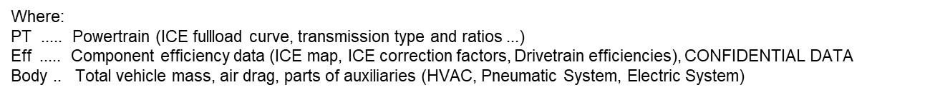
Factor Method – General principle
Vecto 4.0.0.xx Development Version
First step (separately for each relevant fuel/energy carrier): Factor method is applied to calculate energy consumption (EC in MJ/km), e.g.:
Conventional vehicle: Diesel or NG only
OVC-HEV: Diesel (or NG) and electric energy (separately for CD and CS mode)
Dual-fuel vehicle: Diesel and NG
Second step (separately for each relevant fuel/energy carrier): Fuel consumption e.g. [kg/km] = EC [MJ/km] / Lower Heating Value [MJ/kg]
Third step: Sum up CO₂ all fuels: CO₂ [g/km] = FC [kg/km] * CO₂ content [kg/kg] * 1000
For electrical energy cons. (EC_el): Factor method is applied to the values incl. battery losses during external charging

Slide 135
Factor Method – Required number of simulations
Vecto 4.0.0.xx Development Version
Primary vehicle
Simulations for four sub-groups (LF/HF x SD/DD)
→ 11 x 2 = 22 simulations
Completed vehicle
2 to 4 cycles x 2 payloads x 2 (spec / gen body)
→ min 8 to max 16 simulations
For OVC HEVs:
Additional simulations for CD and CS mode, and - for P-HEVs – to determine the EF to be considered
“Worst case” = complete OVC P-HEV: → 152 simulations

Slide 136
Factor Method – Generic bodies for primary xEV
Vecto 4.0.0.xx Development Version
Basis of the methods for xEV are the generic bodies for conventional (i.e. ICE only) buses
Modified parameters are:
Vehicle mass
Auxiliary configuration

Slide 137
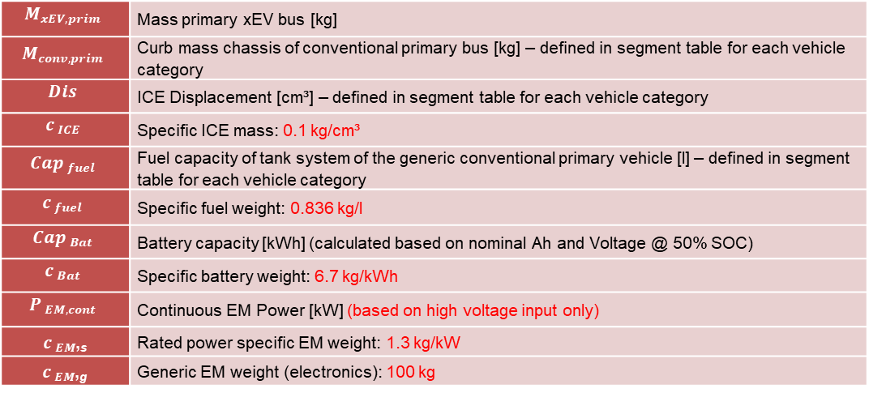
Factor Method – Generic masses for primary xEV
Vecto 4.0.0.xx Development Version
Approach already discussed in DEV Workshops #13 and #14
$$M_{xEV,prim}=M_{conv,prim}−\left\{\begin{matrix}Dis∗c_{ICE}+{Cap}_{Fuel}∗c_{Fuel}/2 if PEV \\ 0 else\end{matrix}\right.+{Cap}_{Bat}∗c_{Bat}+{\left[P_{EM,cont}∗c_{EM,s}+c_{EM,g}\right]}^{∗}$$
$$M_{xEV,prim}$$ | Mass primary xEV bus [kg]
$$M_{conv,prim}$$ | Curb mass chassis of conventional primary bus [kg] – defined in segment table for each vehicle category
$$Dis$$ | ICE Displacement [cm³] – defined in segment table for each vehicle category
$$c_{ ICE}$$ | Specific ICE mass: 0.1 kg/cm³
$${Cap}_{ fuel}$$ | Fuel capacity of tank system of the generic conventional primary vehicle [l] – defined in segment table for each vehicle category
$$c_{ fuel}$$ | Specific fuel weight: 0.836 kg/l
$${Cap}_{ Bat}$$ | Battery capacity [kWh] (calculated based on nominal Ah and Voltage @ 50% SOC)
$$c_{ Bat}$$ | Specific battery weight: 6.7 kg/kWh
$$P_{ EM,cont}$$ | Continuous EM Power [kW] (based on high voltage input only)
$c_{ EM}$,_{s} | Rated power specific EM weight: 1.3 kg/kW
$c_{ EM}$,_{g} | Generic EM weight (electronics): 100 kg
EM considered twice in case of S-HEV

Slide 138
Factor Method – HVAC and AUX config for primary xEV
Vecto 4.0.0.xx Development Version
Parameter | Door drive technology | HVAC/SystemConfiguration | HVAC/ HeatPumpTypeDriverCompartmentCooling | HVAC/ HeatPumpTypeDriverCompartmentHeating | HVAC/ HeatPumpTypePassengerCompartmentCooling | HVAC/ HeatPumpTypePassengerCompartmentHeating | HVAC/AuxiliaryHeaterPower | HVAC/WaterElectricHeater
ID | P291 | P317 | P318 | P319 | P320 | P321 | P322 | P328
Type | string | int | string | string | string | string | int | bool.
Unit | [-] | [-] | [-] | [-] | [-] | [-] | [-] | [-]
Description | Allowed values: ‘pneumatic’, ‘electric’, ‘mixed’ | Allowed values: ‘0’ to ‘10’ In the case of an incomplete HVAC system, ‘0’ shall be provided. ‘0’ is not applicable for complete or completed vehicles. | Allowed values: ‘none’, ‘not applicable’, ‘R-744’, ‘non R-744 2-stage’, ‘non R-744 3-stage’, ‘non R-744 4- stage’, ‘non R-744 continuous’ ‘not applicable’ shall be declared for HVAC system configurations 6 and 10 due to supply from passenger heat pump | Allowed values: ‘none’, ‘not applicable’, ‘R-744’, ‘non R-744 2-stage’, ‘non R-744 3-stage’, ‘non R-744 4- stage’, ‘non R-744 continuous’ ‘not applicable’ shall be declared for HVAC system configurations 6 and 10 due to supply from passenger heat pump | Allowed values: ‘none’, ‘R-744’, ‘non R-744 2-stage’, ‘non R-744 3-stage’, non R-744 4-stage’, ‘non R-744 continuous’ In the case of multiple heat pumps with different technologies for cooling the passenger compartment, the dominant technology shall be declared (e.g. according to available power or preferred usage in operation) | Allowed values: ‘none’, ‘R-744’, ‘non R-744 2-stage’, ‘non R-744 3-stage’, non R-744 4-stage’, ‘non R-744 continuous’ In the case of multiple heat pumps with different technologies for heating the passenger compartment, the dominant technology shall be declared (e.g. according to available power or preferred usage in operation) | Enter ‘0’ if no auxiliary heater is installed. | Input to be provided only for HEV and PEV
Conventional | pneumatic | 6 | not applicable | none | non R-744 2-stage | none | LF: 15000 HF: 30000 | -
HEV | pneumatic | 6 | not applicable | none | non R-744 2-stage | none | LF: 15000 HF: 30000 | False
PEV | pneumatic | 6 | not applicable | not applicable | non R-744-continuous | non R-744 continuous | LF: 0 HF: 0 | True
HVAC Configuration 6: Thermal comfort system; Heat pump for passenger compartment; No independent heat pump for driver compartment

Slide 139
Factor Method – OVC-HEVs (1/2)
Vecto 4.0.0.xx Development Version
Approach for energy consumption „EC“ [MJ/km]
Applied both for fuel and electric energy
Fuel consumption in grams / liters and CO₂ emissions are derivates of those
CD | EC_{compl,specBody,CD}
CS | EC_{compl,specBody,CS}
Weighted | not calculated
CD | EC_{compl,CD} = EC_{prim,CD} x (EC_{compl,specBody,CD} / EC_{compl,genBody,CD})
CS | EC_{compl,CS} = EC_{prim,CS} x (EC_{compl,specBody,CS} / EC_{compl,genBody,CS})
Weighted (CD, CS) | EC_{compl,weighted} = EC_{compl,CD} x UF + EC_{compl,CS} x (1-UF)
CD | EC_{prim,CD}
CS | EC_{prim,CS}
Weighted | EC_{prim,weighted}= EC_{prim,CD} x UF + EC_{prim,CS} x (1-UF)
CD | EC_{compl,genBody,CD}
CS | EC_{compl,genBody,CS}
Weighted | not calculated
Results for complete(d) vehicle
Results for primary vehicle (similar to “single step” OVC)
Factor method simulations at the complete(d) vehicle stage

Slide 140
Factor Method – OVC-HEVs (2/2)
Vecto 4.0.0.xx Development Version
Approach for electric ranges
Results for completed vehicle can simply be calulated based on EC_{compl,CD} as calculated above
Approach for vehicle speeds and other simulation related results reported in the MRF (nr. of gear shifts, % full-load etc.)
Results for completed vehicle to be taken from simulations for completed vehicle with specific body
CD | v_{compl,specBody,CD}
CS | v_{compl,specBody,CS}
Weighted | not required
CD | v_{compl,CD} = v_{compl,specBody,CD}
CS | v_{compl,CS} = v_{compl,specBody,CS}
Weighted (CD, CS) | not required
CD | v_{prim,CD}
CS | v_{prim,CS}
Weighted | not required
CD | v_{compl,genBody,CD}
CS | v_{compl,genBody,CS}
Weighted | not required
Results for complete(d) vehicle
Results for primary vehicle
Factor method simulations at the complete(d) vehicle stage

Slide 141
Results for fuel-fired heater
Vecto 4.0.0.xx Development Version
For vehicles with ICE:
the fuel consumed by a fuel-fired heater is added to the fuel consumption of the ICE
the input data for the fuel-fired heater does not specify the fuel with which it is operated. VECTO assigns by default the fuel of the ICE
in the factor method, this part of the fuel consumption is implicitly part of the “factor formula”
nearly no impact on overall result (only 0,5% weighting of -20°C climate scenario)
For PEV:
if a heater is declared to be present on the complete(d) vehicle, automatically “Diesel” is allocated
the fuel consumption / CO₂ emissions is reported separately (to not come across with the emissions in accordance with the ZEV definition, which is – so far – only linked to propulsion system)
in the factor method, the result is taken from the simulation for the completed vehicle with the specific body

Slide 142
Overview VECTO Tool Modes
Vecto 4.0.0.xx Development Version
 | Medium Lorries (XML) | Heavy Lorries (XML) | Primary buses (XML) | Interim buses (GUI) | Interim buses (XML) | Completed buses (JSON v7) | Completed buses (GUI) | Completed buses (XML) | Complete buses (JSON v10) | Complete buses (XML) | Single bus (JSON v6 + 2 XMLs)
VECTO.exe | X | X | X |  |  | X |  | X | X | X | X
VECTOcmd.exe | X | X | X |  |  | X |  | X | X | X | X
VECTOMultistep.exe | X | X | X | X | X | X | X | X | X | X | X
Comments |  |  |  | function: generates updated VIF |  |  |  |  | "Single step" manufacturing process |  | for validation of factor method
X … Simulation only
X … Simulation and editing

Slide 143
Known issues
Vecto 4.0.0.xx Development Version
Elements not yet implemented
Battery connectors / junction box not included → define and implement generic additional resistances (i.e. loss factors)
Technical elements as resulting from the revision of the CO₂ Standards to be added
Sub-group allocation for the for the newly covered vehicle groups
Generation of weighted results for vocational vehicles
Anything related to ZEV definition?
Elements still under discussion
Medium lorries mission profile and payload weighting factors (equally weighted, only preliminary)
Multiple SOC level(s) for VECTO PEV simulation and respective weighting of results (?)

Slide 144
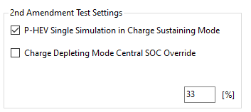
Vecto 0.7.10.2996 Development Version March 2023
Important Note This is a development release for xEV-Lorries. Bus related functionalities may be broken.
Changes
Test settings:
Charge-Sustaining-Mode:
Iterative simulation for OVC-P-HEVs
can be disabled
Charge-Depleting-Mode:
Central SOC can be overridden for
Charge-Depleting-Mode
Declaration values can be overridden by copying the particular file to <VectoDir>\Declaration\Override and changing the desired value.
New XSD-Schema for XML Reports
Updated Hybrid Strategy and Gearshifting

Slide 145
Declaration Mode Lorries – Overview (1/2)
VECTO Development Version 0.7.10.2996 as released on March 15, features the Declaration Mode for Lorries according to the 2nd Amendment.
This enables the official output XMLs (MRF, CIF) to be generated using the official input XMLs.
The result values correspond to the official results, subject to minor adjustments and additions from the testing period (see later slides).
With this version, the Declaration Mode can also be calculated via the GUI (json + csv). This mode also contains some special features for the upcoming test phase (see later slides).

Slide 146
Declaration Mode Lorries – Overview (2/2)
Overview new elements
Generic parameterisation of auxiliaries
Generic parametrisation of P-HEV strategy including update of gear shift strategy
Generic parametrisation of S-HEV strategy
Generic parametrisation of usable SOC range
Separate approach for „Charge depleting mode“ simulation
Calculation of energy consumption at “battery terminals” considering battery charging losses during external charging
Range calculations
Automation of the various simulation runs necessary for PHEVs plus post processing elements
Generic e-PTO cycle for PEV and S-HEV in the MUN cycle
Generation of MRF and CIF

Slide 147
DECL Lorries – Generic parameterisation of auxiliaries
Basic principles of generic data used in DECL
Relevant auxiliary systems:
Pneumatic system
ICE cooling fan + conditioning power for electric propulsion components
Steering system
HVAC: for lorries only “yes/no”
Electric board net (is called “electric system”): for lorries only headlights technology (LED or standard)
Respective tables with generic power demand for each auxiliary system can be found in specific subfolder “Declaration\VAUX” under VECTO main path as csv-files
General table structure looks as follows:
can be directly supplied by REESS if present (indicated with 0/1)
applicability for architecture (indicated with 0/1)
cycle specific mechanical power demand [W]
Technology | conventional | P-HEV | S-HEV | PEV | fully electric | Long haul | Regional delivery | Urban delivery | Municipal utility | Construction
Tech #1
Tech #2
Tech #3
Tech #...

Slide 148
DECL Lorries – Generic parameterisation of auxiliaries
Basic principles of generic data used in DECL
Details of application in DECL:
For all HEV: "fully electric" technology is connected to REESS → mechanical power (i.e. respective alternator drive power) is converted to electric power with generic alternator efficiency of 0.7 used consistently throughout whole VECTO auxiliary approach (i.e. mechanical power from table is multiplied by 0.7 and therefore reduced)
For all PEV: only "fully electric" technology can be declared (acc. to Annex specifications as well) → same principle of conversion from mechanical to electrical power (as explained above applies)
can be directly supplied by REESS if present (indicated with 0/1)
applicability for architecture (indicated with 0/1)
cycle specific mechanical power demand [W]
Technology | conventional | P-HEV | S-HEV | PEV | fully electric | Long haul | Regional delivery | Urban delivery | Municipal utility | Construction
Tech #1
Tech #2
Tech #3
Tech #...

Slide 149
DECL Lorries – Generic parameterisation of auxiliaries
Basic principles of pneumatic system in DECL
Structure of table is slightly different, stating mechanical and electrical power demand at the same time
Reason is that generic saving of AMS techonolgies is reduced for xEV vehicles (only minus 10%) due to reduced recuperative potential compared to conventional ones
can be directly supplied by REESS if present (indicated with 0/1)
PS-Table.csv
applicability for architecture (indicated with 0/1)
cycle specific indication of power demand [W]
Technology | conventional | P-HEV | S-HEV | PEV | fully electric | mechanical power demand [W] | electrical power demand [W]
Tech mechanical #1
Tech mechanical #2
Tech mechanical #3
Tech mechanical #...
Tech electrical #1
Tech electrical #2
Tech electrical #3
Tech electrical #...
Block of mechanical technologies
Block of electrical technologies

Slide 150
DECL Lorries – Generic parameterisation of auxiliaries
Basic principles of ICE fan and electric components conditioning power in DECL
ICE fan power is always fully applied when ICE = on in simulation
For PEV and S-HEV: values from table below are fully applied when at least one EM = on in simulation (i.e. electric powertrain is propelling/braking) or when E_PTO = on
For P-HEV: values from table below are applied according to equations further below with scaling factor “x” reflecting actual split of propulsion power for each timestep
x = ABS(P_{EM}) / [ABS(P_{EM}) + ABS(P_{ICE})] with and P_{EM} and P_{ICE} being the mechanical power of EM and ICE
Applied electric components conditioning power equals: “table value” multiplied by x
For further details please refer to VECTO-DEV WS#12 18.05.2022 (slide 15ff)
Fan-Tech.csv + Cond-Table.csv
Electric conditioning power demand applied to electric system [W]
Long Haul | Regional Delivery | Urban Delivery | Municipal utility | Construction
600 | 600 | 550 | 550 | 600

Slide 151
DECL Lorries – Generic parameterisation of auxiliaries
Basic principles of steering system in DECL
Foundation of approach is that basic power demand defined per cycle is multiplied by technology dependent scaling factors (CFs)
3 sub-groups of power demands defined:
U&F: unloaded and friction
B: banking
S: steering
Total steering power acc. to equation below is calculated separately for mechanical and electrical stering power demand:
All CFs are averaged over all steered axles with electric technology
All CFs are averaged over all steered axles with mechanical technology
If all axles are electric technologies, total steering power is applied as electrical power to REESS
With at least one mechanical techn. present, total steering power is applied as mechanical load
SP-Tech.csv + SP-Table.csv + SP-Axles.csv

Slide 152
DECL Lorries – Generic parameterisation of auxiliaries
Basic principles of HVAC system in DECL
Conventional and P-HEV:
HVAC load is applied as mechanical auxiliary
S-HEV and PEV:
HVAC load is applied as electrical auxiliary
Conversion from mechanical to electrical is done by dividing mechanical base power by generic efficiency of 0.8
HVAC-Table.csv

Slide 153
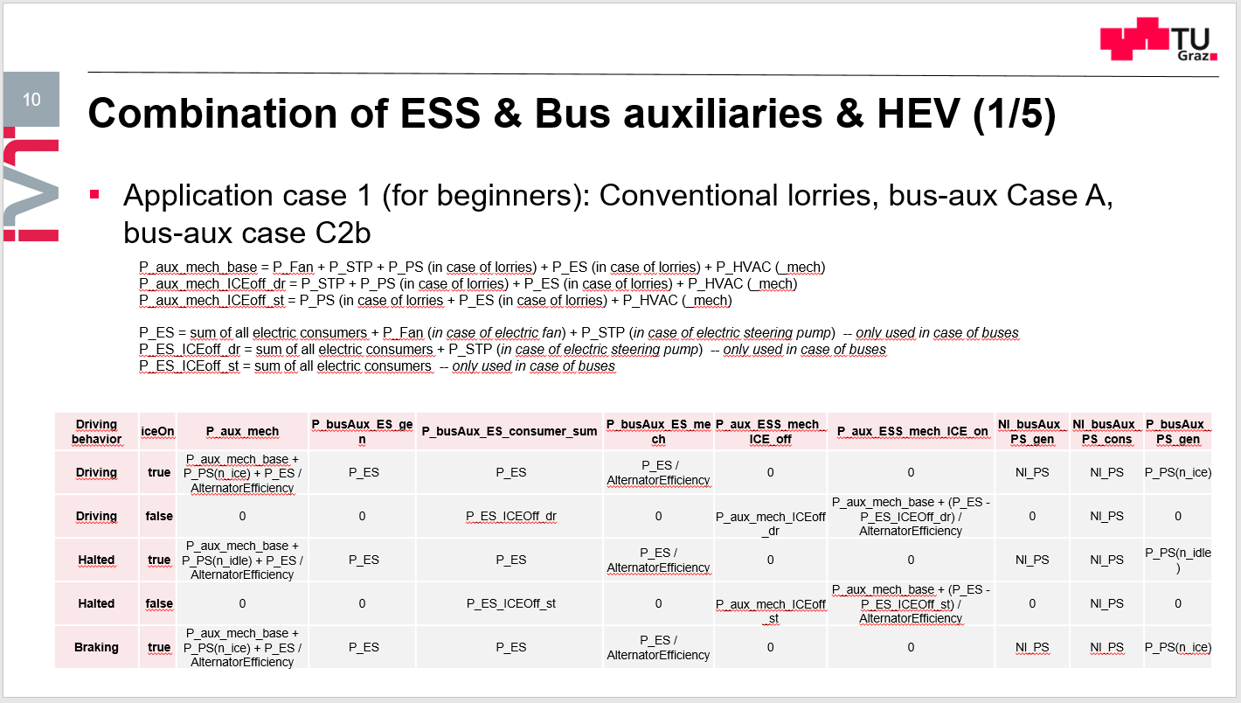
DECL Lorries – Generic parameterisation of auxiliaries
General remark about post-processing of “missing” auxiliary power demand for mechanically driven auxiliaries in timesteps where the ICE is off:
These topic is related to “Utility Factor (UF) for Engine-Stop-Start (ESS)”
For lorries only the very simple case is relevant (application case 1)
Basic rule: for auxiliaries operated independently of ICE status energy demand over cycle is the same with missing portion being accounted for in post-processing
For further details please refer to: VECTO-DEV WS#6 12.07.2021 (slide 7ff)

Slide 154


DECL Lorries – Generic parametrisation P-HEV strategy
Operation in Charge sustaining (CS) mode
Fixed number of 3 simulations to determine optimal strategy parameters done automatically
1st run: generic start value for equivalence factor (EF) depending on vehicle group, mission, payload and usable SOC range applied
refer to \Declaration\HEVParameters\Lorry\HEV_Strategy_Parameters_fequiv_XXsoc.csv
XX = 10, 20 or 40 depending on usable SOC range in percent (interpolation, no extrapolation)
2nd run: from resulting ∆SOC₁ of 1st run (∆SOC = SOC_{End} – SOC_{Start}) new EF is calculated according to following equations:
3rd run: from resulting ∆SOC₂ of 2nd run new equivalence factor is calculated according to following equation:
For further details please refer to: VECTO-DEV WS#8 16.11.2021 (slide 7ff)
$$f_{equiv_2}=f_{equiv_1}−\frac{{∆SOC}_{1}}{k}$$
with
$${k=k}_{0.4}+0.2∗({SOC}_{usable}−0.4)$$
equivalence factor used in 1st simulation run
refer to \Declaration\HEVParameters\Lorry\Gradient_40.csv

Slide 155
DECL Lorries – Generic parametrisation P-HEV strategy
Operation in Charge sustaining (CS) mode
Dedicated GUI feature available in order to overrule 3 iterations and perform calculation with single individual EF only (for engineering exercise)
Instructions:
Copy files from “\Declaration\HEVParameters\Lorry\HEV_Strategy_Parameters_fequiv_XXsoc.csv” to “\Declaration\Override\” without adding any sub-directories
Adapt respective values for individual EF in files (per vehicle group, mission profile and payload) → 1st value for low loading, 2nd for reference loading
vehiclegroup | longhaul | regionaldelivery | urbandelivery | municipalutility | construction
53 |  | 2.6/2.3 | 2.7/2.3
54 |  | 2.6/2.3 | 2.7/2.3
1s |  | 2.6/2.3 | 2.7/2.3
1 |  | 2.6/2.3 | 2.7/2.3
2 | 0.1/0.1 | 2.6/2.3 | 2.7/2.3
3 |  | 2.6/2.3 | 2.7/2.3
4 | 1.4/1.3 | 2.2/2.6 | 1.9/2.3 | 2.1/2.1 | 2.1/2.1
5 | 1.4/1.3 | 2.2/2.6 | 1.9/2.3 |  | 2.1/2.1
… | … | … | … | … | …

Slide 156
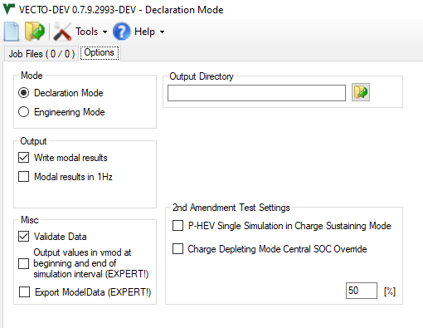
DECL Lorries – Generic parametrisation P-HEV strategy
Operation in Charge sustaining (CS) mode
Dedicated GUI feature available in order to overrule 3 iterations and perform calculation with single individual EF only (for engineering exercise)
Instructions:
Step 3: Activate GUI feature under “Options” tab to apply single run with individually set EF loaded from “\Declaration\Override\” folder
ATTENTION: Only loaded when VECTO is launched initially (updates during active VECTO session have no effect)!
To be checked: Handling of vehicles with very small batteries in LH (due to high amount of energy being captured at the very end of the cycle)

Slide 157
Updated P-HEV gear shift model (DECL + ENG)
Gear shift model for P-HEV used slightly wrong ICE operation point for evaluation of fuel costs → mainly relevant for overdrive drivetrain configurations → effect for non-overdrive drivetrains:
Typical LH application: from slight decrease <1% up to slight increase <1% of HEV FC
Typical dynamic (urban) application:
More realistic (higher) acceleration behavior and better following of speed trace like ICE-only counterpart
Still some percent decrease of FC of HEV compared to previous version
In actual simulation nothing was changed, the change only affects methods used for cost evaluation

Slide 158
Updated P-HEV gear shift model (DECL + ENG)
Class 4 vehicle on RD reference load;​
Gearbox with direct gear (3% higher η) and overdrive;
Much better results after the update compared to the previous implementation;​
Test​ | Consumption [-]​ | Direct gear usage [% time]​ | Overdrive gear usage [% time]​
ICE ​ | 1​ | 42%​ | 26%​
Direct + overdrive​ | 0.965​ | 7%​ | 68%​
Direct only​ | 0.895​ | 78%​ | -​
Direct + overdrive​ | 0.870​ | 57%​ | 12%​

Slide 159
Updated time-based with gear mode for AT (ENG only)​
Several manufacturers reported that the TC can be briefly active in higher gears – mainly during gearshifts;​
Allow input of "TC active" signal in vdri in this mode;​
Changes apply only in engineering mode. Included in the upcoming DEV release;​

Slide 160
DECL Lorries – Generic parametrisation usable SOC range
Actual SOC range used for simulation is determined according to 3 elements:
Generic SOC range for new vehicle
Defined separately for PEV, OVC-HEV, Non-OVC-HEV (NOVC-HEV)
Declared SOC range for new vehicle acc. to Annex III (P413 + P414)
Deterioration factor applied for half of lifetime
Preliminary assumption: 5% decrease of usable SOC range (i.e. 0.95 x SOC-range of new vehicle)
Preliminary figures in table below:
Further discussions regarding final values ongoing → see separate agenda point

Slide 161
DECL Lorries – Separate approach „CD mode“ simulation
„Frozen“ SOC (infinity battery) at „SOC_{center}“ applied (i.e. average of actual SOC_{max} and SOC_{min}) → see previous slide
GUI feature to set frozen SOC to other values than „center SOC“ (see figure)
Value needs to be between actual SOC_{max} and SOC_{min} for each individual battery installed
Influence factors on result:
Limitation of maximum battery power = f(SOC)
Internal resistance = f(SOC) (i.e. battery losses)
Discussions ongoing which SOC level(s) shall be considered for final method → see separate agenda point

Slide 162
DECL Lorries – Calculation EC at “battery terminals”
Case PEV:
Only re-charging in depot relevant for charging losses (since no detailled information in charging behaviour is available)
Power level for determining charging losses in battery defined by following equation: nominal charging power in kW = max(10, (usable SOC in kWh) / 6h)
Usable SOC is determined by integration of OCV-data from actual SOC_{min} to SOC_{max}
Charging efficiency is determined as follows:
Nominal charging current: Charging power above is divided by OCV at SOC_{center} (i.e. average of actual SOC_{max} and SOC_{min})
Charging losses: nominal charging current and internal resistance at SOC_{center}
Charging efficiency: 1 – (charging losses / charging power)

Slide 163
DECL Lorries – Calculation EC at “battery terminals”
Case OVC-HEV :
Charging in depot as well as stationary during mission (acc. to generic usage data) relevant for charging losses
Power level for determining charging losses in battery defined as follows:
Depot:
same as for PEV (see previous slide)
but limited with declared maximum charging power acc. to Annex III (P402)
Stationary during mission:
determined from matrix of generic usage data as already defined for OVC-UF calculation (function of vehicle group and mission profile)
limited with declared maximum charging power acc. to Annex III (P402)
2 separate values of charging efficiency determined as described on previous slide
→ weighted averaging by amount of charged energy for depot and stationary during mission to determine final charging efficiency

Slide 164
DECL Lorries – Calculation EC at “battery terminals”
Case OVC-HEV calculation example:
Charging power levels: Depot 10 kW / Stationary during mission 250 kW
Battery related data and charging currents:
Charging losses and efficiencies:
Weighted final charging efficiency:
Energy charged in depot limited by:
Usable battery capacity
Real world usage factor (0.75)
Energy charged during mission limited by:
Max. charging power
Duration of event
Usable battery capacity
Number of charging events
Real world usage factor (0.5)

Slide 165
DECL Lorries – Calculation EC at “battery terminals”
For further details please refer to: VECTO-DEV WS#9 11.01.2022 (slide 23ff)
Excel will be distributed together with meeting material

Slide 166
DECL Lorries – Automation of OVC-HEV simulation
OVC-HEV are HEV with external charging feature (“Plug-in HEV”)
Declared acc. to Annex III (P401)
2 operation modes for OVC-HEV defined in VECTO:
Charge depleting mode (CD) where the propulsion energy is provided by the electric storage only → results: kWh_el/km, electric range
Charge sustaining mode (CS) where the propulsion energy is provided by the fuel storage → SOC is balanced over complete cycle, thus no electric energy consumption (kWh_el/km = 0 per definition!)

Slide 167
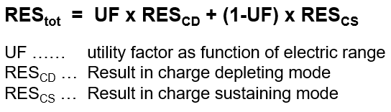
DECL Lorries – Automation of OVC-HEV simulation
Separate simulation runs are performed in VECTO for each mode automatically
Separate results for CD and CS are weighted for final result based on utility factor (UF)
UF is defined as share of electric range in CD mode on total daily mileage of each mission profile
electric range is defined by:
Electric energy consumption in the specific mission in [kWh/km] as result from the simulation
Usable electric energy, which in turn is defined by:
battery capacity due to initial SOC
generic assumptions for re-charging during each mission (number and duration of charging events, available charging power from infrastructure)
Weighted results (fuel or energy consumption) are calculated according to the following equation:

Slide 168
DECL Lorries – Range calculations
Overview of different ranges in result matrix in VECTO
Electric range | Definition
Actual charge depleting range (R_{CDA}) | The range that can be driven in charge depleting mode based on the usable amount of REESS energy, without any interim charging. (Annex IV)
Equivalent all electric range (EAER) | The part of the actual charge depleting range that can be attributed to the use of electric energy from the REESS, i.e. without any energy provided by the non-electric propulsion energy storage system. (Annex IV) i.e. R_{CDA} mathematically reduced by energy content of fuel used (based on fuel consumption in charge sustaining mode)
Zero CO₂ emissions range (ZCER) | The range that can be attributed to energy provided by propulsion energy storage systems considered with zero CO₂ impact. (Annex IV)
for PEV
for OVC-HEV

Slide 169
DECL Lorries – Automation of OVC-HEV simulation
Schematic overview of result matrix in VECTO for CD + CS mode
For further details please refer to: VECTO-DEV WS#13 04.07.2022 (slide 12ff)
Comments:
General structure given by XML schema structure
The "final results" for each mission profile and payload case are always output in the XML element "Total"
FC, CO2, EC in XML element "Total“ are weighted with UF
Ranges in XML element "Total“ are identical to results from CD mode for OVC-HEV
Zero CO2 emissions range equals EAER for OVC-HEV

Slide 170
DECL Lorries – Automation of OVC-HEV simulation - EX
Declared / Component data
„Raw“ results by VECTO
Calculation of different specific ranges from data above
Relevant for CO2 Standards Regulation, not for weighting of CD+CS results

Slide 171
DECL Lorries – Automation of OVC-HEV simulation - EX
Generic data
Calculation of UF specific ranges from consumption figures (previous slide) and generic data above
R_{CDA} corrected by real world factor
Due to re-charging during mission
Calculation of UF as share of electric range in CD mode on total daily mileage (163.9 + 32.0 = 195.8 / 480)

Slide 172
DECL Lorries – Generic e-PTO in MUN cycle
e-PTO applied for PEV and S-HEV in the MUN cycle (generic refuse body)
e-PTO cycle P_{el,PTO} = f(t) derived from:
generic hydraulic pump cycle for ICE and the allocated ICE high idle speed
assuming an average e-PTO efficiency of 80%
Calculation is included time-resolved in the vmod file
Electric energy consumption is considered in electric range for MUN cyle

Slide 173
DECL Lorries – Known issues with current version
Elements not yet implemented
Battery connectors / junction box not included → define and implement generic additional resistances (i.e. loss factors)
Generic P-HEV strategy: → To be tested whether an alternative post-processing method for vehicles with very small batteries is needed as back-up
Technical elements as resulting from the revision of the CO₂ Standards to be added
Sub-group allocation for the for the newly covered vehicle groups
Generation of weighted results for vocational vehicles
Elements still under discussion
Medium lorries mission profile and payload weighting factors (equally weighted, only preliminary)
Generic SOC min/max ranges and deterioration (only preliminary values)
Multiple SOC level(s) for VECTO PEV simulation and respective weighting of results

Slide 174
DECL Lorries – Testing requests and organ. of feedback
Testing requests:
Test configurations relevant in your portfolio
Specific analysis regarding open issues as mentioned on slide “Known issues with current version”
Feedback
Bug reports, questions etc.: please ONLY use JIRA (no specific emails regarding those topics in the upcoming period)
If there is an urgent need for a meeting before the next DEV workshop (e.g. because of a special problem), this will be announced separately.
Bug fixing and support
TUG will focus on finalising the DECL for buses in the coming weeks.
Topics for the DECL for lorries will be collected and sorted by priority.
Unless urgent bugfix releases for blocking issues, there will be no new release before May.

Slide 175
Vecto 0.7.9.2864 JRC Development Version November 2022
Important Note This is a special development release by JRC to validate the time-runs for BEVs.
Changes
Implementation of measured speed cycle for BEVs (E2, E3, E4, IEPC)
Implementation of measured speed with gear for BEVs (E2, IEPC)
Implementation of Pwheel mode for BEVs (E2, E3, E4, IEPC) In this type of cycle, the input field <n> stands for the speed of the electric motor.
The E2 vehicle job “Generic Vehicles\Engineering Mode\GenericVehicleE2\BEV_ENG_timeruns.vecto” is preconfigured to run time-run cycles.

Slide 176
Vecto 0.7.9.2741 Development Version June 2022
Changes/Bugfixes
Implementation of IEPC
Implementation of IEPC-S
Implementation of IHPC
Adaptations HEV-S strategy, SoC correction for HEV-S
PTO idle drag losses for PEV, adapting PTO idle losses according to 2nd amendment
Bugfixes
Hashing tool crashes in .net version 6.0
Corrected length for BusAux volume calculation

Slide 177
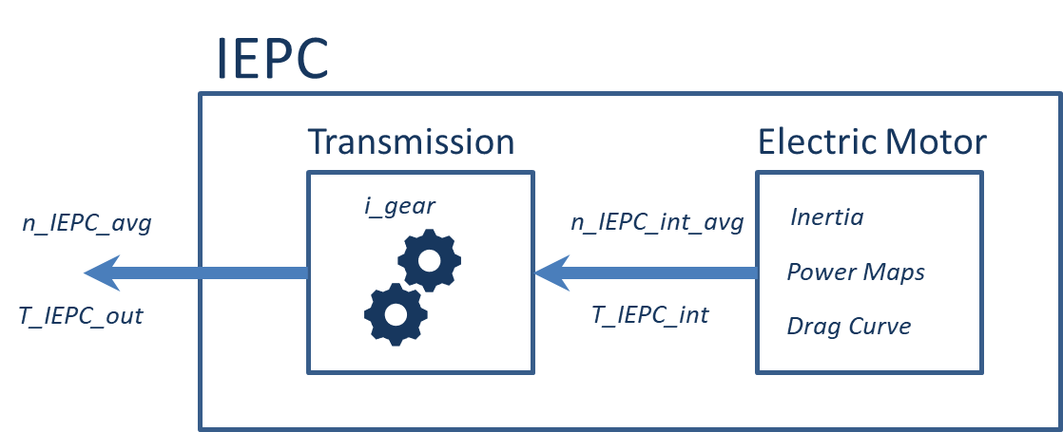
Modeling of IEPC component
IEPC is modelled as APT-N transmission and electric machine
Using already available models, same shift strategy as for E2/S2
Simplified transmission in case of single-speed IEPC
_int signals refer to the out-shaft of the electric motor

Slide 178
Peculiarities of IEPC
Model parameters (max torque, power maps) refer to IEPC out-shaft
Internally converted to electric motor
Overload parameters are measured in the gear with the ratio closest to 1
2 options for drag curve acc. to Annex Xb:
A single drag curve is provided (measured in gear with ratio closest to 1)
Drag curve for every gear is provided

Slide 179
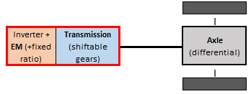
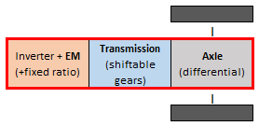
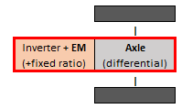
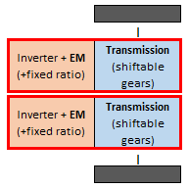
Input data for IEPC component
IEPC powertrain architecture definition
Specific system layout is described by setting of 3 parameters (for detailed description please refer to Annex Xb)
IEPC layout case # | Differential Included | DesignType WheelMotor | DesignTypeWheel MotorMeasured | Layout schematics | Comments
1 | No | No | n.a. |  | Regular axle component required in job file → useage of transmission type „IEPC Transmission – dummy entry“ (allows axle component alone without a min. number of gears)
2 | Yes | No | n.a. |  | No axle component All parameterization via IEPC specific window
3 | No | Yes | 1 |  | Component test performed in L-config acc. to Annex Xb (only one side) → All torque and power values in input data are multiplied with a factor of 2
4 | No | Yes | 2 |  | Component test performed in T-config acc. to Annex Xb (both sides)

Slide 180
Input data for IEPC component
IEPC General parameters
Parameter name | Description
RotationalInertia | For EM inertia, gearbox parts not to be considered (as for regular transmission components). Reference point for definition of inertia is EM output shaft. Determined in accordance with point 8 of Appendix 8 of Annex Xb.
DifferentialIncluded | Set to ‘true’ in the case a differential is part of the IEPC
DesignTypeWheelMotor | Set to ‘true’ in the case of an IEPC design type wheel motor
DesignTypeWheelMotorMeasured | Input only relevant in the case of an IEPC design type wheel motor, in accordance with paragraph 4.1.1.2 of Annex Xb. Allowed values: ‘1’, ‘2’

Slide 181
Input data for IEPC component
IEPC performance parameters
Parameter name | Description
Gear data | For each gear: number, ratio, MaxOutputShaftTorque (optional), MaxOutputShaftSpeed (optional)
Overload data | Overload and Continuous operation point and Overload Time For each voltage level separately Measured in gear closest to ratio 1 acc. to Annex Xb
Max/min torque limits | Full load curve (only for one gear closest to ratio 1 acc. to Annex Xb) For each voltage level separately
Drag torque | Only for one voltage level acc. to Annex Xb
Electric power maps | For each gear For each voltage level separately

Slide 182
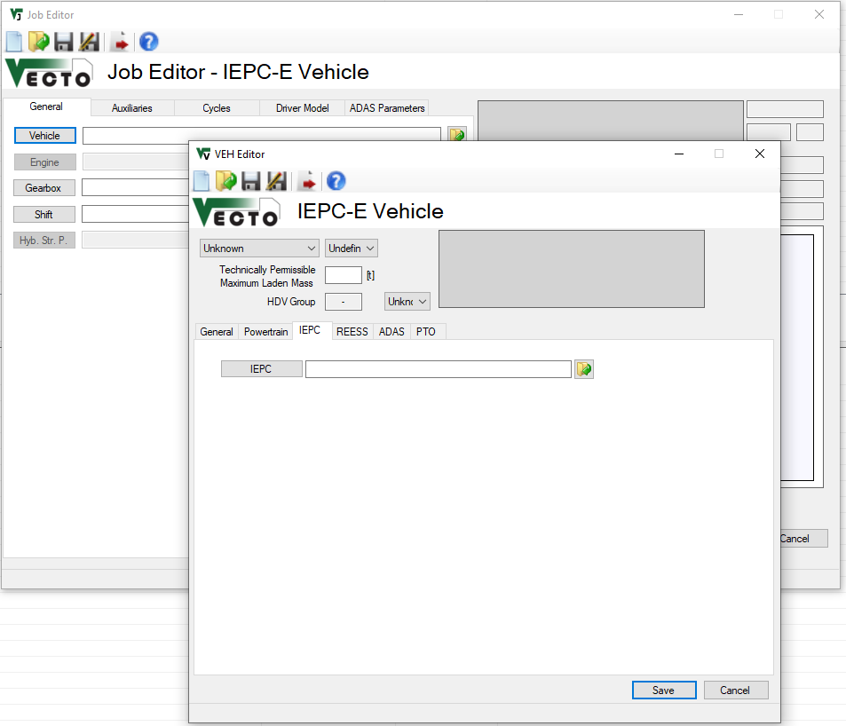
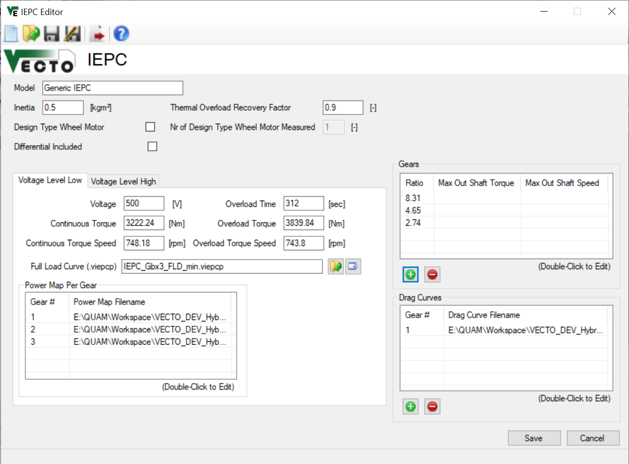
IEPC Input Form
Click for specific IEPC GUI-window
Definition of IEPC component via “Vehicle \ IEPC-Tab”
Lists with gear entries are synchronized, gears can be added/removed in the gear-list on the right

Slide 183
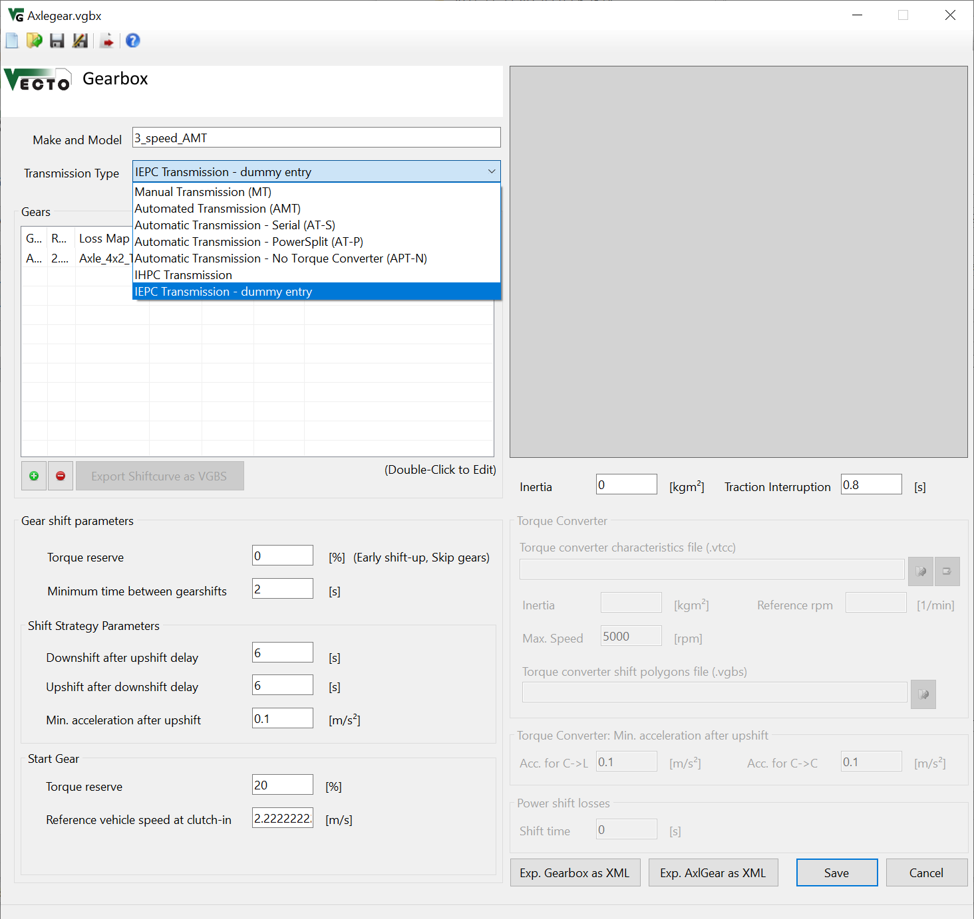
Gearbox Form for IEPC Vehicles
No gearbox file needs to be provided for IEPC with differential included (case 2)
New IEPC gearbox type for all other variants where only the axlegear ratio needs to be provided
Specific Gearbox Type for IEPC. Only requires axlegear to be provided

Slide 184
Modeling of IHPC component
IHPC transmission is modeled as APT-N
IHPC electric motor is modeled as regular electric motor at position P2
Gear-dependent power maps
Peculiarities of IHPC
Drag-curve shall be set to 0 Nm acc. to Annex Xb
For detailed description of component characteristics as well as testing and measurement post-processing methods please refer to Annex Xb

Slide 185
Input data for IHPC component
IHPC general parameters EM (same as for basic EM component)
Parameter name | Description
RotationalInertia | For EM inertia, gearbox parts not to be considered (as for regular transmission components). Reference point for definition of inertia is EM output shaft. Determined in accordance with point 8 of Appendix 8 of Annex Xb.

Slide 186
Input data for IHPC component
IHPC performance parameters EM → same as for basic EM component, except multiple El. power maps
Parameter name | Description
Gear data | For each gear: number (needs to match with specifications in gearbox file)
Overload data | Overload and Continuous operation point and Overload Time For each voltage level separately Measured in gear closest to ratio 1 acc. to Annex Xb
Max/min torque limits | Full load curve (only for one gear closest to ratio 1 acc. to Annex Xb) For each voltage level separately
Drag torque | NOT MEASURED acc. to Annex Xb, but input of “0 Nm” drag torque reqired!
Electric power maps | For each gear For each voltage level separately

Slide 187
Input data for IHPC component
IHPC parameters Gearbox → same as for basic transmission component → transmission type needs to be set to ”IHPC Transmission”
Parameter name | Description
Gear identifier | For each gear (number needs to match with specifications in IHPC file) → Regular axle component to be specified as well
Ratio | For each gear → Regular axle component to be specified as well
Loss Map | For each gear → Methodology how to derive data acc. to Annex Xb (esp. braking side needs to be measured separately as well – as opposed to copy-paste for regular transmission testing) → Regular axle component to be specified as well

Slide 188
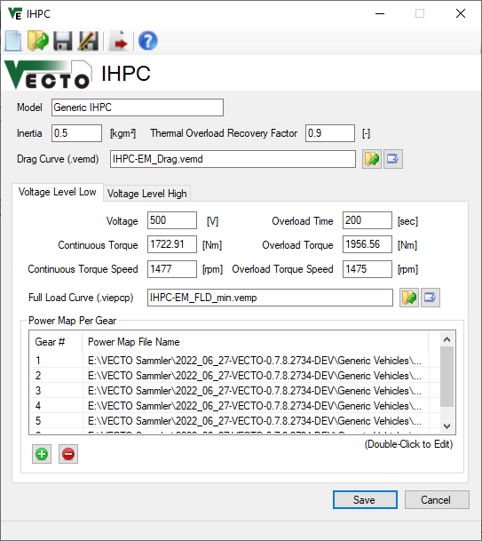
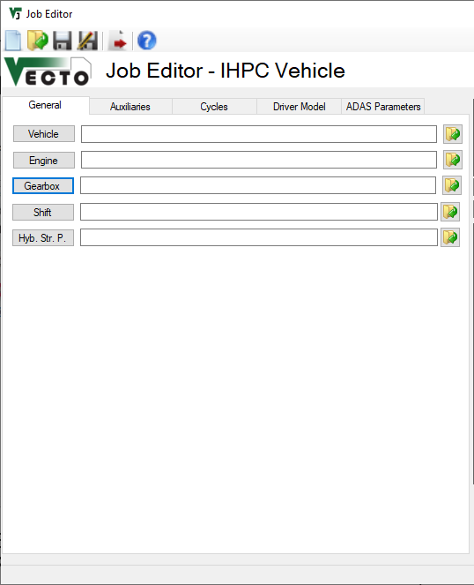
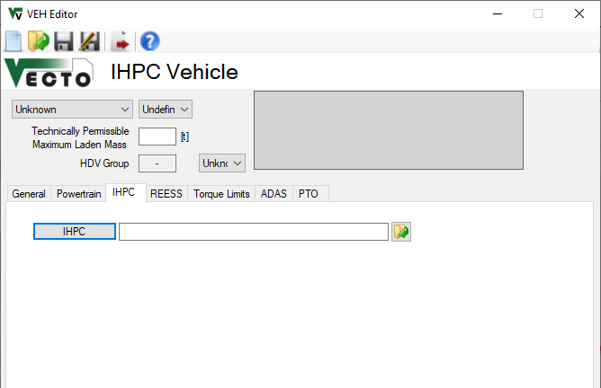
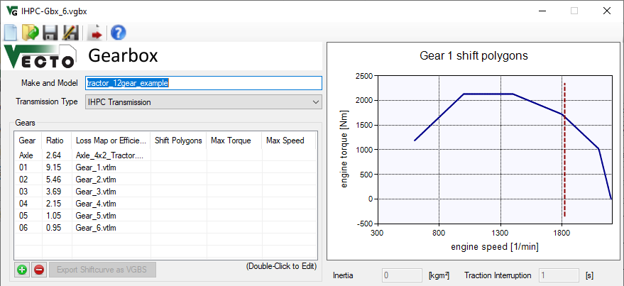
IHPC Input Form
Item #1: IHPC-EM
item #1
Item #1: IHPC-EM
Click for specific IHPC GUI-window
Item #2: IHPC-Gearbox
Number of gears need to match
item #2
Definition of IHPC component as two separate component parts via #1: “Vehicle \ IHPC-Tab”
#2: “Gearbox”
Item #2: IHPC-Gearbox

Slide 189

Adaptations Serial Hybrid Strategy (1/3)
Observation: GenSet often switching between optimal and maximum power, while operating constantly at optimal power would be sufficient

Slide 190


Adaptations Serial Hybrid Strategy (2/3)
Minor changes in Serial Hybrid Strategy
GenSet is switched on as soon as SoC falls below SoC_min
GenSet is switched off as soon as SoC reaches SoC_target
GenSet operation points P_opt and P_max:
In total 4 points defined, for GenSet in regular and in de-rating condition
SoC_min ≤ SoC < SOC_target: P_opt
SoC < SoC_min:
requested el. power > P_opt: GENSET @ P_max
requested el. power ≤ P_opt: GENSET @ P_opt
Note: SoC_min shall be above battery’s min SoC

Slide 191

Adaptations Serial Hybrid Strategy (3/3)
GenSet now always operates in optimal point
Speed profile is unchanged, SoC trace slightly different

Slide 192




SoC Correction for HEV-S
REESS SoC for HEV is corrected using the engine line
Engine line makes no sense for HEV-S as the ICE is decoupled from the drivetrain and operates only in certain points
SoC Correction:
… in case the GenSet was on during the simulation
… in case the GenSet was not on during the simulation

Slide 193
Vecto 0.7.8.2679 Development Version April 2022
Changes/Bugfixes
Multi-Target Executables in .net 6.0 and .net Framework 4.8 (and .net Framework 4.5, but this will be removed with the next release)
Implementation Serial Hybrid Vehicles S2, S3, S4
Implementation APT-S/P with E2 and S2 vehicle architecture
Correct handling of retarder positions with HEV and PEV, adding axlegear input retarder option
Update hashing tool to handle new powertrain components (electric motor, battery, supercap)
Changing EM overload buffer calculation: interpolate between both voltage levels (pre-processing)
Handling of torque limitations (engine torque limit, boosting torque limits, gearbox torque limits) for P2 architecture
Connect electric WHR system to REESS in case of hybrid vehicles
Update LH cycle
GUI improvements: enable/disable some fields in Job Form, Vehicle Form, and Hybrid Strategy Parameters to simplify user interface and avoid erratic entries.

Slide 194
Serial Hybrid Implementation
General approach
Simple operating strategy, not ECMS–based
Three-point controller for GenSet (off/optimal point/maximum power)
Operate GenSet in optimal load-points whenever required and possible
Drivetrain similar to PEV

Slide 195
Serial Hybrids: GenSet Pre-Processing
Find optimal points for the GenSet
Iterate from 0 to maximum power of the ICE (20 steps)
Iterate from ICE idle speed to n_{95h} speed (20 steps)
Calculate electric power and fuel consumption for all load-points
Select operating points:
Maximum electric power, EM de-rated/not de-rated
Optimal operating point (minimum FC per electric power generated), EM de-rated/not de-rated

Slide 196


Serial Hybrid Strategy (main principles)
Calculate max. electric power GenSet can provide
Calculate power demand of electric motor, assuming max. electric power (REESS + GenSet)
Depending on drivetrain power demand and SoC turn on ICE and operate GenSet either in optimal point or at maximum power (considering de-rating of GenSet)
Note: SoC_min and SoC_target are parameters of the SerialHybridStrategy, not REESS

Slide 197
Serial Hybrids: GenSet
When switching on the ICE, it is often not possible to directly operate it in the desired operating point (high ICE speed, too high torque demand due to inertia) ➔ Ramp-up ICE with electric machine switched off (usually 1 or 2 simulation steps) and then turn on the electric machine

Slide 198
Serial Hybrid Strategy Parameters
MinSoC
TargetSoC

Slide 199


Slide 200

EM: overload buffer calculated from both voltage levels
Input parameters of EM measured for min and max voltage level
Overload data
Continuous Torque
Overload Torque + Overload Duration
Maximum and Minimum torque limitations
Electric power map
Implementation in software:
From overload data above, thermal buffer is calculated for each voltage level separately (acc. to equations in VECTO user manual )
Applied values for simulation run are calculated by linear interpolation between two voltage levels, where average of usable SOC range is used
Overload buffer
Maximum and Minimum torque limitations
Continuous Torque

Slide 201


Consider gearbox MaxTorque limits for HEV
Ref. to ticket nr. 1478+1479
Only relevant for P1 + P2 HEV where EM is located upstream of transmission
Starting Point: ICE FLD
Crop with max ICE torque declared at vehicle level (per gear) ‘Vehicle/EngineTorqueLimits’ per gear – P196 + P197
Add boosting torque Boosting limitations for parallel HEV – P415 + P416
In case of P1 or P2: crop with gearbox max input torque (per gear) MaxTorque – P157
➔ Torque limits per gear applied by HybridStrategy
Example for P2

Slide 202
Vecto 0.7.8.xxx Development Version April 2022
Detailed Changes/Bugfixes (See CITnet/Jira)
[VECTO-1541] - Implement E2/S2 with APT-S/P
[VECTO-1549] - Error in gearshift behavior for AT transmissions when braking
[VECTO-1466] - 076.2451 E2 significant increase of calculation time
[VECTO-1479] - Maximum gearbox torque not respected
[VECTO-1519] - 077.2457 E2 Gear oscillation
[VECTO-1520] - 077.2457 P2 Crashing at takeoff
[VECTO-1531] - ElectricMotor Lookup Maximum Torque: Object reference not set to an instance of an object
[VECTO-1532] - 077.2547 P2 crashing with 600 RPM idling speed
[VECTO-1539] - Engine speed ramping up before vehicle halt
[VECTO-1551] - AT-P Transmission Bus Application: Error during braking phase
[VECTO-1559] - battery internal resistance curve
[VECTO-1411] - Switching to new .NET version
[VECTO-1456] - Cycle Cache in engineering mode
[VECTO-1478] - Torque limits only apply to ICE
[VECTO-1521] - Updating tyre dimensions
[VECTO-1522] - VECTO warning if there are more steered axles than steering pump technologies

Slide 203
Vecto 0.7.8.xxx Development Version April 2022
Detailed Changes/Bugfixes (See CITnet/Jira)
[VECTO-1525] - PCC Preprocessing
[VECTO-1533] - Multi-Target Compilation and .NET Upgrade
[VECTO-1538] - Transmission ratios limitation of input value to <=25
[VECTO-1540] - Retarder Types AxleGearInputRetarder
[VECTO-1543] - Calculation of EM Overload buffer, and continuous torque
[VECTO-1545] - WHR electric - connect to REESS
[VECTO-1548] - Update Coach cycle
[VECTO-1560] - update toolchain for generating usermanual
[VECTO-1562] - Adapting WHTC Correction Factor weighting for LH Cycle
[VECTO-1563] - Electric Motor: Calculation of Overload Buffer
[VECTO-1564] - XML Schema adaptations
[VECTO-1565] - VECTO warning if there are more steered axles than steering pump technologies
[VECTO-1569] - Bugfix: Extrapolation warning in PEV shift strategy
[VECTO-1573] - Update LH Cycle and WHTC correction factor weighting

Slide 204
Vecto 0.7.7.2547 Development Version December 2021
Changes/Bugfixes
Implementation APT-N Gearbox + shift strategy
Update EM model (drag curve independent of voltage level)
Update EM electric power map interpolation method
Update user manual
Update/bugfixes PEV shift strategy (influence of drag curve, error in calculation of costs)
Bugfix calculation E_EM_off_loss
Update generic shift lines for PEV E2
Bugfix post-processing fuel consumption correction bus auxiliaries (in case of no alternator)
Bugfixes PCC for xEV

Slide 205
Vecto 0.7.7.2547 Development Version December 2021
General comments (1/x)
All topics in this section will also be explained in the next xEV workshop #9 on 11.01.2022
Also topics for testing and feedback will be discussed in this workshop. Until then, no feedback on the distributed version is expected.
Calculation of overload buffer for EM
Overload buffer is currently calculated with data for lower voltage level only
Update of calculation method based on two voltage levels will be implemented once all details reg. the method are clarified
Propulsion Torque Limits (Vehicle Boosting Limits)
In the rotational speed range from 0 to engine idling speed the full load torque available from the ICE equals the ICE full load torque at engine idling speed due to the modelling of the clutch behaviour during vehicle starts.
Any arbitrary number of values may be declared in between the range of zero and the maximum rotational speed of the ICE full load curve.
Declared values lower than zero are not allowed for the additional torque.
For detailed explanation refer to user manual (“Vehicle Editor – Torque Limits Tab”, “Torque and Speed Limitations”)
Pulse-duration dependency of internal resistance of battery
For detailed explanation refer to user manual
HEV operation strategy method for declaration mode
Method explained in “User Manual/HEV_DECL_method_20211221.pptx” distributed together with VECTO archive
Generic values defined per (vehicle group, mission, payload and usable SOC range) in “User Manual/HEV_Strategy_Parameters.xlsx” distributed together with VECTO archive
For further details refer to distributed material/recording from xEV workshop #8

Slide 206

Vecto 0.7.7.2547 Development Version December 2021
General comments (2/x)
Auxiliaries for PEV
Electric power demand of auxiliaries for both, lorries and buses, need to be parameterized via the “BusAux” GUI window
Gearshift model for PEV
Details explained on next slides
Demand during vehicle driving
Demand during vehicle standstill

Slide 207
Vecto 0.7.7.2547 Development Version December 2021
Gearshift model for PEV (1/x)
Basics:
Downshift for operation point left of green dot-dashed downshift lines
Upshift for operation point right of green dot-dashed upshift line
EffShift method applied for operation point between downshift and upshift lines (refer to user manual)
Driving:
Maximum downshift speed always located at n_P80low (where 80% of max power is available)
For EM in de-rating n_P80low is calculated from the de-rated power curve
Braking:
EffShift is suppressed for operation point within red shaded area (2% below max recuperation power)
New gear after downshift is selected so that operation point is closest to and above n_brake_target_norm (or only closest to n_brake_target_norm in case no operation point with higher speed exists)

Slide 208
Vecto 0.7.7.2547 Development Version December 2021
Gearshift model for PEV (2/x)
All factors in bold red can be tuned via shift parameter file .vtcu
Refer to sample file for User Manual/PEV_ShiftParameters.vtcu distributed together with VECTO archive

Slide 209
Vecto 0.7.7.2547 Development Version December 2021
Detailed Changes/Bugfixes (see CITnet/JIRA)
[VECTO-1460] - APT-N Gearbox
[VECTO-1501] - Update EM Map interpolation method
[VECTO-1477] - Update user manual
[VECTO-1383] - E2 PEV, 2-speed AMT: "Failed to find operating point"
[VECTO-1384] - E2 PEV, 2-speed AMT: Downshifts missing
[VECTO-1414] - E2 selects high gear at low speed after take-off, does not reach target acc
[VECTO-1443] - 0.7.5.2356 EC_el_final calculated from REESS terminal signals
[VECTO-1445] - 073.2356, E2 Missing Downshifts, simulation abort
[VECTO-1464] - Engine Off not working with activated PCC (Hybrid Vehicles)
[VECTO-1465] - PEV PCCState oscillates between Interrupt and UseCase1
[VECTO-1467] - PCC HEV Small Spike at end of UseCase1 when Target speed is reached
[VECTO-1468] - EM map interpolation comments
[VECTO-1470] - 076.2463 EM drag torque questions/findings
[VECTO-1482] - Hybrid Vehicle EM speed gets very high, no gearshift
[VECTO-1483] - Job aborting: E4_Group 5 LH_ll_LongHaul_mod5_id_2
[VECTO-1484] - Job aborting: P2_Group5_s2c0_rep_Payload_LongHaul_mod5_id_27
[VECTO-1486] - NG PI fuel type not working with Engine GUI (.veng) in Engineering Mode
[VECTO-1487] - Calculation of EM efficiency during recuperation
[VECTO-1490] - Exceeded max iterations: Operating Point could not be found

Slide 210
Vecto 0.7.7.2547 Development Version December 2021
Detailed Changes/Bugfixes (see CITnet/JIRA)
[VECTO-1491] - Electric Energy Storage Editor does not show values
[VECTO-1499] - Energy balance when ICE is turned on in a P1 hybrid configuration
[VECTO-1514] - Modeldata uses wrong inertia in case multiple EMs are used on a position
[VECTO-1515] - Output in vsum file
[VECTO-1516] - GUI: PEV vehicle, disable hybrid parameters
[VECTO-1489] - Engine-off eco-roll for P1 hybrids
[VECTO-1448] - 075.2356, E2 Selecting high gear in downhill, needs to use wheel brakes
[VECTO-1472] - Do not end PCC if acceleration is still high enough
[VECTO-1473] - Additional tyre dimensions
[VECTO-1476] - Update EM GUI, EM component
[VECTO-1493] - Use EngineStartStop in PCC-Events for Hybrid P1
[VECTO-1498] - Crosswind correction in engineering mode
[VECTO-1508] - EM-Off Losses in .vsum
[VECTO-1509] - SP Technology "Electric" already contains mechanical power demand
[VECTO-1510] - Remove selection of shift strategy in job dialog
[VECTO-1511] - Error Message for "HEVs and BEVs not supported in Declaration Mode"
[VECTO-1512] - Adapt shift lines for xEV vehicles
[VECTO-1513] - Bus Aux post-processing correction
[VECTO-1481] - New warning message regarding transmission: what does it mean?

Slide 211
Vecto 0.7.6.2451 Development Version September 2021
Changes
ADAS for HEV and PEV vehicles
For HEV vehicles interaction of PCC and HEV strategy under further analysis
Update electric motor model: support for different voltage levels
Update battery model: modular battery components
Update battery model: pulse-duration dependent internal resistance
Bugfixes

Slide 212
Vecto 0.7.5.2353 Development Version June 2021
Changes
Bugfixes in shift strategy for PEV (E2)
Additional Powertrain architectures
P1 AMT and APT-S/P
P2.5 (transmission ratio EM per gear)
P3 & P4 with APT transmissions
Loss-map for electric machine
Bus auxiliaries in engineering mode
Combine Bus auxiliaries with HEV powertrains
Refactoring Engine Stop/Start approach
ICE is always off during simulation, balance missing energy in case ICE is on / ICE is off for all auxiliaries in .vmod.
Correct for missing aux energy in post-processing (not fully implemented in this version)
Added vehicle propulsion limits (relative to ICE max torque)
P2, P3, and P4
Refactored EM model: continuous torque, overload torque as separate inputs

Slide 213
Vecto 0.7.3.2164 Development Version December 2020
Changes
Bugfixes in shift strategy for PEV (E2)
Refined electric motor model: model transmission stage of electric machine as individual sub-component instead of transforming the maps. Adapted columns in .vmod and .vsum regarding electric machine. See user manual for details.
Bugfixes SuperCap model
Removed E_REESS from .vmod file, calculate delta_E_REESS from P_REESS in .vsum file

Slide 214
Vecto 0.7.2.2118 Development Version October 2020
Changes
Implementation of PEV architecture E2 with EffShift-like gearshift strategy
Bugfix REESS Dialog (.vimax)
Bugfix in output of EM overload output in .vmod file

Slide 215
Vecto 0.7.1.2108 Development Version October 2020
Changes
More stable operating point search hybrid strategy
Bugfixes hybrid strategy
Adding Super Cap as REESS
Adding electric machine thermal de-rating
Modified battery model: max charge/discharge current over state of charge
Improvements simulation time hybrid vehicles
Note: As the model data for electric machine and battery changed from the previous VECTO version for hybrid vehicles it is necessary to open the models and provide the newly added model parameters.

Slide 216
Vecto 0.7.0.2076 Development Version September 2020
Changes
This release is the first beta version with capabilities to simulate hybrid and battery electric vehicles.
It covers powertrain architectures “P2”, “P3”, “P4” for hybrid electric vehicles (HEV) and “E3”, “E4” for battery electric vehicles (PEV, pure electric vehicles).
The definitions of the powertrain architectures and other input parameters on vehicle level can be found in the document Input parameters vehicle level 20200907.docx. This document is an excerpt of working document 3 of the HDV CO2 Editing board. Items marked in red are not yet featured by the tool and will follow in the next releases.
Known limitations
Electric machine system overload feature not available – work in progress
Supercaps not implemented – work in progress
Engine Stop Start Utility Factor has to be set to 1 – further discussions in task force needed how UF-approach shall be aligned with hybrid control strategy
P_aux_el are electric auxiliaries connected to the high-voltage system. For hybrid electric vehicles this model parameter shall currently be set to 0. – further discussions in task force needed
APTs with HEV – to be implemented
Eco-roll and PCC not implemented

Slide 217
Vecto 0.6.1.1975 Development Version May 2020
Bugfixes
Change passenger density primary vehicle for IU cycle
primary vehicle: ignore TPMLM (to limit payload, do not abort simulation)
completed vehicle: limit total mass with TPMLM (abort simulation)
consider l_drivetrain. this length is subtracted from internal length for HVAC calculation only (bus volume for ventilation, max cooling capacity); completed vehicle
set alternator gear efficiency to 1 to align with lorries (currently 0.92)
electric system / radio: all vehicles are equipped with radio. modify consumed amps to consider 'usage factor' - updated already in master excel.
Update generic values for primary HF vehicles CdxA
HVAC: check/correct internal height for coaches (shall be 1.8m)
HVAC: subtract driver compartment from total volume for max cooling capacity passengers
HVAC: add configuration #10, add sanity checks (i.e. if driver AC is provided for configurations #2,
Steering pump power demand: tubing factor only applied for first steered axle (as the additionally steered axles are close to the engine and the distance is not known)
Allow enabling/disabling LAC in declaration mode via GUI (not persistent). Additional input on “Options” tab to set min activation speed
.vsum file: E_AUX_SUM matches sum of individual AUX entries; bugfix writing P_busAux_ES_mech
Update user manual on VTP cycle file format
APT gearbox (all gears) generic efficiency 0.925
retarder: set factor for generic retarder losses from 0.5 to 1 (i.e., use standardvalues)
VTP engineering mode - vsum actual CF different to declaration mode
Improvements
Switch GUI to 64bit mode (see VECTO-1270)
New normalization/denormalization method for generic engine FC-Map (see VECTO-1269)
.vsum-file: new entries P_ice_fcmap, P_wheel_in, k_vehline (previous k_vehline is now k_engline
Bus VTP: Fan Parameter C4
don't write CIF for primary vehicle

Slide 218
Vecto 0.6.1.1957 Development Version May 2020
Improvements
Declaration mode for complete and completed buses via “factor method”
VTP mode for heavy buses
VTP mode for dual-fuel vehicles (new cycle file required!)
“Single bus” mode with generic data from segmentation table completed vehicle (previous version used generic data from primary vehicle)
Adding highway sections on coach cycle (required for PCC)
New graphical user interface (VECTO3.exe) (alpha version!)
Creating & editing complete(d) bus XML
Creating & editing complete(d) bus job file (PIF + completed XML)
Creating & editing single bus job file (primary XML + completed XML)
Simulation of all types of VECTO jobs
Currently, other existing job files can not be edited in the new GUI – planned to be extended in future
Functionality similar to currently official VECTO version, for further information see separate user manual on new GUI
XML reports (MRF, CIF, PIF) according to draft Annex IV
Expert feature: allow adding torque converter data to PIF manually (not added by VECTO automatically) to investigate on generic TC data for APT-P (see generic vehicles for reference)
Expert feature: allow writing internal model data used for VECTO simulation as JSON file. Allows to compare model data between primary bus, completed bus generic body, completed bus specific body (factor method) as well as single bus

Slide 219
Vecto 0.6.1.1957 Development Version May 2020
Bugfixes heavy buses
Correcting power demand for engine fan
Consider electric auxiliaries (fan, steering pump) as electrical consumer
Correcting power demand pneumatic system with mechanical clutch
Correcting electrical consumers LED bonus
Correction for double compensation of smart electrics (battery & generated vs. consumed)
Correcting passenger count depending on HVAC configuration
Bugfixes medium lorries
New technologies for electric steering pump
New tyre xml supported
Bugfixes graphical user interface
New sample data VTP

Slide 220
Vecto 0.6.0.1908 Development Version March. 2020
Bugfixes
Consider vehicle’s max speed when validating input data, calculating velocity drop during traction interruption
Reading vehicle design speed (85km/h) from segment table (also related to vehicle’s max speed)
Fix JobEditor GUI – toolbar with icons not visible
Fix null-reference exception simulating vehicles in engineering mode

Slide 221
Vecto 0.6.0.1884 Development Version Feb. 2020
Improvements
Refactoring and bug fixes in bus auxiliaries model (former Ricardo AAUX model), parametrization of bus auxiliaries model (HVAC) from “primary bus” input data and generic values in segmentation matrix,
Support for P0 hybrids in bus auxiliaries model
Support for “primary bus” (declaration mode)
Support for “single bus” – combine input parameters of primary bus and completed bus to a single simulation (no factor method) (declaration mode)
Support for medium lorries
Support for vehicles with front-wheel drive (axlegear included in gearbox)
VTP Mode for medium lorries
New XML schema for new vehicle categories, adapted XML schema for generated reports (MRF, CIF, PIF)
This development version includes all features already included in version 0.5.0

Slide 222
Vecto 0.5.0 Development Version Dec. 2019
Improvements
Adding in-the-loop simulation of advanced driver assistant systems (ADAS)
Engine stop-start during vehicle stop
Eco-roll with and without engine stop
Predictive cruise control: dip coasting, crest coasting
Adding support for dual-fuel vehicles
Adding support for waste- / exhaust-heat recovery systems (electrical and mechanical)
New gear shift strategy (EffShift) for AMT and AT transmissions
Details on the new models, model parameters, and new signals in the output are described in the user manual

Slide 223
Vecto 3.3.10.2401 Official Release 2020-07-29
Improvements
Handling of exempted vehicles (not changed since release candidate) – see next slides for details
Bugfixes
No additional bugfixes compared to VECTO 3.3.10.2401

Slide 224
Vecto 3.3.10.2373 Release Candidate 2020-07-01
Improvements
[VECTO-1421] – Added vehicle sub-group (CO₂-standards to MRF and CIF)
[VECTO 1449] – Handling of exempted vehicles: See next slide for details
[VECTO-1404] – Corrected URL for CSS in MRF and CIF
Bugfixes
[VECTO-1419] – Simulation abort in urban cycle: failed to find operating point on search braking power with TC gear
[VECTO-1439] – Bugfix handling duplicate entries in engine full-load curve when intersecting with max-torque of gearbox
[VECTO-1429] – error in XML schema 2.x for exempted vehicles – MaxNetPower1/2 are optional input parameters

Slide 225
Vecto 3.3.10.2373 Release Candidate 2020-07-01
Handling of exempted vehicles
Axle configuration and sleeper cab are optional input parameters for exempted vehicles (XML schema 1.0 and 2.2.1).
OEMs are recommended to provide these parameters for exempted vehicles.
If the axle configuration is provided as input parameter, the MRF contains the vehicle group.
The sleeper cab input parameter is also part of the MRF if provided as input.
Input parameters MaxNetPower1/2 are optional input parameters for all exempted vehicles.
If provided in the input these parameters are part of the MRF for all exempted vehicle types
It is recommended that those parameters are used to specify the rated power also for PEV (pure electric vehicles)

Slide 226
Vecto 3.3.9.2175 Official Release 2020-12-15
Bugfixes (compared to version 3.3.9.2147)
[VECTO-1374] - VECTO VTP error – regression update

Slide 227
Vecto 3.3.9.2147 Release Candidate 2020-11-17
Bugfixes
[VECTO-1331] - VTP Mode does not function for vehicles of group 3
[VECTO-1355] - VTP Simulation Abort
[VECTO-1356] - PTO Losses not considered in VTP simulation
[VECTO-1361] - Torque Converter in use for the First and Second Gear VTP file does not allow for this
[VECTO-1372] - Deviation of CdxA Input vs. Output for HDV16
[VECTO-1374] - VECTO VTP error
Improvements
[VECTO-1360] - make unit tests execute in parallel

Slide 228
Vecto 3.3.8.2052 Official Release 2020-08-14
Bugfixes
No additional bugfixes compared to VECTO 3.3.8.2024

Slide 229
Vecto 3.3.8.2024 Release Candidate 2020-07-17
Bugfixes
[VECTO-1288] - Simulation Abort UD RL
[VECTO-1327] - Simulation abort Construction RefLoad: unexpected response ResponseOverload
[VECTO-1266] - Gear 4 Loss-Map was extrapolated

Slide 230
Vecto 3.3.7.1964 Official Release 2020-05-18
Bugfixes
[VECTO-1254] - Hashing method does not ignore certain XML attributes
[VECTO-1259] - Mission profile weighting factors for vehicles of group 16 are not correct

Slide 231
Vecto 3.3.6.1916 Official Release 2020-03-31
Bugfixes
[VECTO-1250] - Error creating new gearbox file from scratch

Slide 232
Vecto 3.3.6.1898 Release Candidate 2020-03-13
Improvement
[VECTO-1239] - Adaptation of Mission Profile Weighting Factors
[VECTO-1241] - Engineering mode: Adding support for additional PTO activations
Bugfixes
[VECTO-1243] - Bug in VTP mode for heavy lorries
[VECTO-1234] - urban cycle at reference load not running for bug when find braking operating point

Slide 233
Vecto 3.3.5.1812 Official Release 2019-12-18
Bugfixes (compared to VECTO 3.3.5.1783-RC)
[VECTO-1220] - Simulation Abort Urban Delivery RefLoad

Slide 234
Vecto 3.3.5.1783 Release Candidate 2019-11-19
Improvement
[VECTO-1194] - Handling input parameter 'vocational' for groups other than 4, 5, 9, 10
[VECTO-1147] - Updating declaration mode cycles values in user manual
[VECTO-1207] - run VECTO in 64bit mode by default
Bugfixes
[VECTO-1074] - Vecto Calculation Aborts with Interpolation Error
[VECTO-1159] - Simulation Abort in UrbanDelivery LowLoading
[VECTO-1189] - Error in delaunay triangulation invariant violated
[VECTO-1209] - Unexpected Response Response Overload
[VECTO-1211] - Simulation Abort Urban Delivery Ref Load
[VECTO-1214] - Validation of input data fails when gearbox speed limits are applied

Slide 235
Vecto 3.3.4.1716 Official Release 2019-09-13
Bugfixes (compared to VECTO 3.3.4.1686-RC)
[VECTO-1074] - Vecto Calculation Aborts with Interpolation Error ([VECTO-1046])
[VECTO-1111] - Simulation Abort in Municipal Reference Load

Slide 236
Vecto 3.3.4.1686 Release Candidate 2019-08-14
Improvement
[VECTO-1042] - Add option to write results into a certain directory
[VECTO-1064] - add weighting factors for vehicle groups 1, 2, 3, 11, 12, 16
Bugfixes
[VECTO-1030] - Exceeded max iterations when searching for operating point! Failed to find operating point!
[VECTO-1032] - Gear 5 LossMap data was extrapolated in Declaration Mode: range for loss map is not sufficient
[VECTO-1067] - Vair and Beta correction for Aerodynamics
[VECTO-1000] - Error Loss-Map extrapolation in Declaration Mode
[VECTO-1040] - Gear 6 LossMap data was extrapolated in Declaration Mode
[VECTO-1047] - Failed to find operating point on construction cycle, ref load, AT gearbox

Slide 237
Vecto 3.3.3.1639 Official Release 2019-06-27
Bugfixes (compared to VECTO 3.3.3.1609-RC)
[VECTO-1003] - Vecto Error: Loss-Map extrapolation in declaration mode required (issue VECTO-991)
[VECTO-1006] - Failed to find torque converter operating point on UD cycle (issue VECTO-996)
[VECTO-1010] - Unexpected Response: ResponseOverload in UD cycle (issue VECTO-996)
[VECTO-1015] - XML Schema not correctly identified
[VECTO-1019] - Error opening job in case a file is missing
[VECTO-1020] - HashingTool Crashes
[VECTO-1021] - Invalid hash of job data

Slide 238
Vecto 3.3.3.1609 Release Candidate 2019-05-29
Improvement
[VECTO-916] - Adding new tyre sizes
[VECTO-946] - Refactoring XML reading
[VECTO-965] - Add input fields for ADAS into VECTO GUI
[VECTO-966] - Allow selecting Tank System for NG engines in GUI
[VECTO-932] - Consistency in NA values in the vsum file
Bugfixes
[VECTO-954] - Failed to find operating point for braking power (Fix for Notification Art. 10(2) - [VECTO-952])
[VECTO-979] - VECTO Simulation abort with 8-speed MT transmission (Fix for Notification Art. 10(2) - [VECTO-978])
[VECTO-931] - AT error in VECTO version 3.3.2.1519
[VECTO-950] - Error when loading Engine Full-load curve
[VECTO-967] - Engine-Only mode: Engine Torque reported in .vmod does not match the provided cycle
[VECTO-980] - Error during simulation run

Slide 239
Vecto 3.3.2.1548 Official Release 2019-03-29
Bugfixes (compared to 3.3.2.1519-RC)
[VECTO-861] - 3.3.1: Torque converter not working correctly
[VECTO-904] - Range for gear loss map not sufficient.
[VECTO-909] - 3.3.2.1519: Problems running more than one input .xml
[VECTO-917] - TargetVelocity (0.0000) and VehicleVelocity (>0) must be zero when vehicle is halting
[VECTO-918] - RegionalDeliveryEMS LowLoading - ResponseSpeedLimitExceeded
[VECTO-920] - Urban Delivery: Simulation Run Aborted, TargetVelocity and VehicleVelocity must be zero when vehicle is halting!

Slide 240
Vecto 3.3.2.1519 Release Candidate 2019-03-01
Improvements
[VECTO-869] - change new vehicle input fields (ADAS, sleeper cab, etc.) to be mandatory
[VECTO-784] - Configuration file for VECTO log files
[VECTO-865] - Extend Sum-Data
[VECTO-873] - Add digest value to SumData
Bugfixes
[VECTO-729] - Bugs APT submodel
[VECTO-787] - APT: DrivingAction Accelerate after Overload
[VECTO-789] - APT: ResponseUnderload
[VECTO-797] - VECTO abort with AT transmission and TC table value
[VECTO-798] - VECTO abort with certified AT transmission data and certified TC data
[VECTO-807] - VECTO errors in vehicle class 1/2/3
[VECTO-827] - Torque converter inertia
[VECTO-838] - APT: ResponseOverload
cont.

Slide 241
Vecto 3.3.2.1519 Release Candidate 2019-03-01
Bugfixes
[VECTO-843] - AT Transmissions problem on VECTO 3.3.1.1463
[VECTO-844] - Error with AT gearbox model
[VECTO-847] - Simulation abort due to error in NLog?
[VECTO-848] - AT Gearbox Simulation abort (was: Problem related to Tyres?)
[VECTO-858] - Urban Delivery Abort - with APT-S Transmission and TC
[VECTO-861] - 3.3.1: Torque converter not working correctly
[VECTO-872] - MRF/CIF: Torque Converter certification method and certification nbr not correctly set
[VECTO-879] - SIMULATION RUN ABORTED DistanceRun got an unexpected resp.
[VECTO-883] - Traction interruption may be too long
[VECTO-815] - Unexpected Response: SpeedLimitExceeded
[VECTO-816] - object reference not set to an instance of an object
[VECTO-817] - TargetVelocity and VehicleVelocity must not be 0
[VECTO-820] - DistanceRun got an unexpected response: ResponseSpeedLimitExceeded
[VECTO-864] - Prevent VECTO loss-map extension to result in negative torque loss

Slide 242
Vecto 3.3.2.1519 Release Candidate 2019-03-01
Installation Option (VECTO-784)
VECTO 3.3.2 adds a new feature to run as ‘installed application’ instead of the ‘portable’ mode
VECTO as ‘installed application’
Needs no write permissions to the VECTO application folder
All configuration files and settings are written to %AppData%\VECTO\<Version>
All log files are written to %LocalAppData%\VECTO\<Version>
Switch to ‘installed application’
Copy the VECTO directory and all its files and subdirectories to the appropriate location where the user has execute permissions
Edit the file ‘install.ini’ and remove the comment character (#) in the line containing ExecutionMode = install

Slide 243
Vecto 3.3.1.1492 Official Release 2019-02-01
Bugfixes (compared to 3.3.1.1463-RC)
[VECTO-845] - Fixing bug for VECTO-840
[VECTO-826] - DistanceRun got an unexpected response: ResponseSpeedLimitExceeded
[VECTO-837] - VECTO GUI displays incorrect cycles prior to simulation
[VECTO-831] - Addition of indication to be added in Help and Release notes for simulations with LNG
cont.

Slide 244
Vecto 3.3.1.1463 Release Candidate 2019-01-03
Changes according to 2017/2400 amendments
[VECTO-761] - Adaptation of input XML Schema
[VECTO-762] - Extension of Input Interfaces
[VECTO-763] - Extension of Segmentation Table
[VECTO-764] - ADAS benefits (according to Annex III Point 8. of amendment to 2017/2400)
[VECTO-766] - Update power demand auxiliaries (for extended segmentation table)
[VECTO-767] - Report for exempted vehicles
[VECTO-768] - VTP mode
[VECTO-770] - Fuel Types
[VECTO-771] - Handling of exempted vehicles
[VECTO-824] - Throw exception for certain combinations of exempted vehicle parameters
[VECTO-773] - Correction Factor for Reference Fuel
[VECTO-790] - Adapt generic data for construction/municipal utility
[VECTO-493] - Implementation of generic body weights and air drag values for construction cycle
[VECTO-565] - Consideration of LNG as possible fuel is missing
cont.

Slide 245
Vecto 3.3.1.1463 Release Candidate 2019-01-03
New input parameters
The new input fields (see table below) are optional in this version. When this release candidate will be an official version manufacturers MAY certify their new vehicles using the new input parameters. As from 1st July 2019 the new input fields will become mandatory. Further details are provided in the timetable on the next page.
Default values when the new input parameters are not provided:
Input parameters vehicle – Table 1 Annex III
Field | Default value
VehicleCategory | No default value but input 'rigid truck' will be converted automatically into 'rigid lorry'
ZeroEmissionVehicle | 'No'
NgTankSystem | 'Compressed' (only applicable to gas vehicles)
SleeperCab | 'Yes'
Input parameters ADAS – Pt. 8 Annex III
Field | Default value
EngineStartStop | 'No'
EcoRollWithoutEngineStop | 'No'
EcoRollWithEngineStop | 'No'
PredictiveCruiseControl | 'No'
Currently only the fuel type ‘NG PI’ for the engine certification is allowed by 2017/2400. For LNG vehicles, therefore, the engine fuel type has to be set to ‘NG PI’ and at the vehicle level NgTankSystem has to be set to liquefied. For CNG the same engine fuel type is used but NgTankSystem has to be set to compressed.
cont.

Slide 246
Vecto 3.3.1.1463 Release Candidate 2019-01-03
Timetable
Planned Date | Version | Description
1. Feb. 2019 | 3.3.1.x | Release of official version of release candidate 3.3.1.1463
1. March 2019 | 3.3.2.x-RC | Release candidate, new input parameters are mandatory (+ further bugfixes)
1. April 2019 | 3.3.2.x | Official version of VECTO 3.3.2
1. May 2019 |  | Mandatory use of 3.3.1.x for certification
1. July 2019 |  | Mandatory use of 3.3.2.x for certification
cont.

Slide 247
Vecto 3.3.1.1463 Release Candidate 2019-01-03
Changes/Improvements
[VECTO-799] - Remove TUG Logos from Simulation Tool, Hashing Tool
[VECTO-808] - Add Monitoring Report
[VECTO-754] - Extending Loss-Maps in case of AT gearbox for each gear, axlegear, gearbox
[VECTO-757] - Correct contact mail address in Hashing Tool
[VECTO-779] - Update Construction Cycle - shorter stop times
[VECTO-783] - Rename columns in segmentation table and GUI
[VECTO-709] - VTP editor from user manual not matching new VECTO one: updated documentation
[VECTO-785] - Handling of Vehicles that cannot reach the cycle's target speed: Limit max speed in driver model
[VECTO-716] - Validate data in Settings Tab: update documentation
[VECTO-793] - Inconsistency between GUI, Help and Regulation: update wording in GUI and user manual
[VECTO-796] - Adaptation of FuelProperties
[VECTO-806] - extend loss-maps (gbx, axl, angl) for MT and AMT transmissions
[VECTO-750] - Simulation error DrivingAction: adapt downshift rules for AT to drive over hill with 6% inclination
cont.

Slide 248
Vecto 3.3.1.1463 Release Candidate 2019-01-03
Update of Fuel Properties [VECTO-796]
Fuel type | Reference for fuel properties | Density | CO2 emission factor | Lower Heating Value | Data Source
[-] | [-] | [kg/m³] | [g_CO2/g_Fuel] | [MJ/kg] | [-]
Diesel | B7 | 836 | 3.13 | 42.7 | CONCAWE/JEC (2018)
ED95 | ED95 | 820 | 1.81 | 25.4 | CONCAWE/JEC (2018)
Petrol | E10 | 748 | 3.04 | 41.5 | CONCAWE/JEC (2018)
E85 | E85 | 786 | 2.10 | 29.3 | Calculated from E0 and E100 from CONCAWE/JEC (2018)
LPG | LPG | not required* | 3.02 | 46.0 | CONCAWE/JEC (2018)
CNG | CNG (H-Gas) | not required* | 2.69 | 48.0 | CONCAWE/JEC (2018)
LNG | LNG (EU mix. 2016/2030) | not required* | 2.77 | 49.1 | CONCAWE/JEC (2018)
* VECTO does not provide volume based figures for gaseous fuels
CONCAWE/JEC (2018): Specifications are based on a recent analysis (2018) performed by CONCAWE/EUCAR and shall reflect typical fuel on the European market. The data is scheduled to be published in March 2019 in the context of the study: Well-To-Wheels Analysis Of Future Automotive Fuels And Powertrains in the European Context – Heavy Duty vehicles
cont.

Slide 249
Vecto 3.3.1.1463 Release Candidate 2019-01-03
Bugfixes
[VECTO-819] - object reference not set to an instance of an object
[VECTO-818] - SearchOperatingPoint: Unknown response type. ResponseOverload
[VECTO-813] - Error "Infinity [] is not allowed for SI-Value"
[VECTO-769] - DrivingAction Brake: request failed after braking power was found.ResponseEngineSpeedTooHigh
[VECTO-804] - Error on simulation with VECTO 3.3.0.1433
[VECTO-805] - Total vehicle mass exceeds TPMLM
[VECTO-811] - AMT: ResponseGearShift
[VECTO-812] - AMT: ResponseOverload
[VECTO-822] - SIMULATION RUN ABORTED by Infinity
[VECTO-792] - Vecto Hashing Tool - error object reference not set to an instance of an object (overwriting Date element)
[VECTO-696] - Problem with Primary Retarder: regression update, set torque loss to 0 for 0 speed and engaged gear
[VECTO-776] - Decision Factor (DF) field is emptied after each simulation
[VECTO-814] - Error: DistanceRun got an unexpected response: ResponseGearshift

Slide 250
Vecto 3.3.0.1433 Official Release 2018-12-04
Bugfixes (compared to 3.3.0.1398)
[VECTO-795] – VECTO Hashing Tool crashes
[VECTO-802] – Error in XML schema for manufacturer's record file
Bugfixes (compared to 3.3.0.1250)
[VECTO-723] - Simulation aborts with engine speed too high in RD cycle
[VECTO-724] - Simulation aborts with error 'EngineSpeedTooHigh' - duplicate of VECTO-744
[VECTO-728] - Simulation aborts when vehicle's max speed (n95h) is below the target speed
[VECTO-730] - Simulation Aborts with ResponseOverload
[VECTO-744] - ResponseEngineSpeedTooHigh (due to torque limits in gearbox)
[VECTO-731] - Case Mismatch - Torque Converter
[VECTO-711] - Elements without types in CIF and MRF
[VECTO-757] - Correct contact mail address in Hashing Tool
[VECTO-703] - PTO output in MRF file
[VECTO-713] - Manufacturer Information File in the legislation is not compatible with the Simulation results
Improvement (compared to 3.3.0.1250)
[VECTO-704] - Allow VTP-simulations for AT gearboxes

Slide 251
Vecto 3.3.0.1398 Release Candiate 2018-10-30
Bugfixes
[VECTO-723] - Simulation aborts with engine speed too high in RD cycle
[VECTO-724] - Simulation aborts with error 'EngineSpeedTooHigh' - duplicate of VECTO-744
[VECTO-728] - Simulation aborts when vehicle's max speed (n95h) is below the target speed
[VECTO-730] - Simulation Aborts with ResponseOverload
[VECTO-744] - ResponseEngineSpeedTooHigh (due to torque limits in gearbox)
[VECTO-731] - Case Mismatch - Torque Converter
[VECTO-711] - Elements without types in CIF and MRF
[VECTO-757] - Correct contact mail address in Hashing Tool
[VECTO-703] - PTO output in MRF file
[VECTO-713] - Manufacturer Information File in the legislation is not compatible with the Simulation results
Improvement
[VECTO-704] - Allow VTP-simulations for AT gearboxes

Slide 252
Vecto 3.3.0.1250 2018-06-04
Improvement
[VECTO-665] - Adding style information to XML Reports
[VECTO-669] - Group 1 vehicle comprises vehicles with gross vehicle weight > 7.5t
[VECTO-672] - Keep manual choice for "Validate data"
[VECTO-682] - VTP Simulation in declaration mode
[VECTO-652] - VTP: Check Cycle matches simulation mode
[VECTO-683] - VTP: Quality and plausibility checks for recorded data from VTP
[VECTO-685] - VTP Programming of standard VECTO VTP report
[VECTO-689] - Additional Tyre sizes
[VECTO-702] - Hashing tool: adapt warnings
[VECTO-667] - Removing NCV Correction Factor
[VECTO-679] - Engine n95h computation gives wrong (too high) engine speed (above measured FLD, n70h)
[VECTO-693] - extend vehicle performance in manufacturer record

Slide 253
Vecto 3.3.0.1250 2018-06-04
Bugfixes
[VECTO-656] - Distance computation in vsum
[VECTO-666] - CF_RegPer no effect in vehicle simulation -- added to the engine correction factors
[VECTO-687] - Saving a Engine-Only Job is not possible
[VECTO-695] - Bug in vectocmd.exe - process does not terminate
[VECTO-699] - Output in manufacturer report and customer report (VECTO) uses different units than described in legislation
[VECTO-700] - errorr in simulation with 0 stop time at the beginning of the cycle

Slide 254
Vecto 3.2.1.1133 2018-02-07
Improvement
[VECTO-634] - VTP Mode: specific fuel consumption
Bugfixes
[VECTO-642] - VECTO BUG – secondary retarder losses: IMPORTANT: Fuel-consumption relevant bug! wrong calculation of retarder losses for retarder ratio not equal to 1
[VECTO-624] - Crash w/o comment: Infinite recursion
[VECTO-627] - Cannot open Engine-Only Job
[VECTO-629] - Vecto crashes without errror message (same issue as VECTO-624)
[VECTO-639] - Failed to find operating point for braking power: cycle with low target speed (3km/h). allow driving with slipping clutch
[VECTO-640] - Exceeded max. iterations: driving fully-loaded vehicle steep uphill. fixed by allowing full-stop and drive off again
[VECTO-633] - unable to start VTP Mode simulation
[VECTO-645] - Encountered error while validating Vecto output (generated by API) through Hashing tool for vehicle without retarder

Slide 255
Vecto 3.2.1.1079 2017-12-15
Improvement
[VECTO-618] - Add Hash value of tyres to manufacturer's record file
[VECTO-590] - Handling of hash values: customer's record contains hash of manufacturer's record
[VECTO-612] - Continuously changing hashes: Info in GUI of HashingTool
[VECTO-560] - Change Mail-Address of general VECTO contact
[VECTO-616] - SI-Unit - display derived unit instead of base units
Bugfixes
[VECTO-608] - Power balance in EPT-mode not closed
[VECTO-611] - Invalid input. Cannot cast Newtonsoft.Json.Linq.JObject to Newtonsoft.Json.Linq.Jtoken
[VECTO-610] - TyreCertificationNumber missing in Manufacturer Report
[VECTO-613] - Incomplete description of allowed values of LegislativeClass (p251) in VECTO parameter documentation
[VECTO-625] - Update XML Schema: Tyre dimensions according to Technicall Annex, trailing spaces in enums
Support
[VECTO-615] - Error torque interpolation in declaration jobs exported to XMLImprovements

Slide 256
Vecto 3.2.1.1054 2017-11-20
Improvements
[VECTO-592] - VTP Simulation Mode
[VECTO-605] - Improve simulation speed
Bugfixes
[VECTO-602] - Error in simulation without airdrag component
[VECTO-589] - Scheme .xml error

Slide 257
VTP Simulation Mode
Verification Test Procedure (VTP) Simulation Mode
Similar to Pwheel mode, different cycle format (see user manual)
Requires:
Vehicle in declaration mode (XML)
Measured driving cycle
Parameters for engine-fan model
VECTO calculates the gear based on the wheel speed and engine speed (and vehicle parameters) and ignores the gear provided in the driving cycle
Fuel consumption interpolation is done using the engine speed from the cycle and calculated power demand (to avoid wrong engine speeds due to wrong gear selection)
Simulation uses all auxiliaries except engine fan
Engine fan is modeled separately, power demand depends on fan speed (see user manual)
Auxiliary power selected according to segment table, BUT power demand depends on vehicle speed
v < 50 km/h: Urban
50 <= v < 70 km/h: Rural
v >70 km/h: Long haul
Gear and fuel consumption in the driving cycle are optional for now, may be used in future versions

Slide 258
Vecto 3.2.0.1022 2017-10-19
Bugfixes
[VECTO-585, VECTO-587] – VECTO Simulation aborts when run as WCF Service
[VECTO-586] – Gearshiftcout in reports too high
[VECTO-573] – Use of old library references .net framework 2.0

Slide 259
Vecto 3.2.0.1005 2017-10-02
Improvements
Release of Vecto Hashing Tool
[VECTO-557] Engine speed simulated too high during long stops
Bugfixes
[VECTO-569] - ‘Engine Retarder’ not correctly recognized as input
[VECTO-571] - Customer Report – wrong output format of average RRC
[VECTO-573] - Correction of displayed units in graph window
[VECTO-575] - Correction of simulation aborts (due to gearbox inertia, engineering mode)
[VECTO-577] - Correction of XML export functionality
[VECTO-579] - Bug fix GUI crashes on invalid input
[VECTO-558] - Correction of output in .vsum file – BFColdHot always 0
[VECTO-564] - Bug fix: correct output of vehicle group in XML report
[VECTO-566] - Vehicle height not correctly read (engineering mode)
[VECTO-545] - Update documentation on Settings dialog

Slide 260
Vecto 3.2.0.940 2017-07-28
Bugfixes
[VECTO-546] - GearboxCertificationOptionType Option 2 not accepted by VECTO
[VECTO-547] - Engine Manufacturer and Engine Model are empty in .vsum
[VECTO-548] - online user manual
[VECTO-549] - Inconsistent (and wrong) decimal separator in XML output (manufacturer report)
[VECTO-551] - Average Tyre RRC not in Customer Information File output
[VECTO-536] - GUI: improvements vehicle dialog (add missing pictures for vehicle categories)
[VECTO-550] - Allow custom settings for AirDensity in Engineering mode
[VECTO-552] - set engine rated power, rated speed to computed values from FLD if not provided as input

Slide 261
Vecto 3.2.0.925 2017-07-14
Improvements
[VECTO-366] added EMS vehicle configuration, EMS is only simulated when engine rated power > 300kW
[VECTO-463] add pneumatic system technology 'vacuum pump‘
[VECTO-465] change RRC value of trailers (declaration mode) from 0.00555 to 0.0055 (due to limits in user interface)
[VECTO-477] AT Gearbox, powershift losses: remove inertia factor
[VECTO-471] update cross-wind correction model: height-dependent wind speed (see Excel spreadsheet in User Manual folder for details)
[VECTO-367] Add Vehicle Design Speed to segmentation table
[VECTO-470] Add XML reading and export functionality
[VECTO-486] Adding hashing library
[VECTO-469] Limit engine max torque (either due to vehicle or gearbox limits), limit gearbox input speed
[VECTO-466] Update vehicle payloads: 10% loaded and reference load are simulated
[VECTO-467] Add generic PTO activation in municipal cycle
[VECTO-468] Add PTO losses (idle) in declaration mode
[VECTO-479] Added PTO option 'only one engaged gearwheel above oil level' with 0 losses

Slide 262
Vecto 3.2.0.925 2017-07-14
Improvements
[VECTO-483] Adapt CdxA supplement for additional trailers
[VECTO-494] Implementation of different fuel types
[VECTO-502] Implementing standard values for air-drag area (if not measured)
[VECTO-501] Implement engine idle speed set in vehicle (must be higher than engine's idle speed value)
[VECTO-504] Adding HVAC technology 'none‘
[VECTO-489] Extrapolate gearbox lossmaps (required when torque limitation by gearbox is ignored)
[VECTO-505] Implement AT transmissions in declaration mode
[VECTO-507] Allow to ignore validation of model data when starting a simulation (significant improvement on simulation startup time - about 10s)
[VECTO-506] modified method how torque-converter characteristics in drag is extended. allow drag-values in the input, only add one point at a high speed ratio
[VECTO-509] Add axle-type (vehicle driven, vehicle non-driven, trailer) to GUI
[VECTO-511] Add engine idle speed to Vehicle input form (GUI)
[VECTO-510] Write XML reports (manufacturer, customer information) in declaration mode
[VECTO-474] new driving cycles for Municipal and Regional Delivery

Slide 263
Vecto 3.2.0.925 2017-07-14
Improvements
[VECTO-522] step-up ratio for using torque converter in second gear set to 1.85 for busses (still 1.8 for trucks)
[VECTO-525] remove info-box with max loading in GUI
[VECTO-531] Payload calculation: limit truck payload to the truck's max payload. (earlier versions only limited the total payload of truc + trailer to the total max. payload, i.e. allowed to shifted loading from truck to the trailer)
[VECTO-533] allow second driven axle, rdyn is calculated as average of both driven axles
[VECTO-537] new Suburban driving cycles
[VECTO-541] increase declaration mode PT1 curve to higher speeds (2500 is too low for some engines)
[VECTO-542] reduce overspeed in declaration mode to 2.5km/h

Slide 264
Vecto 3.2.0.925 2017-07-14
Bugfixes
[VECTO-462] fix: decision if PTO cycle is simulated
[VECTO-473] fix: adapt range for validation of torque converter characteristics
[VECTO-464] fix: extrapolation of engine full-load curve gives neg. max. torque. Limit engine speed to n95h
[VECTO-480] fix: a_pos in .vsum was less than zero
[VECTO-487] fix: Duration of PTO cycle was computed incorrectly if PTO cycle does not start at t=0
[VECTO-514] fix: sort entries in .vsum numerically, not lexically
[VECTO-516] fix: consider axlegear losses for estimation of acceleration after gearshifts
[VECTO-517] fix: valid shift polygon was considered invalid when extended to very high torque ranges
[VECTO-424] fix: VectoCore.dll could not be found when the current working directory is different to the directory of the vectocmd.exe
[VECTO-425] fix: vectocmd.exe - check if the output is redirected, and skip updating of the progress bar when this is the case
[VECTO-426] fix: vectocmd.exe - log errors to STDERR
[VECTO-519] fix: computation of n95h fails for a valid full-load curve due to numerical inaccuracy. add tolerance when searching for solutions
[VECTO-520] fix: gearashift count in vsum is 0

Slide 265
Vecto 3.1.2.810 2017-01-18
Improvements
[VECTO-445] Additional columns in vsum file
Allow splitting shift losses among multiple simulation intervals
Allow coasting overspeed only if vehicle speed > 0
Torque converter: better handling of ‘creeping’ situations
Bugfixes:
[VECTO-443] Bugfix in AMT shift strategy: skip gears not working correctly

Slide 266
Vecto 3.1.2.796 2017-03-07
Improvements:
[VECTO-405] Adding clutch-losses for AMT/MT gearboxes during drive-off, reduce drive-off distance after stop from 1m to 0.25m, set clutch closing speed (normalized) to 6.5%, changes in clutch model
[VECTO-379] Make GUI more tolerant against missing files. Instead of aborting reading the input data the GUI shows a suffix for missing input files
[VECTO-411] Allow a traction interruption of 0s for AMT/MT gearboxes
[VECTO-408] Gearbox Inertia for AT gearboxes set to 0
[VECTO-419] Adapted error messages, added list of errors
[VECTO-421,VECTO-439] Added volume-related results to vsum file (volume is computed based on default bodies)
[] Energy balance (vsum) and balance of engine power output and power consumers (vmod) level
[VECTO-430] AT shift strategy: upshifts may happen too early
[VECTO-431] AMT shift strategy always started in first gear due to changes in clutch model
[VECTO-433] adapt generic vehicles: use typical WHTC correction factors
[VECTO-437] set vehicle speed at clutch-closed to 1.3 m/s
[VECTO-436] fix simulation aborts with AT gearbox (neg. braking power, unexpected response, underload)
Bugfixes:
[VECTO-415] Powershift Losses were not considered for AT gearboxes with PowerSplit
[VECTO-416] Measured Speed with gear failed when cycle contained parts with eco-roll (computation of next gear failed)
[VECTO-428] Sum of timeshares adds up to 100%
[VECTO-429] Min Velocity for lookahead coasting was not written to JSON file

Slide 267
Vecto 3.1.1.748 2017-01-18
Bugfixes:
[VECTO-404] Driving Cycle with PTO stopped simulation after first PTO activation

Slide 268
Vecto 3.1.1.742 2017-01-12
Improvements:
[VECTO-390, VECTO-400] Adapt engine speed to estimated engine speed after gear shift during traction interruption (double clutching)
[VECTO-396, VECTO-388] Add shift losses for AT power shifts
[VECTO-389] new gear shift rules for AT gearboxes
[VECTO-387] added max input speed for torque converter
[VECTO-385] Automatically add generic torque converter data for drag
[VECTO-399] Add missions and loadings for vehicle categories 11, 12, and 16 (declaration mode)
[VECTO-384] cleanup memory after simulation run
[VECTO-394] new option for vectocmd to disable all output
[VECTO-392] make the GUI scale depending on the Windows font size
[VECTO-391] Gearbox output speed and output torque added to .vmod files
[VECTO-386] Gearbox window: disable input fields not applicable for the selected gearbox type
Bugfixes:
[VECTO-401] Computation of n_95h etc. fails if engine’s max torque is constant 0
Lookup of Airdrag parameters in declaration mode
[VECTO-378] Improved file-handling in AAUX module

Slide 269
Vecto 3.1.0.683 2016-11-14
Bugfixes:
[VECTO-375] Fixed bug when braking during slope change from negative to positive values.
[VECTO-372] Added check for unusual acceleration/deceleration data which could lead to error when halting.
[VECTO-371] Added additional behavior to overcome such situations
[VECTO-370] Added additional behavior to overcome such situations
[VECTO-369] CrosswindCorrection is now saved and read again from JSON files
[VECTO-373] WHTC-Engineering correction factor now correctly read/write in JSON files
[VECTO-368] Fixed validation for specific cases when values are intentionally invalid.
[VECTO-357] Updated GUI to not show ECO-Roll option to avoid confusion
Fixed numerous bugs in AT-ShiftStrategy regarding the Torque Converter
Fixed numerous bugs in MeasuredSpeed Mode (and MeasuredSpeed with Gear) in connection with AT-Gearbox and TorqueConverter
Fixed a bug when PTO-Cycle was missing
Corrected axle loss maps for Generic Vehicles in Declaration Mode to match technical annex
Corrected SumFile Cruise Time Share. Added that timeshares must add up to 100%

Slide 270
Vecto 3.1.0.683 2016-11-14
Improvements:
[VECTO-355] Updated documentation, added powertrain schematics in chapter "Simulation Models"
[VECTO-374] Check range for Torque Converter speed ratio input data to be at least between 0 and 2.2
Updated many error messages to be more explicit about the reason of error
Added "Mission Profiles" Directory with driving cycles publicly available in the application root directory.
Added "Declaration" directory with the declaration data files in the application root directory.
Added warning when engine inertia is 0
Added check that engine speed must not fall below idle speed (even in measured speed mode)
Shift curve validation for AT gearboxes: shift curves may now overlap due to different shift logic in AutomaticTransmissions.
Updated Crosswind Coefficients for Tractor+Semitrailer

Slide 271
Vecto 3.1.0.662 2016-10-24
Bugfixes:
[VECTO-360] Fixed error during startup of VECTO (loading of DLLs).
[VECTO-358] Fixed errors during simulation where vehicle unintentionally was driving backwards. Fixed 1Hz-Filter for ModFiles (distance was wrong under certain circumstances, vehicle seemingly jumping back before halt)
[VECTO-361] Fixed classification of vehicles with GVM of exactly 7500kg
[VECTO-364] Fixed an error in measured speed mode (run aborts).
[VECTO-363] Compute shift polygons in declaration mode now uses correct boundary for full load margin.
[VECTO-365] Fixed editing gears in declaration mode
Improvements:
[VECTO-355] User Manual updated (Screenshots, Descriptions, File Formats, Vecto V2 Comments removed).
[VECTO-317] Declaration data for Wheel sizes updated
[VECTO-359] Simplified code regarding PT1 behavior.
[VECTO-323] PTO-Cycle may now be left empty when not used in driving cycle.

Slide 272
Vecto 3.1.0.652 2016-10-14
Main Updates
Removed VECTO Core 2.2
Refactoring of the User-Interface Backend: loading, saving files and validating user input uses Vecto 3 models
AT-Gearbox Model: differentiate between AT gearbox with serial torque converter and AT gearbox using powersplit
Numbering of gears with AT gearbox corresponds to mechanical gears, new column TC_locked in .vmod file to indicate if torque converter is active
Torque converter gear no longer allowed in input (added by Vecto depending on the AT model)
New implementation of torque converter model (analytic solutions)
Added PTO option for municipal utility vehicles: PTO idle losses, separate PTO cycle during standstill
Added Angledrive Component
Option for constant Auxiliary Power Demand in Job-File

Slide 273
Vecto 3.1.0.652 2016-10-14
Main Updates (cont.)
Normalize x/y values before triangulating Delaunay map (transmission loss-maps, fuel consumption loss map)
Additional fuel consumption correction factor in declaration mode: cold/hot balancing factor
Added fuel consumption correction factor (WHTC, Cold/Hot balancing, …) in engineering mode
Update auxiliaries power demand according to latest whitebook
Allow multiple steered axles
Adapted engine idle controller (during declutch) – engine speed decreases faster
SUM-File: split E_axl_gbx into two columns, E_axl and E_gbx
New columns in mod-file: PTO, torque converter
Removed full-load curve per gear, only single value MaxTorque
Removed rims (dynamic wheel radius depends on wheel type)
Fixes in AAUX module: open correct file-browser, save selected files

Slide 274
Status quo VECTO software and open issues (Oct. 2016)
Next issues on the to do list
Further development of the AT model Consideration of losses during power shifts, update of gear shift logics
Reimplementation of engine stop/start
Declaration mode: implementation of EMS vehicle configurations
Items waiting for decision on methods and resources:
Update engine data (according to update of Annex II) Other fuels than diesel, “top torque” feature, correction factor for periodic regerating DPFs
Declaration mode:
Revision of calculated vehicle loads
implementation of refuse cycle (instead “municipal”) Update of driving cycle, consideration of generic PTO loads during collection part, generic body weight and payload
VECTO output (approval authorities, customer info, monitoring)
Buses
Predictive ADAS

Slide 275
Vecto 3.0.4.565 2016-07-19
Bugfixes
AAUX HVAC Dialog does not store path to ActuationsMap and SSMSource
GUI: check for axle loads in declaration mode renders editing dialog useless
Vecto 2.2: Simulation aborts (Vecto terminates) when simulating EngineOnly cycles
Vecto 3: Building SimulationRun EngineOnly simulation failed

Slide 276
Vecto 3.0.4.544 2016-06-28
Main Updates
New gear shift strategy according to White Book 2016
New coasting strategy according to White Book 2016
New input parameters (enineering mode) for coasting and gear shift behavior
Use SI units in Advanced Auxiliaries Module and compile with strict compiler settings (no implicit casts, etc.)
Allow efficiency for transmission losses (in engineering mode)
Bugfixes
Auxiliary TechList not read from JSON input data
Improvements in driver strategy
Bugfixes in MeasuredSpeed mode

Slide 277
Notes for using Vecto 3.x with AAUX (1)
The AdvancedAuxiliaries module requires the number of activations for pneumatic consumers (brakes, doors, kneeling) and the (estimated) total cycle time. This can be configured in the .APAC-file (actuations file). For standard bus/coach cycles (i.e., the cycle file contains “bus” and “heavy_urban” or “suburban” or “interurban” or “urban”; or the cycle contains “coach” (case insensitive)) the actuations file already contains the number of activations and the cycle time. For other cycles the filename without extension is used to lookup the activations in the .APAC file (case sensitive)

Slide 278
Notes for using Vecto 3.x with AAUX (2)
Vecto 3 uses an average auxiliaries load (determined by the AAUX module depending on the settings) for the simulation. The AAUX module computes the fuel consumption in parallel to VectoCore and accounts for smart consumers (e.g., alternator, pneumatics, …).
Output
The .vmod file contains both, the fuel consumption calculated by VectoCore (per simulation interval) and AAUX (accumulated and per simulation interval). Columns in .vmod file:
AA_TotalCycleFC_Grams [g]: accumulated fuel consumption as computed by the AAUX model, considering smart consumers
FC-Map [g/h]: fuel consumption as computed by VectoCore interpolating in the FC-Map, using an average base load of auxiliaries
FC-AUXc [g/h]: fuel consumption corrected due to engine stop/start (currently not applicable)
FC-WHTCc [g/h]: WHTC-corrected fuel consumption (not applicable in engineering mode)
FC-AAUX [g/h]: fuel consumption per simulation interval, derived from AA_TotalCycleFC_Grams
FC-Final [g/h]: final fuel consumption value with all (applicable) corrections applied (stop/start, WHTC, smart auxiliaries)

Slide 279
Notes for using Vecto 3.x with AAUX (3)
Output .vsum
Columns in .vsum file:
FC-Map: total fuel consumption as computed by VectoCore interpolating in the FC-Map, using an average base load of auxiliaries
FC-AUXc: total fuel consumption corrected due to engine stop/start (currently not applicable)
FC-WHTCc: WHTC-corrected fuel consumption (not applicable in engineering mode)
FC-AAUX: fuel consumption per simulation interval, derived from AA_TotalCycleFC_Grams
FC-Final: final fuel consumption value with all (applicable) corrections applied (stop/start, WHTC, smart auxiliaries)

Slide 280
Vecto 3.0.3.537 2016-06-21
Main Updates
Plot shift lines as computed according to WB 2016 declaration mode in GUI
Bugfixes
GUI: Buttons to add/remove auxiliaries are visible again
Error in calculation of WHTC correction factor
Fix: consider gearbox inertia (engineering mode) for searching operating point
Wrong output of road gradient in measured speed mode (correct gradient for simulation)
Fuel consumption in .vsum file now accounts for AdvancedAuxiliaries model
GraphDrawer (Vecto): handle new .vmod format of Vecto 3
AdvancedAuxiliaries: language-settings independent input parsing
Paux was ignored when running Vecto 2.2
Error in massive multithreaded execution
Fix unhandled response during simulation
Fix output columns in .vmod

Slide 281
Vecto 3.0.3.495 2016-05-10
Main Updates
Support for Advanced Auxiliaries (Ricardo) in Vecto 3.0.3 and Vecto 2.2
Performance improvements
Gearshift polygons according to WB 2016
Revision of SUM-data file, changed order of columns, changed column headers
Bugfixes
Delaunay Maps: additional check for duplicate input points
Creation of PDF Report when running multiple jobs at once
Sanity checks for gear shift lines
Improvements DriverStrategy: handling special cases

Slide 282

Performance Comparison
Time [s]
Total execution time (15 runs in parallel): Vecto 3.0.2: 6min 6s; Vecto 3.0.3: 35s

Slide 283
VECTO 3.0.2 2016-03-11
Main updates
New simulation modes:
Pwheel (SiCo),
Measured Speed (with/without gear)
v_air/beta cross-wind correction (vcdb)
Adaptations of powertrain components architecture
Move wheels inertia from vehicle to wheels
Auxiliaries no longer connected via clutch to the engine but via a separate port
Engine checks overload of gearbox and engine overload
Fixed some driving behavior related issues in VectoCore:
When the vehicle comes to a halt during gear shift, instead of aborting the cycle, it tries to drive away again with an appropriate gear.
ModData Format changed for better information and clarity
Added validation of input values (according to latest VectoInputParameters.xls)
Various bugfixes

Slide 284
Pwheel (SiCo) Mode
Function as already available in Vecto 2.2 also added in Vecto 3.0.2
Driving cycle specifies power at wheel, engine speed, gear, and auxiliary power
No driver model in the simulation.
The Vecto gear-shift model is overruled.
Function used for creating reference results for SiCo tests
For details see user manual: Simulation Models / Pwheel Input (SiCo)

Slide 285
Measured Speed Mode
Functionality already available in Vecto 2.2 added in Vecto 3.0.2
Driving cycle not defined by target speed but by actual speed. No driver model in the simulation.
Gear and engine speed can be specified in the driving cycle. In this case the Vecto gear-shift model is overruled.
Function used for “proof of concept” purposes
For details see user manual: Calculation Modes / Engineering Mode / Measured Speed

Slide 286
.vmod File Update
In Vecto 3.0.2 the structure of the modal data output has been revised and re-structured. Basicaly for every powertrain component the .vmod file contains the power at the input shaft and the individual power losses for every component. For the engine the power, torque and engine speed at the output shaft is given along with the internal power and torque used for computing the fuel consumption.
For details see the user manual: Input and Output / Modal Results (.vmod)

Slide 287
Changelog 3.0.2
- New simulation modes:
+ Measured Speed
+ Measured Speed with Gear
+ Pwheel (SiCo)
- Adaptations of powertrain components architecture
+ Move wheels inertia from vehicle to wheels
+ Auxiliaries no longer connected via clutch to the engine but via a separate port
+ Engine checks overload of gearbox and engine overload
- Fixed some driving behavior related issues in VectoCore:
+ When the vehicle comes to a halt during gear shift, instead of aborting the cycle, it tries to drive away again with an appropriate gear.
- [ModData Format](#modal-results-.vmod) changed for better information and clarity
- Entries in the sum-file are sorted in the same way as in Vecto 2.2
- In engineering mode the execution mode (distance-based, time-based measured speed, time-based measured speed with gear, engine only) are detected based on the cycle
- Added validation of input values
- Gravity constant set to 9.80665 (NIST standard acceleration for gravity)
- Improved input data handling: sort input values of full-load curves (engine, gbx, retarder)
- Better Integration of VectoCore into GUI (Notifications and Messages)
- v_air/beta cross-wind correction (vcdb) impemented
- For all calculations the averaged values of the current simulation step are used for interpolations in loss-maps.
- Allow extrapolation of loss maps in engineering mode (warnings)
- Refactoring of input data handling: separate InputDataProvider interfaces for model data
- Refactoring of result handling: separate result container and output writer
- New Long-Haul driving cycle included
- User Manual updated for VECTO V3.x
- Fix: sparse representation of declaration cycles had some missing entries
- Bugfix: error in computation of engine's preferred speed
- Bugfix: wrong vehicle class lookup
- Bugfix: duplicate entries in intersected full-load curves
- Bugfix: retarder takes the retarder ratio into account for lossmap lookup
- Bugfix: use unique identifier for jobs in job list
- Bugfix: error in triagulation of fuel consumption map

